Slide 1

新目标英语（2）

Slide 2

Ⅰ. There are five questions or unfinished state- ments based on the passage. For each of them choose the best answer from the four choices marked A, B, C and D.
Ⅱ. Fill in the blanks in the following sentences, us- ing the words or phrases given below. Change the form where necessary.
Ⅲ. Translate the following Chinese sentences into English.

Slide 3
Section A
Information Technology and Education
China Will Be World Information Power in 15 Years
Plato
Talking about Philosophical Topics in Everyday Life

Slide 4
Mid-Autumn Festival
The Double Ninth Festival
Differences Between Chinese High Schools
and American High Schools
The Chinese Education System
The USA Education System
Cooperative Learning in English Lessons

Slide 5
— It Really Works!
How do Cooperative Learning and Collaborative
Learning Differ from the Traditional Approach?
Collaborative Writing
The Art of Writing Proposals
Pioneering Spirit of the Revolutionaries
The People in Jiaxing

Slide 6
South Lake: Classic Jiangnan Water Town
Traditional Chinese Philosophy and
Traditional Chinese Medicine
Chinese Culture and Traditions
Benefits of Studying Wushu
Brief Introduction to Wushu (Chinese Kungfu)
Non-verbal Communication

Slide 7
Really Matters in Our Daily Work
Reading Efficiently by Reading Intelligently
Reading Strategies VS Reading Skills
Marking Your Textbook
The Four Great Inventions of Ancient China
Papermaking
How Health Care Reform Will Affect

Slide 8
Your Wallet and Your Life
Mortgage Rates Fall to New Lows Again
Why China Leads the World in Mobile Payments
Over 60% of Chinese People Eat Takeouts
at Least Twice a Week
Hong Kong􀆳s High-speed Rail Takes off
Sports in Britain and the USA

Slide 9
Children􀆳s Love for Football in Senegal
Olympic Games

Slide 10

Unit 1
Information Technology
Introduction to Information Technology

Slide 11

随着社会的发展,信息技术已融入我们生活的各个方面。增强用英语对信息技术的表达能 力,对您无疑是有益的。

Slide 12

注:★=较高难度的单
词,▲=更高难度的单词,◆=超纲单词。
In the last decade,we have been witnesses of a gradual and complex process of integration¹of in- formation technology in the different sectors²of our

Slide 13
societies. Information technology goes from the financial³ sector to the commercial one, from the e- ducative sector to the cultural one. This process seems unchangeable. Everything makes us predict that computers and computer networks will not be foreigners in homes, schools, universities or work centers. Instead, computers and computer networks

Slide 14
will be considered as a natural part of the envi- ronment in which we are born and grow, and they follow the same way of other well strengthened⁴ technologies that already exist in the every-day-life of people.^{①}
In fact, we have seen in the past how every new

Slide 15
technology (from cars to airplanes, from films to cell phones⁵) requires a dialectic⁶ process of adapta- tion because of society.^{②}Such adaptation process can last even for several generations. Finally, the new technologies become in a way⁷ almost a natu- ral part of the environment in which we live. See- ing and using radios and phones has been natural

Slide 16
for us. In the same way, using computers will be natural too.
Information technology cannot be reduced⁸ just to the concept of machines because it includes various dimensions⁹. However, the computer has been for many years the only visible sign of the existence of

Slide 17
information technology for people. Unfortunately, even today, that is the most obvious vision¹0 that exists in different sectors of societies. Information technology cannot be even reduced to a fashion be- cause its roots appeared in remote times.
In fact, modern information technology has its

Slide 18
roots in the convergence¹1 of three important ten- dencies¹2: the development of calculator¹3 ma- chines, the processes of automation¹4 and the de- tailed description of information.^{③}Each one of these sectors has had its own evolution¹5 character- ized by different stages. Many of these stages are directly linked with the development of mathemat-

Slide 19
ics.
From the mid 60􀆳s to the late 70􀆳s, information technology went through¹6 deep transformations¹7:
On the one hand, there is a considerable extension of the information technology applications¹8. Many people consider this stage as a true revolution, and

Slide 20
later on it was going to impact¹9 on all the econom- ic and social structures.
On the other hand, there is the appearance of per- sonal computers. In this stage exists the will to fight against the centralization²0 of data by very few people with special rights.

Slide 21
These two transformations contribute in a determi- nant way to the spread of modern information technology. Such effect brings new problems linked to the large increase of different forms of applications. The necessity of a better control of these new applications implies knowing in a deep way the limits and potentialities²1 of information

Slide 22
technology. This is a global necessity of contempo- rary societies that interests all sectors, from the sci- entific to the industrial, from the commercial to the educative, and so on.
Each sector has to study and resolve the specific problems related to the integration of the deep val-

Slide 23
ues of information technology. This activity im- plies the necessity of incorporation²2of a new ele- ment in our culture. Such incorporation requires a process of adaptation and learning of this “new” sector of knowledge in order to incorporate infor- mation technology as another element of our cul- ture. The development of a “computer-science

Slide 24
culture” allows us to understand that information technology will bring about a transformation in the social organization, in everyday life, in different work forms, in the way of being of each one of us, and in the way in which we relate with everyone else and with our objects of study.

Slide 25

——http://dipmat.math.unipa.it/~grim/EBalderas. PDF
(599 words)
Notes
① Instead, computers and computer networks will be considered as a natural part of the environment

Slide 26
in which we are born and grow, and they follow the same way of other well strengthened technologies that already exist in the every-day-life of people.
相反,可以把电脑和电脑网络看作我们生长环境 的一个自然部分。和其他在日常生活中已得到 充分应用的技术一样,它们同样与人们的生活息

Slide 27
息相关。
② In fact, we have seen in the past how every new technology (from cars to airplanes, from films to cell phones) requires a dialectic process of adapta- tion because of society.
事实上,我们在过去已经见证了由于社会的缘故

Slide 28
每项新技术(从汽车到飞机,从胶卷到手机)所经 历的辩证适应过程。
③ In fact, modern information technology has its roots in the convergence of three important tenden- cies: the development of calculator machines, the processes of automation and the detailed descrip-

Slide 29
tion of information.
事实上,现代信息技术集3个重要趋势于一体,即 计算机器的发展、自动操作的过程以及信息的 详细阐述。
Exercises
Ⅰ. There are five questions or unfinished statements based on the passage.

Slide 30
For each of them choose the best answer from the four choices marked A, B, C and D.
1. Which of the following is not correct about the field involved by in- formation technology?
A. Information technology goes from the financial sector to the commercial one.
B. Information technology goes from the educative sector to the cultural one.

Slide 31
C. Information technology only exists in the above four areas.
D. Information technology almost exists everywhere in our daily life.
2. According to the passage, computers will be naturally accepted .
A. sometime in the future
B. in one generation

Slide 32
C. in the next decade
D. in a very short time
3. Which of the following can best summarize the origin of modern in- formation technology?
A. The development of calculator machines.
B. The processes of automation.

Slide 33
C. The detailed description of information.
D. All of the above.
4. The underlined phrase “bring about” in the last paragraph most probably means “ ”.
A. bring B. cause C. take D. raise
5. According to the passage, which of the following statements is true?

Slide 34
A. Every new technology comes to people􀆳s daily life easily.
B. Computers are welcomed by people without any difficulty.
C. Information technology will be gradually accepted by people.
D. QQ was accepted by all the people as soon as it appeared.
Ⅱ. Fill in the blanks in the following sentences, using the words or phrases given below. Change the form where necessary.

Slide 35
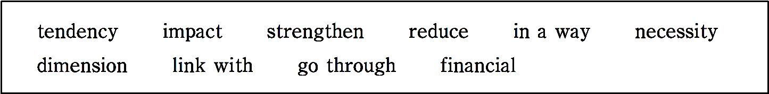
1. It is a matter of to wear formal clothes when meeting the Queen.
2. Tokyo and New York are major centers.
3. it was one of our biggest mistakes.

Slide 36
4. He􀆳s amazingly cheerful considering all he has had to .
5. This latest development has further my determination to leave.
6. There is a to the problem that we have not discussed.
7. The newspapers his name hers.
8. Her father􀆳s death greatly on her childhood years.

Slide 37
9. There is a for this disease to run in families.
10. The problem to two main issues.
Ⅲ. Translate the following Chinese sentences into English.
1. 最近十年,我们目睹了信息技术在社会的不同部门逐渐融合的复杂过 程。
2. 由于信息技术涵盖了多个方面,因此不能把它概念化地归结为机器。

Slide 38
3. 这两个转变对现代信息技术传播起到了决定性的作用。
4. 这是当代社会全球化的必然要求,包括科技、工业、商业、教育等。
Section A
In this section, you are going to read a passage with ten statements attached to it. Each statement contains information given in one of the paragraphs. I- dentify the paragraph from which the information is derived. You may choose a paragraph more than once. Each paragraph is marked with a letter.

Slide 39
Information Technology and Education
A) In recent years, the fast, effective and global communication of knowledge has created a new foundation for cooperation (合 作) and teamwork, both nationally and internationally. The in- creasing role played by information technology in the develop- ment of society calls for an active reaction to the challenges of the information society.

Slide 40
B) The Danish government􀆳s IT policy report to the Folketing (Danish parliament) (议会) and annual IT plans of action are an expression of the fact that the government takes the develop- ment of the information society seriously and regards the public sector as the spearhead (先锋) in selected areas. In this connec- tion, education is one of the quite central areas.
C) Only if society works towards a higher level of education for the population as a whole and involves the individual citizen in

Slide 41
life-long education, will Denmark maintain its competitiveness (竞争力) and develop a labor market which, in the global com- petition for jobs, is even today under great pressure.
D) The following strategic (战略性的) targets are an expression of the fact that the Ministry of Education is ready to face the challenge.
E) An IT educational policy must ensure:

Slide 42
Up-to-date(现代的,最新的) qualifications in the information society
F) Up-to-date qualifications gained against the background of a high general level of education in the population will be decisive(决定性的) if Denmark is to maintain competitiveness and its share of the global labor market in the information society. IT skills and IT understanding are thus central precondi- tions for the individual, both now and especially in the future.
G) The advantage of using information technology is that time-consuming work routines can increasingly be performed by means of this technology and time can thus be devoted instead to communicating and informing, to the

Slide 43
processing of information and the production of knowledge.
H) This means that the ability to gain an overview (概述,概观) and to choose between items of information will be quite central skills. Only with their help can the increasing volume of information be used to meet individ- ual needs and to increase the speed of decision-making and the production of knowledge. At the same time, an overview of the potential of information technology on the part of the user is necessary for its rational use.
I) It is, therefore, necessary to develop professional skills as well as basic IT operating skills. IT skills are obtained mainly through prolonged experience

Slide 44
in use. Therefore, it is part of the ministry􀆳s strategy that the educational sys- tem should be so arranged that pupils and students become used to regarding IT as a tool to be used in the learning process.
The integration of new pedagogic opportunities
J) New pedagogic (教学法的) opportunities must be explored and tested, just as new forms of communication must become established among pupils, students, teachers and the education sector as a whole. The IT policy of the Ministry of Education focuses on research, development and spread, includ- ing the creation of frameworks (准则) for the exchange and spread of expe-

Slide 45
rience among pupils, students, teachers and leaders of educational institu- tions.
K) Finally, IT opens up opportunities for a more individualized form of teaching in which pupils and students themselves can control the learning process and the teacher is not necessarily present. Teaching has to be orga- nized in such a way that learners learn to learn and to accept responsibility for their own education. Educational courses based on IT technology can be developed to support everyone, in new and more effective ways, including specially weak learner groups in the learning of basic skills such as reading,

Slide 46
writing and arithmetic.
Equal and flexible(灵活的) access to education
L) Irrespective of (不考虑) age, school background and living place, it must be ensured that everyone has an opportunity to participate in a broad range of educational activities. An IT educational policy strategy in this area includes a considerable extension of virtual educational courses and possibilities, where physical presence is not an initial requirement and where the advan- tages of courses that are not geographically and temporally(时间上地) limit- ed can be realized.

Slide 47
M) By means of information technology, education can thus be made avail- able outside of working hours, at the weekend, during working hours in co- operation between companies and educational institutions, as well as in a completely different part of the country from that in which the teaching is taking place. Education can, in this way, be said to be “unlimited”.
Effective and flexible structure and organization
N) Today, virtually all educational courses available at foreign educational institutions compete with corresponding (相应的) Danish courses, just as competition within Denmark for the decreasing numbers of students is ex-

Slide 48
pected to become stronger. More Danish companies are now establishing their own training departments with a view to meeting their own needs for adult and supplementary (补充的,额外的) training. Major foreign companies are also establishing their own virtual training centers. Therefore, there is a need in this area for new ideas, so that educational institutions can continue to be the main suppliers of new qualifications to the labor market and life in general. New forms of organization and co-operation within the educational system already have consequences for educational institutions, their geo- graphical coverage and the courses they offer.

Slide 49
O) It is thus the aim to utilize the opportunity to maintain a geographical de- centralization (分散) of the Danish educational system. In further and higher education and in adult and supplementary training, distance teaching can be used to offer education to local communities, where there would not other- wise be a sufficient population for the establishment of courses.
——http://eng.uvm.dk/publications/9Information tec/eng_it.htm#educ.
(887 words)
1. The benefit of using IT is that technology can be used to do time-

Slide 50
consuming routine work.
2. According to Denmark􀆳s IT report, Denmark will maintain its compe-titiveness if the society works towards a higher-level and lifelong IT education for the population.
3. IT-based educational courses are supposed to provide students with opportunities to control the learning process.
4. The IT policy includes the creation of frames for the exchange and spread of experience among students, teachers and leaders of schools.

Slide 51
5. IT skills and IT knowledge are the important requirements for in- dividuals.
6. Educational courses based on IT can be developed to help both good learners and weak learners.
7. Due to an IT educational policy strategy, virtual educational cours- es and possibilities are provided, where physical presence is not so essential.
8. New types of organization and co-operation of the educational sys- tem already have important effects on educational institutions.

Slide 52
9. In further and higher education, distance teaching can provide edu- cation for local communities, where there would not otherwise be enough population for a course.
10. Through information technology, education can thus be made available outside of working hours in completely different areas of the coun- try.
Time required: 15 minutes
Time used: minutes

Slide 53
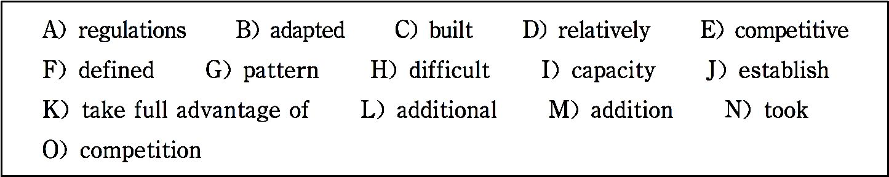
Section B
In this section, there is a passage with ten blanks. You are required to select one word for each blank from a list of choices given in the word bank. Read the passage through carefully before making your choices. You may not use any of the words in the bank more than once.
China Will Be World Information Power in 15 Years

Slide 54
The Chinese Ministry of Information Industry plans to build China into a world power in the information industry in 10 to 15 years.
China plans to 1 a number of large-scale national electronic information industrial bases in the field of electronic informa- tion products manufacturing. These will include 2 concen- trated distribution (分布), strong radiation (辐射) roles, and competitive export 3 . At the same time, national electronic

Slide 55
information industrial parks will be created to meet special needs of communication, digital (数字的) audio (音频的) and video products, computer network products, microelectronics, components, and software.
In the field of communication operations, China will try hard to develop a sound 4 for better service and a healthy market 5 . A number of multinational communication businesses of international competitiveness will be created. In 6 , an ad-

Slide 56
vanced management system 7 for the new developments will be established.
In the field of information communication, China will find ex- tensive applications of electronic information technology in the fields of industrial information processing, e-government, and e- commerce. China will also 8 information technology to transform its traditional industries and establish a fully function- ing national information system.

Slide 57
The Ministry of Information Industry has 9 major topics for further study. These topics include the development trends of information technology in the next 5 to 10 years, analysis of the development of the 3rd generation mobile telecommunication (电信), the development of the digital TV industry, the devel- opment of the software and integrated circuits (集成电路) in- dustries, and communication laws, 10 , and management systems for the new period.

Slide 58
——http://www.most.gov.cn/eng/newsletters/2004/200411/t2004 1130_17758.htm
(262word)
Time required: 8 minutes
Time used: minutes
Section C

Slide 59
In this section there is a passage followed by some questions or unfinished statements. For each of them choose the best answer from the four choices marked A, B, C and D.
Information technology has made deep changes in mathematics at non-ele- mentary levels since several years ago. It is good to remember what some au- thors say: “Computers are transforming the way mathematicians discover, prove and communicate ideas.” “Computers and computation have changed the entire modern world, but their effects in the fields of sciences and engineering have been especially deep.” Many of the problems related

Slide 60
with the application of mathematics to other fields have changed because of the use of information technology as an instrument. “The perennial debate over whether mathematics should be taught by mathematicians or by engi- neers looks increasingly anachronistic (时代错误的,落伍过时的) in the light of technological change.” This process seems unchangeable like in other fields. “Applied mathematics is and will become more and more computational.” These quotes and many others make us predict that the next century the mathematical work will change radically on the matters of what has been done in past centuries.

Slide 61
There are other signs that go beyond personal opinions. For example, a guide of the National Institute of Standards and Technology in the USA lists a to- tal of 110 math programs for mathematical modeling and statistic analysis that are accessible to scientists and engineers. In a list of 120 math journals, we found 24 of them that mention information technology as an important issue. By 7/12/1999, we found 79 electronic journals of math. The web sites of research centers, service centers, and math departments grow in quantity and quality.
Mathematics was a resource for information technology for a long time.

Slide 62
Now, likewise information technology is a resource for mathematics, conse- quently new mathematics branches appeared or some branches were modi- fied. Today is studied: Discrete Math, Dynamical Systems, Chaos Theory, Fractal Geometry, Computational Geometry, Numerical Analysis, Experi- mental Math, Visual Math, and so on.
Everything mentioned before shows that we are witnesses of the raising of new methodologies and new forms of communication in mathematical work.
—— http://dipmat.math,unipa.it/grim/E Balderas.PDF

Slide 63
(321 words)
1. The quotations in paragraph 1 are used to tell readers that .
A. computers are very important
B. information technology has made deep changes in mathematics
C. information technology is very important in our daily life
D. mathematics plays an important role in our daily life

Slide 64
2. The probable meaning of the underlined word “accessible” in the sec- ond paragraph is .
A. useless B. available C. useful D. important
3. Which of the following is the best title for the article?
A. The Development of Information Technology.
B. The Development of Mathematics.

Slide 65
C. Mathematics and Information Technology.
D. Computers and Information Technology.
4. Which of the following statements is not true?
A. The author predicts that in the next century the mathematical work will change greatly.
B. In the USA, a guide of the National Institute of Standards and Technology lists 110 math programs for mathematical modeling and statistic analysis

Slide 66
that are accessible to scientists and engineers.
C. Mathematics and information technology interact,and some new mathe- matics branches appeared.
D. Information technology is mentioned as an important issue by 20% of 120 electronic journals.
5. What is the author􀆳s attitude towards the information technology?
A. Positive. B. Critical. C. Negative. D. Pessimistic.

Slide 67
Time required: 8 minutes
Time used: minutes

Slide 68
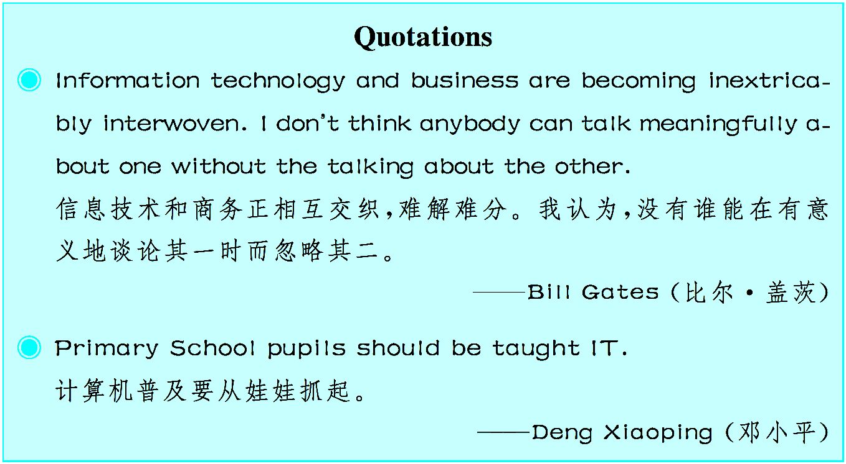

Slide 69
Unit 2
Western Philosophers
What is a Philosopher?

Slide 70
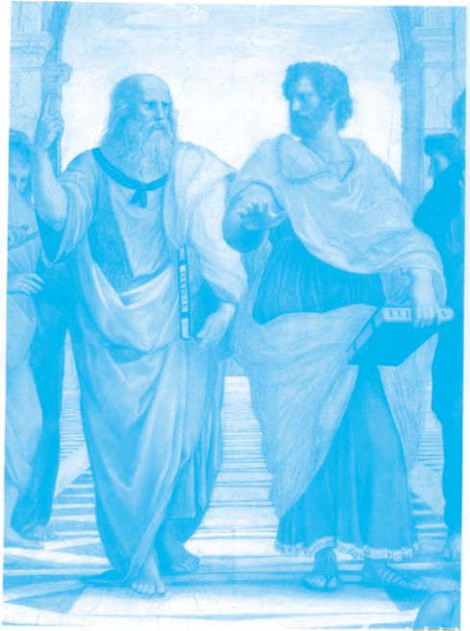
从古希腊的苏格拉底、柏拉图、亚里士多德到当代的维特根斯坦、罗素、萨特,西方哲学 家的思想指引着一代又一代人。对于西方哲学家,您有多少了解呢?

Slide 71
When people hear the term philosopher, they often imagine the philoso- phers of ancient Greece with long white beards dressed in flowing robes, all sitting around contemplating¹ the meaning of life. While it is true that philosophers do contemplate the meaning of existence, they are deep thinkers on many issues that continue to fuel² the desire for knowledge and the quest³ for truth.^{①}
In order to understand what a philosopher is, it􀆳s important to understand a bit about philosophy. There are several branches of philosophy, including metaphysics⁴, logic, ethics⁵ and much more, but generally philosophy is the

Slide 72
study of matters concerning existence. For example, ethics deals with moral dilemmas, whereas logic examines thinking patterns⁶. Metaphysics ponders the natural world and our relationship with the world and universe in which we live.
A philosopher seeks truth in regard to the issues of existence and those con- ditions that affect humanity⁷. The philosopher attempts to answer previously unanswerable questions through debate and arguments based on logical thought. A philosopher may also be referred to as a deep thinker. She is on a quest to know how, when, where and mostly why. Philosophers often have a

Slide 73
strong interest in religion and science. Many philosophers may also be scien- tists, clergymen or religionists. A philosopher may focus mainly on one branch of philosophy or many aspects of the overall study.
Ancient philosophers debated over the state of the universe, life purpose, ex- istence and the political system as well as other subjects concerning humani- ty and the nature of life.Times changed and so did philosophy but not entire- ly. Many of the topics of debate that were of importance to the philosophers of old remain just as important in modern philosophy.^{②} The only difference is that discoveries were made along the way that have provided answers to

Slide 74
some questions, but most of the unanswerable questions of old remain that way in this day and age. In fact, it seems that for every question answered, new ones form to keep the minds of philosophers, scientists and religionists ever occupied.
There were many great philosophers throughout history. Aristotle⁸ was one of them. In fact, some considered Aristotle to be the greatest of philosophers. Aristotle lived from 384 to 322 B.C. He was a student of Plato⁹. Aristotle au- thored many great writings on life, death, the soul, heaven, physics, politics and more. Most of them lost now.

Slide 75
Plato was a great intellectual¹0 mind as well as a compelling¹1 writer. He was a student of Socrates¹2. Plato wrote much material that is just as relevant in modern times as it was in his own. Plato wrote in dialogues detailing conversations between individuals describing passionate¹3 debates, ideas and information.
Socrates was much more than a philosopher. He was a wise and courageous soul. He was put to death chiefly because the authorities were uncomfortable with the fact that Socrates caused others to question their own beliefs. He accepted his death with dignity¹4. Socrates did not write his intellectual

Slide 76
philosophies down but instead was probably the most well-known conversa- tionalist and philosopher. Socrates, Plato and Aristotle were just a few of the many great philosophers throughout history.
Although ancient Greece might be most well known for its great philoso- phers, other cultures developed their own philosophies as well, and there was no shortage of great thinkers around the globe. Chinese and other Asian civ- ilizations became known for their schools of thought. Confucius¹5 was an- other great philosopher. Philosophers such as Confucius and Socrates knew a truth that remains universal. Philosophy is more about the inner world of

Slide 77
humankind and our relationship with the outer physical world than any other physical construct¹6. Philosophy is a quest to find the inner truth in order to obtain answers to all other questions.
——http://www.ehow.com/about_4571739_what-philosopher.html
(626 words)
Notes
① While it is true that philosophers do contemplate the meaning of exis-

Slide 78
tence, they are deep thinkers on many issues that continue to fuel the desire for knowledge and the quest for truth.
哲学家们的确思考存在的意义,同时他们也深思许多能够激发人们求知 和求真的问题。
② Times changed and so did philosophy but not entirely. Many of the topics of debate that were of importance to the philosophers of old remain just as important in modern philosophy.
时代在变化,哲学也在变化,但是哲学的变化并非完全颠覆——那些对古

Slide 79
代哲学家而言非常重要的话题在现代哲学中也同样重要。
Exercises
Ⅰ. There are five questions or unfinished statements based on the passage. For each of them choose the best answer from the four choices marked A, B, C and D.
1. Which of the following statements is not true?
A. Generally speaking, philosophers think deeply about the meaning of exis-

Slide 80
tence.
B. Philosophers may also study the conditions that affect human nature.
C. Philosophers may also have a strong interest in religion and science.
D. A philosopher should focus on nothing but one branch of philosophy.
2. In paragraph 2, in the sentence “Metaphysics ponders the natural world and our relationship with the world and universe in which we live”, the un- derlined word “ponder” probably means .

Slide 81
A. think about B. fight against C. defend D. praise
3. Ancient philosophers may debate on the following topics except .
A. the state of the universe
B. the purpose of life and the meaning of existence
C. the future of a nation
D. the political system

Slide 82
4. It can be inferred from paragraph 4 that .
A. as time goes by, the topics ancient philosophers debated over are out of date, useless in modern society
B. modern philosophers should focus on modern philosophical topics rather than the old ones
C. although the forms may be different, the topics debated by the ancient philosophers and modern philosophers share some common characteristics

Slide 83
D. most of the previously unanswerable questions will not be answered in the future, either
5. Which of the following statements is true?
A. Aristotle wrote a lot of great writings on many topics, such as: life, death, the soul, heaven, physics, and politics and so on, most of them are available nowadays.
B. What Plato wrote is of the same importance in modern times as it was in his own.

Slide 84
C. Socrates wrote his intellectual philosophies down, which makes him the most famous conversationalist and philosopher.
D. Eastern and western philosophers may have different opinions toward truth because of different thinking patterns.
Ⅱ. Fill in the blanks in the following sentences, using the words or phrases given below. Change the form where necessary.

Slide 85

1. I have a question the Nobel Prize for Peace.
2. He is always ready to help others, thus is a living Lei Feng.
3. They for a new method of language teaching for years.
4. The desire to look attractive is .

Slide 86
5. He the problem before making a final decision.
6. He was faced with the of whether to return to his country or not.
7. He is a good father. He is also a good son as well as a good husband.
8. Please take it with you. It will not much space.
9. You can also knowledge through practice.

Slide 87
10. When I left, the men were still on the topic.
Ⅲ. Translate the following Chinese sentences into English.
1. 听到“哲学家”这个词时,人们常常想象古希腊哲学家们的样子,他们 留着长长的白胡须,穿着飘逸的长袍,坐在一起思考着人生的意义。
2. 为了理解什么是哲学家, 懂得一点哲学是重要的。
3. 苏格拉底被处死的主要原因是他使得其他人质疑他们自己的信 仰,当局对此极为不满。

Slide 88
4. 尽管古希腊可能是因其伟大的哲学家而闻名于世,但其他国家也 发展了自己的哲学思想,而且世界上的其他地方也不乏伟大的思想家。
Section A
In this section, you are going to read a passage with ten statements attached to it. Each statement contains information given in one of the paragraphs. I- dentify the paragraph from which the information is derived. You may choose a paragraph more than once. Each paragraph is marked with a letter.

Slide 89
Plato
A) Plato was born around the year 428 B.C. in Athens. His fa- ther died while Plato was young, and his mother remarried to Pyrilampes, in whose house Plato would grow up. Plato􀆳s birth name was Aristocles, and he gained the nickname Platon, mean- ing broad, because of his broad build. His family had a history in politics, and Plato was destined to (注定) a life in keeping with this history. When Plato met Socrates, however, he had

Slide 90
met his definitive teacher. As Socrates􀆳 disciple (弟子), Plato adopted his philosophy and style of debate, and directed his studies toward the question of virtue and the formation of a no- ble character.
B) Plato was in military service from 409 B.C. to 404 B.C. When the Peloponnesian War ended in 404 B.C., he joined the Athenian oligarchy (雅典的寡头政治) of the Thirty Tyrants, one of whose leaders was his uncle Charmides. The violence of

Slide 91
this group quickly prompted Plato to leave it. In 403 B.C., when democracy was restored in Athens, he had hopes of pursuing his original goal of a political career. Socrates􀆳 execution in 399 B.C. had a profound effect on Plato, and was perhaps the final event that would convince him to leave Athenian politics forev- er.
C) Plato left Attica along with other friends of Socrates and traveled for the next twelve years. During this period he studied

Slide 92
the philosophy of his contemporaries, geometry (几何学), geol- ogy (地质学), astronomy (天文学) and religion.
D) After 399 B.C. Plato began to write extensively. It is still up for debate whether he was writing before Socrates􀆳 death, and the order in which he wrote his major texts is also uncertain. However, most scholars agree to divide Plato􀆳s major work into three distinct groups. The first of these is known as the Socratic Dialogues because he stays close to the text of Socrates􀆳 teach-

Slide 93
ings. They were probably written during the years of his travels between 399 and 387 B.C..
E) Plato returned to Athens in 387 B.C. and, on land that had once belonged to Academos, he founded a school of learning which he called the Academy. Plato􀆳s school is often described as the first European university. Its curriculum offered subjects including astronomy, biology, mathematics, political theory, and philosophy. Plato hoped the Academy would provide a

Slide 94
place where thinkers could work toward better government in the Grecian cities. He would preside(主持) over the Academy until his death.
F) The period from 387 to 361 B.C. is often called Plato􀆳s “middle” or transitional period. It is thought that he may have written the Meno, Euthydemus, Menexenus, Cratylus, Republic, Phaedrus, Symposium and Phaedo during this time. The major difference between these texts and his earlier works is that he

Slide 95
tends toward grander metaphysical themes and begins to estab- lish his own voice in philosophy. Socrates still has a presence, however, sometimes as a fictional character. The middle dia- logues also reveal Plato􀆳s method of hypothesis(假设).
G) Plato􀆳s most influential work, The Republic, is also a part of his middle dialogues. It is a discussion of the virtues of justice, courage, wisdom, and moderation(中庸), of the individual and in society. It works with the central question of how to live a

Slide 96
good life, asking what an ideal state would be like, and what de- fines a just individual. These lead to more questions regarding the education of citizens, how government should be formed, the nature of the soul, and the afterlife. The dialogue finishes by reviewing various forms of government and describing the ideal state, where only philosophers are fit to rule. The Republic cov- ers almost every aspect of Plato􀆳s thought.
H) In 367 B.C., Plato was invited to be the personal tutor to

Slide 97
Dionysus Ⅱ, the new ruler of Syracuse. Plato accepted the invi- tation, but found on his arrival that the situation was not con- ducive (有益的) for philosophy. He continued to teach the young ruler until 365 B.C. when Syracuse entered a war. Plato returned to Athens, and it was around this time that Plato􀆳s fa- mous pupil Aristotle began to study at the Academy. In 361 B.C. Plato returned to Syracuse in response to a letter from Dion, the uncle and guardian of Dionysus Ⅱ, begging him to

Slide 98
come back. However, finding the situation even more unpleas- ant than his first visit, he returned to Athens almost as fast as he had come.
I) Back at the Academy, Plato probably spent the rest of his life writing and conversing. His work has also been influential in the areas of logic and legal philosophy.
J) His final years at the Academy may be the years when he

Slide 99
wrote the “Later” dialogues, including the Parmenides, The- atetus, Sophist, Statesman, Timaeus, Philebus, and Laws. Socrates has been delegated (委派) a minor role in these texts. Plato uses these dialogues to take a closer look at his earlier metaphysical speculations (形而上学思路). He discusses art, including dance, music, poetry, architecture and drama, and ethics in regards to immortality, the mind, and Realism. He also works with the philosophy of mathematics, politics and religion,

Slide 100
covering such specifics as censorship, atheism, and pantheism. In the area of epistemology (认识论) he discusses a priori knowledge and Rationalism. In his theory of Forms, Plato sug- gests that the world of ideas is constant and true, opposing it to the world we perceive through our senses, which is deceptive and changeable.
K) In 347 B.C. Plato died, leaving the Academy to his sister􀆳s son Speusippus. The Academy remained a model for institutions

Slide 101
of higher learning until it was closed in 529 by the Emperor Justinian.
——http://www.egs.edu/library/plato/biography
(923 words)
1. During his travels from 399 B.C. to 387 B.C., Plato extensively learned philosophy, geometry, geology, astronomy

Slide 102
and religion.
2. Plato was convinced to leave Athenian politics forever because of the death of Socrates.
3. Plato was nicknamed Platon because of his broad fig- ure.
4. The Socratic Dialogues stayed close to Socrates􀆳

Slide 103
teachings within the text.
5. The curriculum of Plato􀆳s Academy offered a variety of subjects including astronomy, biology, mathematics, political theory, and philosophy.
6. The Republic mainly discusses the moral goodness of justice, courage, wisdom, and moderation.

Slide 104
7. Plato acted as president over the Academy until his death.
8. The great difference between his middle dialogues and the Socratic Dialogues is that Plato tends toward grander metaphysics and begins to establish his own theory in philoso- phy.
9. Plato returned to Athens almost as quickly as he could

Slide 105
when he found the situation in Syracuse even less pleasant than his first visit.
10. Plato points out in his theory that the world of ideas is constant and true, and that the world we perceive through our senses is deceptive and changeable.
Time required: 15 minutes

Slide 106
Time used: minutes
Section B
In this section, there is a passage with ten blanks. You are required to select one word for each blank from a list of choices given in the word bank. Read the passage through carefully before making your choices.You may not use any of the words in the bank more than once.

Slide 107
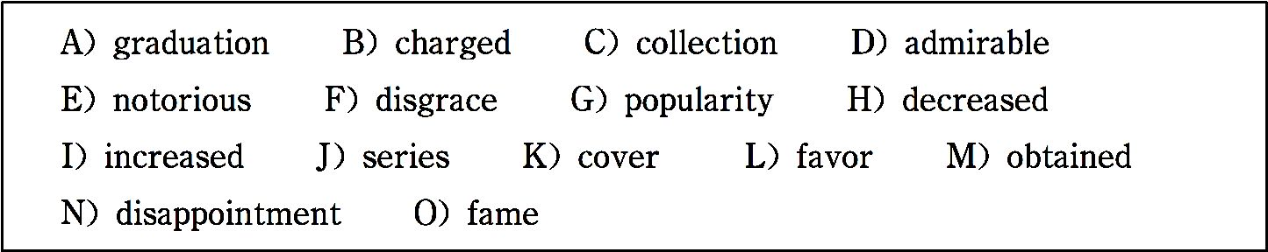
Francis Bacon (1561~1626) was the founder of English materialist phi- losophy (唯物主义哲学). He was born into the family of Sir Nicholas Ba- con, keeper of the Privy Seal (御玺) to Queen Elizabeth.The boy won the 1 of the Queen. He went to Cambridge at twelve and after 2 at sixteen, he took up law. He soon became one of the most successful lawyers of the

Slide 108
time. At twenty-three he became a member of the House of Commons and his judgment and eloquence (口才) made him famous. When James Ⅰ came to England, Bacon 3 one important office after another until he became lord Chancellor (大法官) and was made a peer (nobleman) in 1618. He was an 4 judge, but in the course of rising he had made enemies who 5 him with bribery (受贿). He was deprived (免去) of his office, fined and banished (流放) from London in 1621. Five years later, he died in 6 .
Francis Bacon is famous not only for his philosophical works, but also for his essays. In 1597 he published a 7 of ten essays, which were after-

Slide 109
wards 8 to fifty-eight, including the well-known one On Reading, whose title is actually Of Studies. These essays 9 a wide variety of subjects, such as love, truth,friendship, parents and children, beauty, studies, youth and age and many others. They have won 10 for his clearness, brevity (简洁) and force of expression.
——http://yingyu.100xuexi.com/Extend Item/OTDetail.aspx
(249 words)
Time required: 8 minutes

Slide 110
Time used: minutes
Section C
In this section there is a passage followed by some questions or unfinished statements. For each of them choose the best answer from the four choices marked A, B, C and D.
Talking about Philosophical Topics in Everyday Life

Slide 111
Most people have a general interest in philosophy and have some basic knowledge about well-known philosophers and their ideas. Nonetheless, remember when talking in a general setting to avoid getting too technical. For example, avoid the jargon (术 语) that mostly only philosophers use. Also, do not cite specific philosophers or books too much, as outside of philosophy-fo- cused academia people may not know much about such topics.
You can ensure not to exclude (排斥) anybody by keeping the

Slide 112
discussion focused on the ideas and opinions of only the people involved. Tell others what you think about certain philosophical topics, and ask them what they think about those topics. Ask them philosophical questions, such as, “What do you think is the meaning of life?”
You will get people to talk about philosophy more often if they enjoy it and feel comfortable. For that reason, avoid talking down to anyone or talking to them in a condescending (傲慢的)

Slide 113
tone. Create a comfortable atmosphere for others to put forward their ideas.
You may have the desire to try to show off. However, doing that would just make others not want to discuss philosophy with you. Do not try to impress people by purposely talking about topics they do not know well. Do not try to impress them with your knowledge of people, books, or facts that they do not know. Do not use big words that they do not understand to im-

Slide 114
press them. You will just make them feel bad, and make your- self look arrogant, neither of which will foster (促进) quality discussion.
Just speak your mind in a way that the others will understand best. Also, avoid rambling (杂乱无章). When telling others your philosophical thoughts you can easily just ramble on and on, which will bore others. Instead, sum up your thoughts in quicker, simpler statements, and then give the other person a

Slide 115
chance to talk.
The normal etiquette and tricks of conversation also apply. Oth- ers will judge you and the conversation based on your listening skills more than on your speaking skills. Listen intently to what others say, and ask them questions about it so they know you listened. Additionally, asking questions will keep the conversa- tion going. To spark further conversation, ask open-ended ques- tions.

Slide 116
——http://www.en8848.com.cn/Article/Culture/Philosophy/587 84.html
(374 words)
1. Why shouldn􀆳t we cite specific philosophers or books too much while talking about philosophical topics?
A. Because nobody can understand them.

Slide 117
B. Because they are out of date.
C. Because only philosophy majors can cite specific philoso- phers and books.
D. Because most non-philosophy majors may not know much about such topics.
2. Which of the following ways cannot help us make sure that

Slide 118
all the people involved are included in a conversation on philo- sophical topics?
A. Tell them what you think about certain philosophical topics.
B. Ask them what they think about the philosophical topics.
C. Ask them some philosophical questions.
D. Tell them that philosophy is useful.

Slide 119
3.The underlined word “arrogant” in paragraph 4 most prob- ably means “ ”.
A. learned B. eloquent C. showing too much pride D. timid
4. According to the passage, which of the following ways is helpful to develop a quality philosophical discussion?

Slide 120
A. Make the atmosphere comfortable enough for others to put forward their ideas.
B. Impress people by talking about topics they are unfamiliar with.
C. Impress people with what they do not know, such as your knowledge of people, books, facts, etc.

Slide 121
D. Impress people with big words which are hard to understand.
5. How to avoid rambling while talking about philosophical top- ics?
A. Try to give more explanations on philosophy terms.
B. Summarize your thoughts quickly and give others a chance to talk.

Slide 122
C. Listen carefully while the others are talking.
D. Ask the others open-ended questions.
Time required: 8 minutes
Time used: minutes

Slide 123
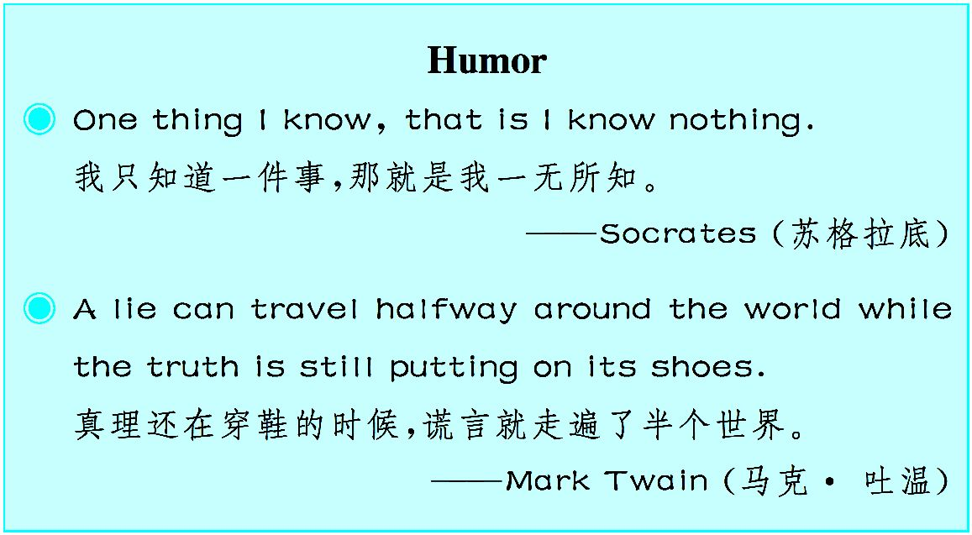

Slide 124
Unit 3
Chinese Traditional Festivals
Double Seventh Festival¹

Slide 125

神话传说反映了古人对现实生活的理想追求,富有浓厚的文学色彩,本文提供了与外国人交 流时值得掌握的话题。

Slide 126
The Double Seventh Festival, on the 7th day of the 7th lu- nar² month, is a traditional festival full of romance. It often falls in August in the Gregorian calendar³.
This festival is in mid-summer when the weather is warm and the grass and trees are green. At night when the sky is dotted with⁴ stars, gaze up to where the Milky Way (or the heavenly river in Chinese) traverses⁵ the night sky and you will see a con- stellation⁶ of five small stars on the east bank. ^{①}Among them

Slide 127
there is Vega⁷ also named the Weaving Maid⁸ or Zhi Nv in Chi- nese. Opposite her, on the distant west bank is Altair⁹, also named Cowherd¹0 or Niu Lang in Chinese, shining brilliantly through the ages — lonely and waiting. And about them there is a beautiful love story passed down from generation to genera- tion.
Long long ago, there was an honest and kind-hearted fellow named Niu Lang (the Cowherd). His parents died when he was a

Slide 128
child. Later he was driven out of his home by his sister-in-law. So he lived by himself herding¹1 cattle and farming. One day, a fairy from heaven called Zhi Nv (the Weaving Maid) fell in love with him and came down secretly to the earth and married him. The Cowherd farmed in the field and the Weaving Maid wove at home. They lived a happy life and gave birth to¹2 a boy and a girl. Unfortunately, the God of Heaven¹3 soon found out the fact and ordered the Queen Mother of the Western Heavens ¹4 to

Slide 129
bring the Weaving Maid back.
With the help of celestial¹5 cattle, the Cowherd flew to heaven with his son and daughter. When he was about to catch up with his wife, the Queen Mother took off one of her gold hairpins¹6 and made a stroke¹7. One billowy¹8 river appeared in front of the Cowherd. The Cowherd and the Weaving Maid were sepa- rated on the two banks forever and could only feel their tears. Their loyalty to love touched magpies¹9, so tens of thousands of

Slide 130
magpies came to build a bridge for the Cowherd and the Weav- ing Maid to meet each other.^{②} The Queen Mother was eventual- ly moved and allowed them to meet each year on the 7th day of the 7th lunar month. Hence their meeting date has been called “Qi Xi” (Double Seventh).
Scholars have shown that the Double Seventh Festival originat- ed from the Han Dynasty (206 B.C.~220 A.D.). Historical doc- uments from the Eastern Jin Dynasty (371~420 A.D.) mention

Slide 131
the festival, while records from the Tang Dynasty (618~907 A. D.) depict²0 the grand evening banquet of Emperor Taizong and his concubines²1. By the Song (960~1279 A.D.) and Yuan (127 9~1368) Dynasties, special articles for the “Qi Xi” were seen being sold on markets in the capital. The bustling²2 markets demonstrated the significance of the festival.
In the old days, Chinese women, especially unmarried ones, used to take this festival quite seriously. In the evening, they of-

Slide 132
fered incense²3, sewing kits²4, fruit and flowers to the Cowherd and the Weaving Maid. They would pray for cleverness in needlework and marital²5 bliss²6. Chinese women believed the two hand in hand²7— marital happiness came only if their sewing skills were up to scratch²8.
Today some traditional customs are still observed in the rural areas of China, but have been weakened or diluted²9 in the cities. In recent years, in particular, urban youths have celebrat-

Slide 133
ed Valentine􀆳s Day in China. As a result, owners of flower shops, bars and stores are full of joy as they sell more commodi- ties³0 for love. However, the legend³1 of the Cowherd and the Weaving Maid has taken root in the hearts of the Chinese peo- ple.—— http://www.china.org.cn/english/features/Festivals
(610 words)

Slide 134
Notes
① At night when the sky is dotted with stars, gaze up to where the Milky Way (or the heavenly river in Chinese) traverses the night sky and you will see a constellation of five small stars on the east bank.
在繁星密布的夜晚,抬头凝望横穿夜空的银河(即中文中的天

Slide 135
河),会看到银河东岸五颗小星星组成的星座。
② Their loyalty to love touched magpies, so tens of thousands of magpies came to build a bridge for the Cowherd and the Weaving Maid to meet each other.
由于他们对爱情的忠诚感动了喜鹊,成千上万的喜鹊飞到天 上搭起一座天桥让牛郎和织女相会。

Slide 136
Exercises
Ⅰ. There are five questions or unfinished statements based on the passage. For each of them choose the best answer from the four choices marked A, B, C and D.
1. The women in the past offered incense, sewing kits, fruit and flowers to the Cowherd and the Weaving Maid in order to .

Slide 137
A. pray for health
B. pray for cleverness in needlework and marital bliss
C. pray for treasure
D. pray for the future children
2. Which of the following statements is not true?
A. Niu Lang and his wife lived in the home of his sister-in-law, herding cat-

Slide 138
tle and farming.
B. The Double Seventh Festival is on the 7th day of the 7th lunar month.
C. The Queen Mother of the Western Heavens finally brought the Weaving Maid back.
D. The magpies, touched by the couple􀆳s loyalty to love, built a bridge for them to meet each other.
3. The word “bliss” in paragraph 6 most probably means “ ”.

Slide 139
A. distress B. joy
C. happiness D. pain
4. The Double Seventh Festival originated from the .
A. Tang Dynasty B. Ming Dynasty
C. Song Dynasty D. Han Dynasty
5. Which of the following adjectives can be used to describe the attitude of

Slide 140
the Chinese women in the past towards the Double Seventh Festival?
A. Critical. B. Indifferent.
C. Serious. D. Negative.
Ⅱ. Fill in the blanks of the following sentences, using the words or phrases given below. Change the form where necessary.
generation pray for give birth to depict observe

Slide 141
gaze festival loyalty in particular be dotted with
1. The sky stars.
2. She at me in disbelief when I told her the news.
3. She a fine healthy girl.
4. Grandfathers, fathers and sons belong to three different .
5. The novel French society in the 1930s.

Slide 142
6. They to God an end to their sufferings.
7. Can I count on your ?
8. At times, we decorate our houses with flowers and red flags.
9. You should avoid eating fat meat, pork .
10. Do you Christmas and Easter in your country?
Ⅲ. Translate the following Chinese sentences into English.

Slide 143
1. 他快要追上他的妻子时,王母娘娘拔下一根金簪划了一下,牛郎面前出 现了一条天河。
2. 在古代,中国女性,尤其是未婚女性经常非常认真地对待这个节日。
3. 一个关于他们的美丽的爱情故事代代相传。
4. 然而,牛郎和织女的传说已深深扎根于中国人民的心中。

Slide 144
Section A
In this section, you are going to read a passage with ten statements attached to it. Each statement contains information given in one of the paragraphs. I- dentify the paragraph from which the information is derived. You may choose a paragraph more than once. Each paragraph is marked with a letter.
Mid-Autumn Festival

Slide 145
A) The joyous Mid-Autumn Festival is celebrated on the fif- teenth day of the eighth lunar month. In the Western calendar, the day of the festival usually occurs sometime between the sec- ond week of September and the second week of October.
B) This day is also considered a harvest festival since fruits, vegetables and grain have been harvested by this time and food is abundant. With delinquent (拖欠的) accounts settled prior to the festival, it is a time for relaxation and celebration. Food of-

Slide 146
ferings are placed on an altar (祭坛) set up in the courtyard. Apples, pears, peaches, grapes, melons, oranges and pomelos (柚子) may be seen. Special foods for the festival include moon cakes, cooked taros (芋头) and water caltrops (菱角), a type of water chestnuts resembling black buffalo horns. The round moon cakes, measuring about three inches in diameter and one and a half inches in thickness, resemble Western fruitcakes in taste and consistency. These cakes are made with melon seeds,

Slide 147
lotus seeds (莲子), almonds (杏仁), minced meats, bean paste, orange peels and lard (猪油). A golden yolk (蛋黄) from a salt- ed duck egg is placed at the center of each cake, and the golden brown crust is decorated with symbols of the festival. Tradition- ally, thirteen moon cakes are piled in a pyramid to symbolize the thirteen moons of a “complete year”, that is, twelve moons plus one intercalary (闰月的) moon.
Origin

Slide 148
C) The Mid-Autumn Festival is a traditional festivity for both the Han and minority nationalities. The custom of worshipping the moon can be traced back as far as the ancient Xia and Shang Dynasties. In the Zhou Dynasty, people held ceremonies to greet winter and worship the moon whenever the Mid-Autumn Festival set in. It became very popular in the Tang Dynasty that people enjoyed and worshipped the full moon. In the Southern Song Dy- nasty, however, people sent mooncakes to their relatives as gifts to express their best wishes of family reunion. When it became dark, they looked up at the full silver moon or went sightseeing on lakes to celebrate the festival. In the Ming and Qing Dynasties, the custom of Mid-Autumn Festival celebra-

Slide 149
tion became extremely popular. Together with the celebration there appeared some special customs in different parts of the country, such as burning in- cense, planting Mid-Autumn trees, and lighting lanterns on towers. However, the custom of playing under the moon is not so popular as it used to be, but it is not less popular to enjoy the bright silver moon. Whenever the festival sets in, people will look up at the full silver moon, drinking wine to celebrate their happy life or thinking of their relatives and friends far from home, and extending their best wishes to them.
Moon cakes

Slide 150
D) There is a story about the moon cake. During the Yuan Dynasty (1279~13 68), China was ruled by the Mongolian people. Leaders from the preceding Song Dynasty (960~1279) were unhappy at submitting (顺从) to the foreign rule, and discussed how to coordinate the rebellion without being discovered. The leaders of the rebellion, knowing that the Moon Festival was drawing near, ordered that special cakes be made. Each moon cake contained a mes- sage with the outline of the attack. On the night of the Moon Festival, the rebels successfully attacked and overthrew the government. Today, moon cakes are eaten to commemorate (纪念) this legend.

Slide 151
E) For generations, moon cakes have been made with sweet fillings of nuts, mashed red beans, lotus-seed paste or Chinese dates (枣子), wrapped in a pastry. Sometimes a cooked egg yolk can be found in the middle of the rich tasting dessert. People compare moon cakes to the plum pudding and fruit cakes which are served in the English holiday seasons.
Different forms to celebrate the festival
F) For thousands of years, the Chinese people have related the vicissitudes (变迁,兴败) of life — joy and sorrow, parting and reunion — to the changes of the moon as it waxes (渐圆) and wanes (渐缺). Because the full moon is

Slide 152
round and symbolizes reunion, the Mid-Autumn Festival is also known as the festival of reunion. All family members try to get together on this special day. Those who can not return home enjoy watching the bright moon and feel a deep longing for their loved ones.
G) Today, festivities centered round the Mid-Autumn Festival are more var- ied. After a family reunion dinner, many people like to go out to attend spe- cial performances in parks or on public squares.
H) People in different parts of China have different ways to celebrate the Mid-Autumn Festival. In Guangzhou in South China, a huge lantern show is

Slide 153
a big attraction for local citizens. Thousands of differently shaped lanterns are lit, forming a fantastic contrast with the bright moonlight. In East China􀆳 s Zhejiang Province, watching the tide of the Qiantang River during the Mid- Autumn Festival is not only a must for local people, but also an attraction for those from other parts of the country. The ebb and flow of tides coincide with the waxing and waning of the moon as it exerts a strong gravitational (引力的) pull. In mid autumn, the sun, the earth and the moon send out strong gravitational forces upon the seas. The mouth of the Qiantang River is shaped like a bugle (军号). So the tide which forms at the narrow mouth is particularly impressive. Spectators crowd on the river bank, watching the

Slide 154
roaring waves. At its peak, the tide rises as high as three and a half meters.
—— http://old.24en.com/html/profession/chinese/200509212361.htm
(903 words)
1. In China worshipping the full moon became very popular in the Tang Dynasty.
2. Water caltrop is one of the special foods for the festival.

Slide 155
3. Moon cakes are eaten to commemorate a legend about rebelling.
4. For thousands of years, the Chinese people have related the vicissi- tudes of life to the changes of the moon.
5. Attending special performances in parks or on public squares is a way to celebrate the Mid-Autumn Festival.
6. People consider moon cakes similar to the plum pudding and fruit cakes which are eaten in the English holiday seasons.

Slide 156
7. When people make moon cakes, a golden yolk from a salted duck egg is placed at the center of each cake, and the golden brown crust is deco- rated with symbols of the festival.
8. Whenever the festival sets in, people will look up at the full silver moon and drink wine to celebrate their happy life.
9. All family members try to get home for a family reunion on the Mid-Autumn Festival day.
10. People􀆳s ways to celebrate the Mid-Autumn Festival vary from

Slide 157
place to place.
Time required: 15 minutes
Time used: minutes
Section B
In this section, there is a passage with ten blanks. You are required to select one word for each blank from a list of choices given in the word bank. Read the passage through carefully before making your choices. You may not use

Slide 158
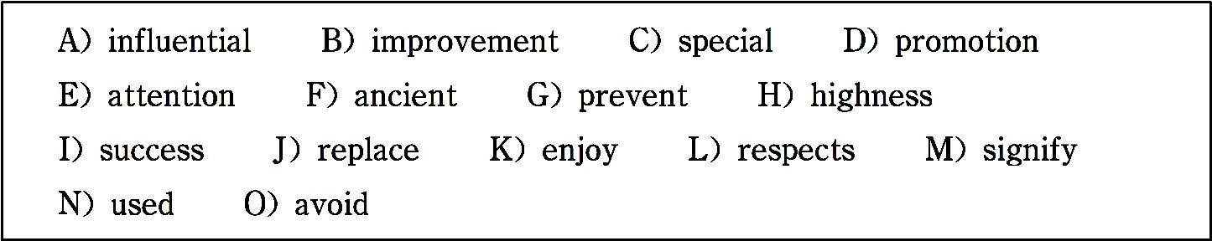
any of the words in the bank more than once.
The Double Ninth Festival
The Double Ninth Festival, also named as Chong Yang Festival, falls on the ninth day of the ninth month of the Chinese lunar calendar, hence it gets the name of Double Ninth Festival.

Slide 159
On Double Ninth Festival, people would like to drink chrysan- themum (菊花) wine and have chrysanthemum cakes. The chrysanthemum is a plant often 1 as a Chinese herbal medicine. People in 2 times believed that, in addition to detoxification (解毒作用), chrysanthemum, as dogwood—the plant with a strong fragrance, could drive away evil spirits and 3 one from getting a chill in late autumn. Besides, the Chi- nese word for wine is Jiu, a homonym of the Chinese word for

Slide 160
long lasting, symbolizing longevity.
Another special food for this festival is chrysanthemum cakes. The Chinese word for cake is Gao, a homonym of the Chinese word for 4 , symbolizing progress and 5 at work and in daily life and 6 in life year by year. In addition, moun- tains are high, so eating cakes can 7 going for a climb — by a stretch of the imagination.

Slide 161
Since nine is the highest odd digit, people take two of them to- gether to 8 longevity. Therefore, the ninth day of the ninth month has become a day for people to pay their 9 to the el- derly and a day for the elderly to 10 themselves.
——http://www.tqnyc.com/NYC041156/doubleninthfestival.htm
(229 words)

Slide 162
Time required: 8 minutes
Time used: minutes
Section C
In this section there is a passage followed by some questions or unfinished statements. For each of them choose the best answer from the four choices marked A, B, C and D.

Slide 163
As early as 2,500 years ago, in about the Spring and Autumn Period (770 B. C.~476 B.C.), China had determined the point of the Winter Solstice (冬至) by observing the movements of the sun with a sundial. It is the earliest of the 24 seasonal division points. The time will be each December 22 or 23 ac- cording to the Gregorian calendar (阳历).
The Winter Solstice became a festival during the Han Dynasty (206 B.C.~22 0 A.D.) and thrived in the Tang and Song Dynasties. The Han people regard- ed the Winter Solstice as a “Winter Festival”, so officials would organize celebrating activities. On this day, both officials and common people would

Slide 164
have a rest. The army stopped fighting, frontier fortresses closed and busi- ness and traveling stopped. Relatives and friends presented to each other de- licious food. In the Tang and Song Dynasties, the Winter Solstice was a day to offer sacrifices to Heaven and ancestors. Emperors would go to the sub- urbs to worship the Heaven; while common people offered sacrifices to their deceased parents or other relatives. The Qing Dynasty (1644~1911) even had the record that “the Winter Solstice is as formal as the Spring Festival”, showing the great importance attached to this day.
In some parts of Northern China, people have dumpling soup on this day;

Slide 165
while residents of some other places eat dumplings, saying doing so will keep them from frost in the upcoming winter. But in parts of Southern China, the whole family will get together to have a meal made of red-bean and glutinous rice (糯米) to drive away ghosts and other evil things. In other places, people also eat tangyuan, a kind of stuffed small dumpling balls made of glutinous rice flour. The people in Taiwan even keep the custom of offering nine-layer cakes to their ancestors. They make cakes in the shape of chicken, duck, tortoise, pig, cow or sheep with glutinous rice flour and steam them on different layers of a pot. These animals all signify auspiciousness (吉利,吉祥) in Chinese tradition. After the sacrificial ceremony, there is al-

Slide 166
ways a grand banquet.
—— http://china-corner.com/forum/forum_posts.asp?TID=1607
(342 words)
1. Which of the following statement is true?
A. The Winter Solstice was celebrated as a festival in the Spring and Au- tumn Period.

Slide 167
B. The Winter Solstice became a festival during the Tang and Song Dynas- ties.
C. The Winter Solstice is a day to offer sacrifices to Heaven.
D. The point of the Winter Solstice is the earliest of the 24 seasonal division points.
2. The underlined word “sundial” in the first paragraph refers to .
A. the movement of the sun

Slide 168
B. a device which shows the time as the sun moves across the sky
C. a kind of food eaten on the Winter Solstice
D. a tool for communication in the Spring and Autumn Period
3. The Winter Solstice was not celebrated as a festival in .
A. the Song Dynasty B. the Han Dynasty
C. the Spring and Autumn Period D. the Qing Dynasty

Slide 169
4. The food eaten by people on the Winter Solstice includes .
A. glutinous rice B. dumplings
C. tangyuan D. all of the above
5. The people in Taiwan make cakes in the shape of chicken, duck, tortoise, pig, cow or sheep because .
A. they are all delicious

Slide 170
B. they can steam them on different layers of a pot
C. they all suggest a positive and successful future
D. they are all lovely animals
Time required: 8 minutes
Time used: minutes

Slide 171
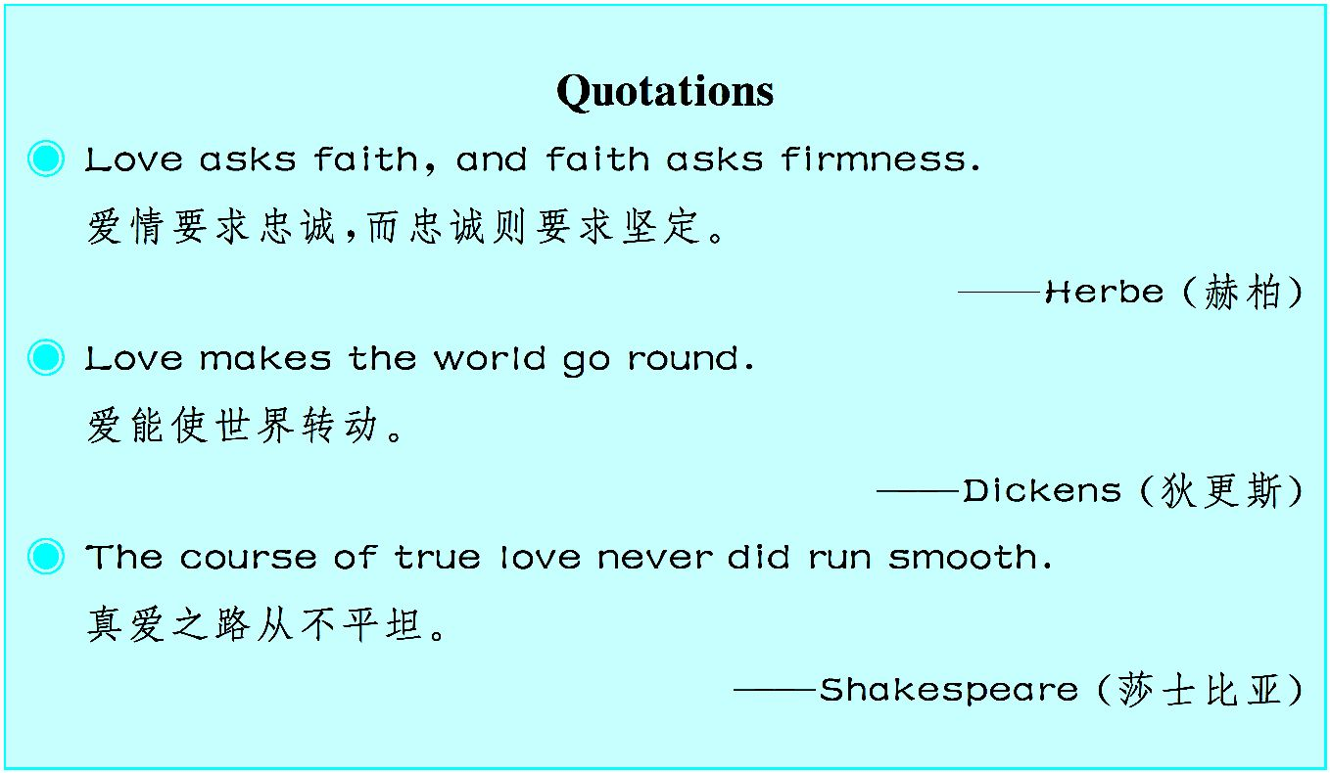

Slide 172
Unit 4
Western and Chinese Education
Chinese Immigrants􀆳 Dilemma:
Chinese Education or Western Education?

Slide 173

移民西方国家的中国人往往都会感受到与国内教育的巨大差异。中西方教育的差异源于 二者国情、社会现状等的不同。不能盲目追捧某一国的教育体制,必须结合自身的国情,取 其精华,加以改进和发展,才能真正地提高教育水平。

Slide 174
There are many attractions to the Western education system. It molds¹ top talents in science, business, arts and sports without sacrificing the happiness of childhood. For Chinese immigrants, the image of the western dream is much easier to grasp than the reality.
Most children of Chinese immigrants study in public schools. Western public schools aim to cultivate² informed citizens by providing them with a basic education on issues of morality³, culture and general life.^{①} A public school education cannot meet the same standards as an elite⁴ education in terms of teaching equipment, faculty and work intensity⁵. Without the pressure of

Slide 175
homework and exams, children in public schools may feel more relaxed and have more time for leisure. But their aspirations⁶ might rise no higher than a career as a cleaner, a taxi driver, a cook, a supermarket cashier, a security guard, a firefighter, or a librarian.
The civic⁷ education in western public schools may seem very successful. However, for Chinese parents with dreams of a place in the elite, it􀆳s hard to accept — “Do we abandon a successful career in China and start from zero in a strange place just to see our child become a happy ordinary worker?”
Is there an ideal education plan? Some people suggest that children of Chi-

Slide 176
nese immigrants come back and undergo their primary education in China, so that the children have a strong academic base, and be better at math. We do hate the spoon-feeding⁸ and rote learning⁹ education mode in China. However, the oriental¹0 education provides children with a solid educational base, and especially an obvious advantage in hard courses such as math, physics and chemistry. It also helps the children to learn good Chinese. Speaking good Chinese is quickly becoming a clear advantage in western job markets. After their primary education in China, children can continue to study abroad and take advantage of a western education. Is this the ideal ed- ucation plan for children of Chinese immigrants?

Slide 177
Choose the education which best suits. A Chinese mother in Canada chose to send her son to China from the second year of primary school, and then have him back from the fifth year. She says that although there were obvious improvements in his Chinese and math, his English level dropped fast. It took a long time for him to readapt to the new educational environment. Thus the ideal education plan may not exist. The two education systems have both advantages and disadvantages. We can only choose the one which suits us better.
When people move to a new culture, if they intend to stay as a family, they

Slide 178
should immerse¹1 their children in the new culture so that they􀆳ll fit in with the modern society. The kids of immigrants in Canada generally attend ordi- nary state elementary schools, which can be supplemented¹2 by one day a week at a special Chinese school. If the family is going to return to China very soon, they can also just attend a Chinese school, but the kids will be less internationally broadened.
In the Chinese education system, every child is cultivated to reach the top. Only 10 percent of them will succeed — there is room at the top for only a small number of people. However, China provides its parents with a dream,

Slide 179
and an equal chance for everyone to receive an elite education. The Western system, which provides an elite education to only a small number of people, can be a good choice for parents of a more relaxed disposition¹3.^{②} Parents will have the opportunity to raise their children in accordance with their own talents and wishes.
—— From http://bbs.chinadaily.com.cn/thread-903981-1-1.html
(602 words)

Slide 180
Notes
① Western public schools aim to cultivate informed citizens by providing them with a basic education on issues of morality, culture and general life.
西方公立学校致力于通过基础教育,从道德、文化和日常生活方面培养 见多识广的公民。
② The Western system, which provides an elite education to only a small

Slide 181
number of people, can be a good choice for parents of a more relaxed dispo- sition.
西方的教育体制虽然只给少数人提供精英教育,但对思想开明的家长来 说,是一个不错的选择。
Exercises
Ⅰ. There are five questions or unfinished statements based on the passage. For each of them choose the best answer from the four choices marked A, B, C and D.

Slide 182
1. Which of the following is not the reason why public school education cannot cultivate social elites?
A. Teaching equipment. B. No pressure of homework.
C. Basic educational system. D. Teaching faculty.
2. In paragraph 4, the underlined part “rote learning” probably means .
A. hard working B. difficult learning

Slide 183
C. regular learning D. memorization by repetition
3. Children of Chinese immigrants sometimes return to China for primary e- ducation so as to lay .
A. a firm cultural foundation
B. an advantage in learning mode
C. a solid academic foundation

Slide 184
D. writing ability
4. Which of the following words can be best used to describe the writer􀆳s at- titude towards “the ideal education plan”?
A. positive B. negative C. ambivalent D. neutral
5. It can be inferred from paragraph 6 that .
A. children of immigrants should attend local schools for primary education.

Slide 185
B. children of immigrants should make endeavor to overcome the cultural barrier.
C. parents of immigrants􀆳 children should help their kids improve their lan- guage skills.
D. for children of immigrants, attending Chinese schools is a good choice.
Ⅱ. Fill in the blanks in the following sentences, using the words or phrases given below. Change the form where necessary.

Slide 186
morality aspiration supplement immerse cultivate
mold intensive immigrant in accordance with solid
1. We sweat a lot in summer; therefore, we should some salt.
2. We must work hard to in young people the revolutionary spir- it of learning diligently and taking pleasure in helping others.
3. He is a Democratic nominee with support from the members

Slide 187
of his own party.
4. This is a show that features conversations about spirituality, , arts, culture and ethics.
5. The scheme has been revised the opinions of the masses.
6. Every , by taking an oath of allegiance to the United States of America, becomes just as much an American as the president.
7. They will receive training before they start to work in this

Slide 188
company.
8. He has never had any to earn a lot of money for his family.
9. His experience in the army had and colored his whole life.
10. You should love China, yourself in Chinese culture and even learn to change your way of thinking.
Ⅲ. Translate the following Chinese sentences into English..

Slide 189
1. 西方教育体制培育了大量文科和理科的尖端人才。
2. 公立学校教育无法在教学设备和教职员工方面达到精英教育的标 准。
3. 人们不赞成填鸭式和死记硬背式的教育模式。
4. 在异国,移民们应该让自己的孩子沉浸于新的文化之中,以便融入现代 社会。

Slide 190
Section A
In this section, you are going to read a passage with ten statements attached to it. Each statement contains information given in one of the paragraphs. I- dentify the paragraph from which the information is derived. You may choose a paragraph more than once. Each paragraph is marked with a letter.
Differences Between Chinese High Schools

Slide 191
and American High Schools
A) Chinese high schools differ from American high schools in many ways, primarily in structure. A Chinese school day is much longer than an American school day. While American students usually attend school for about seven hours each week- day, Chinese students spend much more time in school. For ex- ample, at Harbin Number One High School, students begin school at 7:00 a.m. and remain in school until 8:20 p.m.

Slide 192
B) Class structure varies as well. In contrast to the American system, American students have each class in a different room with different classmates, Chinese students remain in the same classroom all day long, with teachers rotating in and out. As a result, the Chinese language has a special word to distinguish (区分) classmates of the same class from classmates in the same grade. Inside these classrooms, students remain at the same desk all day long, and at the Harbin High School, they each

Slide 193
share a desk with another person. The classrooms of each grade are separated, with senior students taking classes on the top floor.
C) In addition to the dissimilarities in structure, Chinese high schools also differ from American high schools in the college application process that students undergo. In the United States, colleges use a holistic(全面的)application system that takes the following into account, such as a student􀆳s high school grades,

Slide 194
standardized test scores, extracurricular activities, teacher rec- ommendations, application essay and often a personal interview. Students apply to colleges by January, find out where they are accepted by April, and select a college by May. Because stu- dents are accepted to colleges by April, the last few months of the senior year involve relatively little work and almost no pres- sure.
D) The Chinese college admission process is very different. Col

Slide 195
-lege acceptance is determined entirely by standardized exami- nations administered(执行) once a year at the end of each school year. Although students take these tests at the end of their first and second years of high school, the test that really matters is the exam taken at the end of their final year of high school. The great significance of this final examination leads to a tremendous amount of pressure on students to work hard for the whole school year, particularly in the few months before the

Slide 196
important examination. The examination is only given once a year, and if a student is sick that day, he or she must delay at- tending college for a year until the examination is offered again. The pressure from this examination makes many students at- tend classes on weekends to be well prepared for the test.
E) The major way in which Chinese and American high schools differ is the way in which information is given. In America, per- sonal expression is valued heavily. Many classes are based on

Slide 197
the discussion of the materials, and teachers expect students to be engaged in this dialogue. Classroom participation, meaning how a student contributes to the class discussion, is a significant part of a student􀆳s grade, so a student who is attentive but never speaks up could receive a lower grade as a result.
F) However, Chinese classrooms do not place this same empha- sis on classroom participation. In Chinese classrooms, the typi- cal case is that the teacher gives lectures and the students listen

Slide 198
to the teacher quietly. This means that students can do well in class by being diligent and attentive, but it also means that less interaction exists between the teacher and students.
G) This difference extends to the overall attitude towards class- room. In American classrooms, students are likely to talk not only when they participate in classroom discussions, but also when they listen to other students. As a result, the classroom can become noisy and boisterous. Students often develop a friendly

Slide 199
relationship with teachers who teach the course. In Chinese classrooms, respect towards teachers is emphasized. Students are much more quiet and attentive than many American stu- dents, and when a student is called on to speak, he or she is ex- pected to stand up and answer the questions. This classroom at- mosphere is more formal and respectful.
H) The differences between the educational experience in Amer- ica and China are sharp because they reflect a great deal about

Slide 200
the broader differences between the cultures. A good example of this is the different levels of formality between American and Chinese classrooms; these differences exist in culture as well. The Chinese language reflects respect far more than the English language, particularly the more formal word “您” used to ad- dress a second person, which elevates(提高) the speaker􀆳s tone and shows respect to him or her.
I) It is important to compare American educational system with

Slide 201
Chinese educational system because the education students re- ceive plays a big role in the way they act in society as adults. In some ways, the educational systems reflect the society􀆳s direc- tion as a whole. The United States, operating under a democratic government that values free speech, follows an educational sys- tem that encourages students to express their opinions freely. In China, people place more emphasis on obedience(服从) and re- spect.

Slide 202
J) As China􀆳s rapid development and prominence(声望) in to- day􀆳s economy shows, the Chinese educational system has pro- duced many high-achieving, industrious individuals. However, some worry that China will be at a disadvantage if Chinese stu- dents lack encouragement to think for themselves and express their thoughts. China􀆳s current educational system has clearly succeeded in fostering capable students. The coming years will show whether free expression, encouraged heavily in American

Slide 203
education and less so in Chinese education, is an essential skill needed for a country to become a world power.
——https://www.tceic.com/242jgg8ggkggj1l347933l66.html
(951 words)
1. The education difference between China and America lies in the cultural difference.

Slide 204
2. The American students always have different class- mates but Chinese students tend to have fixed classmates in the same grade.
3. In China, the most important exam for senior high school students is the standardized examination taken at the end of their final year of high school which brings great pressure on them.

Slide 205
4. Though the Chinese educational system cultivates tal- ented students, some people are concerned about Chinese stu- dents􀆳 ability to express their own opinions.
5. If an American student wants to achieve high grades, he should attach great importance to classroom discussion.
6. Compared with American students, Chinese students tend to be less noisy in class and show more respect to their

Slide 206
teachers.
7. American high schools and Chinese high schools dif- fer a lot in structure.
8. The educational system and the education students re- ceive can reflect the development of the society.
9. The American college admission is determined by the

Slide 207
overall assessment of a student.
10. In Chinese schools, teachers and students don􀆳t communicate frequently with each other.
Time required: 15 minutes
Time used: minutes
Section B

Slide 208
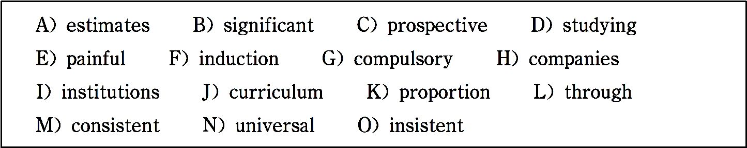
In this section, there is a passage with ten blanks. You are required to select one word for each blank from a list of choices given in the word bank. Read the passage through carefully before making your choices. You may not use any of the words in the bank more than once.
The Chinese Education System
The Chinese education is the largest education system in the

Slide 209
world. In June, 2018, there were 9.75 million students taking the National Higher Education Entrance Examination (Gaokao) in China. In 1986, the Chinese government passed a 1 educa- tion law, making nine years of education mandatory (强制的) for all Chinese children. Today, the Ministry of Education 2 that above 99 percent of the school-age children have re- ceived 3 nine-year elementary education.
In March, 2018, the Ministry of Education of the People􀆳s Re-

Slide 210
public of China announced that a total of 489,200 international students were studying in China in 2017. International students were 4 in over 935 higher education 5 in China. In the past few years, the number of international students who study in China has significantly increased every year. The higher edu- cation sector has growth as well. China has increased the 6 of its college-age population in higher education. At the same time, China is improving the quality of education through a ma-

Slide 211
jor effort at school 7 reform.
China has a 8 teacher development system. Teaching has historically been and remains today a highly respected profes- sion in China. Teachers make full preparations in their subject matter and 9 teachers spend a great deal of time observing the classroom teaching of experienced teachers, often in schools attached to their universities. Once teachers are employed in school, there is a system of 10 and continuous professional

Slide 212
development in which groups of teachers work together with master teachers on lesson plans and help the new teachers im- prove their teaching skills.
——https://www.chinaeducenter.com/en/cedu.php
(261words)
Time required: 8 minutes

Slide 213
Time used: minutes
Section C
In this section there is a passage followed by some questions or unfinished statements. For each of them choose the best answer from the four choices marked A, B, C and D.
The USA Education System

Slide 214
Do you find the American education system to be confusing and different from the education system in other countries? Do you want to attend a university in the USA? The American educa- tion system offers international students the most diverse set of options in the world. In fact, an international student who elects to take advantage of the American education system can pursue anything from nuclear science to film and dance. The possibili- ties are almost endless! The American education system re-

Slide 215
quires that students complete 12 years of primary and secondary education prior to attending university or college. This may be accomplished either in public (or government-operated) schools, or in private schools. These 12 years of schooling [or their e- quivalent(同等条件)] may also be completed outside the USA, thus giving foreign students the opportunity to enjoy the bene- fits of the American education system and receive high-quality education in America.

Slide 216
Perhaps one of the most impressive facts is the large number of presidents, prime ministers and leaders from other countries who have experienced the American education system and graduated from a university or school in the USA. In many fields and industries, the American education system offers the most cutting-edge (尖端的), sought-after programs at the best schools in the world. That is why graduating from an accredited (公认的) American school and being exposed to the rigors of

Slide 217
the American education system is an investment for foreign stu- dents.
Whether you want to study at a USA university, a top college, a vocational(职业的) or high school, a thorough understanding of how the American education system works is essential. Some international students make such comments on American educa- tion system as “Coming from Asia, I was shocked by the vast number of options offered by the American school system. Just

Slide 218
think of all of the products, services and processes invented in the USA! This innovation is the result of a system which allows a student to learn so many things in so many different fields. I am so glad that I chose to study in the USA and received good education in America.”
——http://www.usastudyguide.com/best-education-system-in- the-world.htm

Slide 219
(364words)
1. The greatest advantage of American education is that it can .
A. help the students to make innovations
B. enable the students to develop the ability of critical thinking
C. cultivate famed people

Slide 220
D. provide a large number of options for students
2. Which of the following can be regarded as the prerequisite of attending American universities?
A. To complete twelve-year schooling in schools.
B. To complete secondary education at private schools.
C. To pass the college entrance examination in America.

Slide 221
D. To complete elementary education at public schools.
3. In paragraph 2, “sought-after” means .
A. attractive B. fashionable C. interesting D. popu- lar
4. Due to , many foreign students choose to study in American universities.

Slide 222
A. the advanced equipments B. the outstanding research programs
C. the popularity of culture D. the sophisticated technolo- gies
5. It cannot be inferred from the comments on overseas students that .

Slide 223
A. students can experience the complete studying process in America
B. students can benefit from the various kinds of study pro- grams in America
C. students can obtain profound social experiences in America
D. students can be provided with good learning environment in

Slide 224
America
Time required: 8 minutes
Time used: minutes

Slide 225
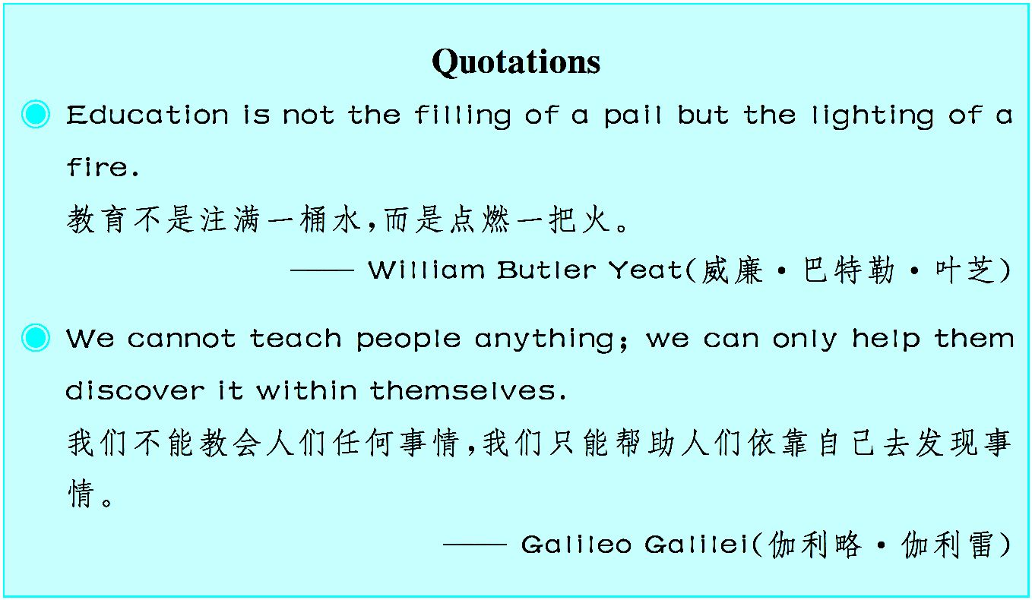

Slide 226
Unit 5
Cooperative¹ Learning
Cooperative Learning

Slide 227
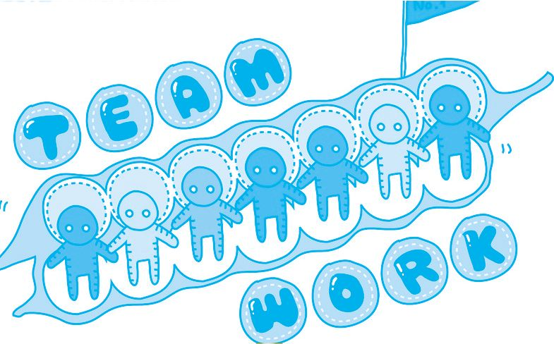
您听说过合作学习吗?您体验过这种学习方式吗?了解它对您的学习可是大有帮助的。

Slide 228
Cooperative learning is a successful teaching strategy² in which small teams, each with students of different abilities, use a variety of learning activities to improve their understanding of a subject. Each member of a team is responsible not only for learning what is taught but also for helping teammates learn, thus creating an atmosphere of achievement. Students work through the assignment until all the group members successfully understand and complete it.

Slide 229
The first and most important element in structuring cooperative learning is positive interdependence³. Positive interdependence is successfully structured when group members perceive⁴ that they are linked with each other in a way that one cannot succeed unless everyone succeeds. Group goals and tasks, therefore, must be designed and communicated to students in ways that make them believe that they should sink or swim⁵ together. When positive interdependence is solidly structured, it high-

Slide 230
lights⁶ that each group member􀆳s efforts are required and indis- pensable⁷ for group success and each group member has a u- nique contribution to make to the joint⁸ effort because of his or her resources and/or role and task responsibilities. Doing so cre- ates a commitment to the success of group members as well as to one􀆳s own success and is the heart of cooperative learning.
The second basic element of cooperative learning is promotive⁹ interaction¹0. Students need to do real work together in which

Slide 231
they promote each other􀆳s success by sharing resources and helping, supporting, encouraging each other, and applauding each other􀆳s efforts to achieve. There are important cognitive¹1 activities and interpersonal¹2 dynamics¹3 that can only occur when students promote each other􀆳s learning. This includes o- rally explaining how to solve problems, giving one􀆳s knowl- edge to others, checking for understanding, discussing concepts being learned, and connecting present learning with past learn-

Slide 232
ing. Each of those activities can be structured into group task di- rections and procedures¹4. Doing so helps ensure that coopera- tive learning groups are both an academic support system¹5 and a personal support system. It is through promoting each other􀆳s learning that members become personally committed to each other as well as to their mutual¹6 goals.
The third basic element of cooperative learning is small group and individual accountability¹7. ^{①} Two levels of accountability

Slide 233
must be structured into cooperative lessons. The group must be accountable for achieving its goals and each member must be accountable for contributing his or her share of the work. Indi- vidual accountability exists when the performance of each indi- vidual is assessed¹8 and the results are given back to the group and the individual in order to ascertain¹9 who needs more assis- tance, support, and encouragement in learning. The purpose of cooperative learning groups is to make each member a stronger

Slide 234
individual. Students learn together so that they subsequently²0 can gain greater individual competence²1.
The fourth basic element of cooperative learning is small group skills. Cooperative learning is inherently²2 more complex than competitive or individualistic learning because students have to engage simultaneously²3 in taskwork²4 and teamwork²5. Social skills for effective cooperative work do not magically appear when cooperative lessons are employed. Instead, social skills

Slide 235
must be taught to students just as purposefully and precisely as academic skills. Leadership, decision-making, trust-building, communication, and conflict-management skills empower²6 students to manage both teamwork and taskwork successfully.
The fifth basic element of cooperative learning is group process- ing²7. Group processing exists when group members discuss how well they are achieving their goals and maintaining effec- tive working relationships. ^{②} Groups need to describe what

Slide 236
member actions are helpful or unhelpful and make decisions about what behaviors to continue or to change. The careful analysis of how members are working together will result in continuous improvement of the learning process, and it can en- hance²8 the effectiveness of group learning.
—— http://www.co-operation.org/pages/cl.html
(611words)

Slide 237
Notes
① The third basic element of cooperative learning is small group and individual accountability.
合作学习的第三个基本要素是小组及成员应负的责任。
② Group processing exists when group members discuss how

Slide 238
well they are achieving their goals and maintaining effective working relationships.
小组成员讨论他们的目标实现到何种程度以及有效的合作 学习关系保持到何种程度,这就是小组自我评估。
Exercises
Ⅰ. There are five questions or unfinished statements based on the passage. For each of them choose the best answer from the four choices marked A, B,

Slide 239
C and D.
1. In cooperative learning, .
A. each member of a team completes the assignment individually
B. each member of a team is only responsible for his own study
C. each member of a team is of the same ability
D. the team is successful when all the members successfully understand and

Slide 240
complete the assignment
2. The word “indispensable” in paragraph 2 probably means “ ”.
A. important B. essential
C. helpful D. not necessary
3. Which of the following is not included in promotive interaction?
A. Discussing concepts that students are learning.

Slide 241
B. Giving one􀆳s knowledge to others and relating old knowledge to new knowledge.
C. Describing what member actions are helpful or unhelpful.
D. Checking for understanding.
4. Why is cooperative learning more complex than competitive or individual- istic learning?
A. Because students must learn social skills to manage both teamwork and

Slide 242
taskwork successfully.
B. Because students have different abilities.
C. Because students are not familiar with each other.
D. Because students don􀆳t know what taskwork and what teamwork is.
5. What is the author􀆳s attitude towards cooperative learning?
A. Critical. B. Positive. C. Negative. D. Pessimistic.

Slide 243
Ⅱ. Fill in the blanks of the following sentences, using the words or phrases given below. Change the form where necessary.
strategy perceive enhance connect with indispensable
performance promote competence result in be responsible for
1. Mr. Smith is not in his work as a teacher.
2. A good director is for a successful film.

Slide 244
3. He uses a to get what he wants.
4. She was no longer the Motor Company.
5. The salesman was given a and an increase in salary last month.
6. The poor working conditions a sit-down strike.
7. I a change in his behavior.

Slide 245
8. He won a gold medal for his fine in the contest.
9. The growth of a city often the value of land close to it.
10. A driver should his passengers􀆳 safety.
Ⅲ. Translate the following Chinese sentences into English.
1. 小组里的每个成员不仅要负责自己学会老师所教的内容,而且负责帮 助成员学习,从而营造一种获得成就感的氛围。

Slide 246
2. 当小组成员意识到他们在某种程度上彼此关联,除非每个成员都成功, 否则自己不可能成功时,积极的相互依存关系就成功构建了。
3. 正是通过相互促进学习,小组成员才能对彼此承担起责任并为他们的 共同目标而努力。
4. 各小组需要描述哪些成员行为是有益的或无益的,并决定要继续或改 变的行为。

Slide 247
Section A
In this section, you are going to read a passage with ten statements attached to it. Each statement contains information given in one of the paragraphs. I- dentify the paragraph from which the information is derived. You may choose a paragraph more than once. Each paragraph is marked with a letter.
Cooperative Learning in English Lessons

Slide 248
— It Really Works!
A) Nofei-Arbel at Kibbutz Ginossar is an experimental school where I􀆳ve been teaching English for many years and I have been trying out alternative methods for the teaching of lan- guages. Three years ago, when I first initiated to apply coopera- tive learning techniques into my classes, it was welcomed as a positive step in this direction. Since then, I have found that CL (cooperative learning) not only develops the pupils􀆳 ability to

Slide 249
read and write but, as the term suggests, it also enhances the pupils􀆳 social skills and academic skills as well.
B) In order to understand how CL can enhance pupils􀆳 learning, we have to remember in mind that having the pupils sit in groups to work on a task is not the same as forming CL groups. So, what is Cooperative Learning?
C) Here is a quick reminder of what CL is all about. CL has its

Slide 250
roots in STAD which was developed by Slavin in the USA and was further developed by Sharan and Lazarowitz in Israel. It is important to mention that CL is an eclectic (兼收并蓄的) method which draws from different fields related to teaching, namely, sociology, linguistics, psychology and so on. Perhaps here lies its strength as CL combines the “Whole Language” approach to learning a language by which the holistic (全面的) elements are located in the connections between the basic skills

Slide 251
of the language and the needs of the learner, i.e. the teacher uses the course book as well as other resources to create students􀆳 interest and motivation (动机).
D) CL enhances creativity and provides the students with tools for critical thinking and problem solving. It is regarded as a stu- dent-centered way of teaching with the emphasis on peer-tutor- ing (同龄人当辅导教师的) techniques that keep most pupils involved. In my experience, these techniques increase students􀆳

Slide 252
motivation, help them develop a positive image of self and oth- ers and also help in the development of other important social skills, such as sharing ideas with their team members, learning to respect them and so on.
Procedure and reflections:
E) From the beginning of the school year the pupils sit in groups consisting of four to five pupils who are different in their abilities and performances. The teams work together for six to eight weeks until they are assigned to

Slide 253
new teams. Members of the groups are assigned roles such as “a reporter, a secretary, a time keeper” and other roles which they themselves see the need to have. It is also important to mention that each team is identified by a name which all group members have agreed upon.
F) The CL groups work in this way once a week and sometimes continue to work with their assigned team in the session to follow depending on the task they have been working on, e.g. mini-projects or performance tasks that take some time to finish.
G) Just before the new groups are formed, we look at the chart (图表) which

Slide 254
displays the group achievements in terms of points and the name of the win- ning group is announced. This group gets a certificate of merit or an evalua- tion of some sort. The pupils are then asked to fill in a feedback form ex- pressing their feelings, thoughts and opinions about the time spent together as a team, the work done and what they feel they have achieved. This self-e- valuation is most essential and emphasizes the positive aspects of CL as it brings the problematic cases to the teacher􀆳s attention. Here are some of the questions asked and some of the responses.
H) To the question “How did you work?” some of the replies were:

Slide 255
·We discussed the ideas and assignments together.
·We took turns to contribute ideas.
·We helped each other.
I) To the question “How did you feel in your group?” some of the replies were:
·It was great fun working together.

Slide 256
·We felt it was possible to learn as a group.
·We learnt what CL really means.
And in contrast:
·I didn􀆳t feel good because two children in my group got on my nerves.
J) To the question “What did you enjoy doing with the group?” some an- swered:

Slide 257
·We enjoyed reading and writing stories together.
·I enjoyed speaking English with the group members.
·I liked everything.
K) The question “What didn􀆳t you like while working with your group?” is a very important question since it focuses on problematic aspects of CL. Here are some of the replies:
·I didn􀆳t always like reading with a partner.

Slide 258
·I didn􀆳t like children talking instead of working.
·I didn􀆳t like having to work for others.
L) All in all, the amount of negative replies is minimal and the most pupils love CL lessons. Indeed, an outsider going suddenly into a CL class would get the impression that he had inadvertently (漫不经心地) entered a beehive (蜂房,熙熙攘攘的地方或场面) where each member knows his role and is busily fulfilling it. Another advantage of CL is that while the groups are working on a task, the teacher gets the opportunity to sit with the weaker pupils and give them the extra attention they need. CL also changes the tradi-

Slide 259
tional role of the teacher as a “knowing all — spoon-feeding (填鸭式灌输) — don􀆳t do anything without me” person to one who is more of a “coun- selor (顾问) — adviser — guide — monitor (监督员)”.
M) In conclusion, CL has shown itself to be a teaching method which is wel- comed by most students and one which I can only strongly recommend.
(881 words)
1. Cooperative learning is different from having pupils sit in groups to work on a task.

Slide 260
2. Sociology, linguistics and psychology are related to cooperative learning.
3. In a class which is taught by using CL techniques, peer students help each other in learning.
4. Cooperative learning not only improves the pupils􀆳 ability to read and write but also develops the pupils􀆳 social skills.
5. In a CL class, the teacher uses the textbook and other resources to arouse students􀆳 interest and motivation.

Slide 261
6. A teacher plays the role of counselor and monitor in a CL class.
7. By using the method of cooperative learning, the teacher can de- velop pupils􀆳 ability to think critically.
8. The author strongly recommends CL teaching method which is popular among most students.
9. One of the advantages of cooperative learning is that the teacher can give weaker students extra help they need.

Slide 262
10. Some students didn􀆳t feel good in group work because two chil- dren in his/her group got on his/her nerves.
Time required: 8 minutes
Time used: minutes
Section B
In this section, there is a passage with ten blanks. You are required to select one word for each blank from a list of choices given in the word bank. Read

Slide 263
the passage through carefully before making your choices. You may not use any of the words in the bank more than once.
A) best B) different from C) important D) efficient
E) involved F) structured G) cause H) success
I) such asJ) such K) especially L) same M) developing N) multiple O) solve
How do Cooperative Learning and Collaborative

Slide 264
Learning Differ from the Traditional Approach?
Cooperative learning and collaborative learning differ from traditional teaching approaches because students work together rather than compete with each other individually.
Collaborative learning can take place at any time when students work together — for example, when they help each other with homework. Cooperative learning takes place when students

Slide 265
work together in the same place on a project in a small group. Mixed-skill groups can be 1 helpful to students in 2 their social abilities.
The skills needed to work together in groups are quite 3 those used to succeed in writing a paper on one􀆳s own or com- pleting most homework or “seatwork” assignments. In a world where being a “team player” is often a key part of business 4 , cooperative learning is a very useful and rele-

Slide 266
vant tool.
Because it is just one of a set of tools, however, it can easily be integrated into a class that uses 5 approaches. For some as- signments individual work may be most 6 , while for others cooperative groups work 7 .
Research suggests that cooperative and collaborative learning bring positive results 8 deeper understanding of content,

Slide 267
increased overall achievement in grades, improved self-esteem, and higher motivation to remain on task. Cooperative learning helps students become actively and constructively 9 in con- tent, take ownership of their own learning, 10 group con- flicts and improve teamwork skills.
(225 words)
Time required: 8 minutes

Slide 268
Time used: minutes
Section C
In this section there is a passage followed by some questions or unfinished statements. For each of them choose the best answer from the four choices marked A, B, C and D.
You can walk into any classroom in the world and know its spirit immediate- ly, know whether the children in it are free to develop skills and acquire

Slide 269
knowledge, know whether they support each other and work together, or un- dermine each other􀆳s learning.
Underlying lessons in mathematics and reading, and in other subjects, are the basic activities that must be practiced by teachers and learners.
Building group spirit leads to the success of the whole class. Competitions, divisions, and favoritism (偏爱) interfere with the learning of all students. As a teacher, you can help the children think of themselves as members of a learning team, in which the success of one is the success of all, and in which no student can be “left behind”.

Slide 270
Effective communication involves listening, speaking, and taking turns. A good teacher manages communication to be sure that a few children don􀆳t answer all the questions or dominate the discussion. Active listening, in which students take responsibility for hearing and understanding what each other says, is a vital part of the learning environment. Assertive(坚定自信 的) speaking is equally important, and it can clearly express thoughts and feelings without interfering with the rights of others.
Cooperation enables learners to work together,sharing responsibilities, mate- rials,roles and learning. In a science activity, one child might weigh different

Slide 271
materials, while another might record results. Halfway through the activity, the children might swap roles. Cooperation must be practiced if groups of children are to work independently.
Problem-solving and negotiation help learners resolve conflicts and make decisions. To learn how to think, children need to be encouraged to agree upon goals, make decisions and support them, and follow through to learn the outcomes of their choices. All of these processes depend on group-spirit, communication, and cooperation. And, when conflicts arise, the same skills will help you and your students resolve them through negotiation.

Slide 272
—— http://www.unicef.org/teachers/teacher/co-op.htm
(311 words)
1. Which of the following is not mentioned in the text?
A. When you walk into any classroom in the world, you may know whether the children in it can enjoy the freedom to develop skills.
B. When you walk into any classroom in the world, you may know whether the children can cooperate in their study.

Slide 273
C. When you walk into any classroom in the world, you may get to know all the students immediately.
D. When you walk into any classroom in the world, you may know whether the children can acquire knowledge freely.
2. According to the passage, in a learning team, .
A. the students work independently
B. the students are responsible for hearing and understanding what each oth-

Slide 274
er says
C. the students express their thoughts and feelings without paying any atten- tion to others
D. cooperation isn􀆳t necessary when groups of children want to work inde- pendently
3. The underlined word “swap” in paragraph five probably means .

Slide 275
A. arrange B. exchange
C. change D. divide
4. Which of the following is not true according to the passage?
A. The teacher should help students build group spirit.
B. Listening and speaking are important in effective communication.
C. A good teacher should treat students equally.

Slide 276
D. Problem-solving often causes conflicts,and students don􀆳t know how to resolve these conflicts.
5. The main idea of the passage is .
A. how to develop students􀆳 ability to cooperate with others and achieve bet- ter results in learning
B. how to build group spirit
C. how to communicate effectively

Slide 277
D. how to solve problems successfully
Time required: 8 minutes
Time used: minutes

Slide 278

Unit 6

Slide 279
Strategies for Developing
Writing Skills
Peer Response Groups¹

Slide 280
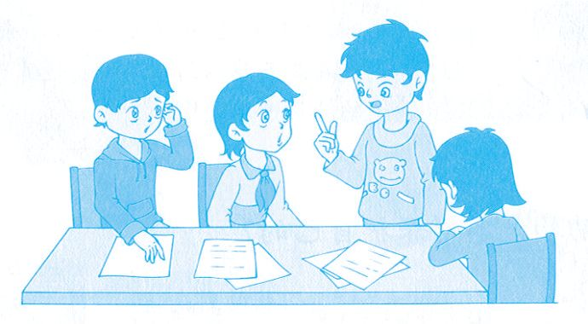
写作能力的提高仅凭个人的努力就够了吗?只有老师才能批改您的作文吗?其实,同学间的 相互讨论也能提高您的写作水平哦!

Slide 281
One productive way that teachers can provide beneficial feedback for student writing is through the use of Peer Response Groups.^{①} In these groups, students read and respond to each other􀆳s drafts² of a particular as- signment and may, in the process, understand the assignment better.
In order for peer groups to be productive — whether time is given in class or they are set up outside of class — the teacher needs to train the students in critical reading by setting up specific procedures³ and objectives⁴.
Guidelines⁵ for students to organize their own out-of-class peer response groups:

Slide 282
These guidelines define three steps for organizing and participating in peer writing groups. First comes preparation before the initial meeting, which en- tails completing a short writing inventory⁶ and personal goals questionnaire⁷ to get group members thinking about both their writing needs and about goals for the group. The second step focuses on organization during the ini- tial meeting. This involves getting to know one another, setting group goals, deciding on⁸ logistics⁹ (i.e. When and where will the group meet? How will the group communicate between meetings and exchange work? Who will hand in pieces? When? etc.). The third step offers parameters¹0 for the work- shop, establishing section¹1 rules that allow the group to use its time well and

Slide 283
to get the most out of each other􀆳s comments.
Finally, the guidelines offer tips for responding to other people􀆳s writing and questions to ponder¹2 while evaluating peer writing. These questions allow students to organize their comments into higher order and lower order con- cerns.^{②} Many times students focus on lower order concerns, such as gram- mar, punctuation¹3, and spelling instead of spending time on more important concerns like clarity¹4, organization, and enough evidence to back up¹5 a view.^{③}
Guidelines for managing in-class peer response workshops:

Slide 284
Students can be grouped in fours, with each student having a copy of the other students􀆳 drafts. The teacher could decide beforehand¹6 how the stu- dents are grouped or allow students to group themselves. All students in the group would focus on the same draft to address whatever the objectives the teacher (perhaps in collaboration¹7 with the students) thinks appropriate based on the assignment.
If the assignment had asked students to write an argument¹8, objectives could include looking at the cogency¹9 and organization of the argument. Students could read each draft, addressing these questions:

Slide 285
What is the thesis²0 of the draft?
What evidence do I use to support my thesis?
What other evidence do I need to support my points?
Such questions allow the writer to guide the discussion of the response and force a more substantive²1 response than “yes” or “no”. Students should be encouraged to write their responses on the draft before they dis- cuss them so that the writer has access to them during revisions²2.

Slide 286
When students first work in groups on each other􀆳s writing, the teacher needs to monitor²3 their progress to ensure that they stay on²4 the task, an- swering the assigned questions and that each group member has an opportu- nity to receive feedback from the group.^{④}
Setting up Peer Response Groups initially can seem time-consuming and en- suring that such groups are productive requires patience on the part of the teacher. Students may need time to practice taking turns²5 in group work and in assimilating²6 different perspectives. But over the course of the semester and a series of assignments, the critical feedback that can be found

Slide 287
in these groups can lead to better student writing and thinking.
—— http://wac.gmu.edu/teaching/prg.html
(576 words)
Notes
① One productive way that teachers can provide beneficial feedback for stu- dent writing is through the use of Peer Response Groups.

Slide 288
通过运用合作学习小组这一富有成效的方式,老师能给学生的写作提供 有益的反馈意见。
② These questions allow students to organize their comments into higher order and lower order concerns.
这些问题使组内同学对习作从上层(即语篇层)和下层(即语言层)两个方 面做出评价。
③ Many times students focus on lower order concerns, such as grammar, punctuation, and spelling instead of spending time on more important con-

Slide 289
cerns like clarity, organization, and enough evidence to back up a view.
有许多次学生们把注意力集中在习作的下层(即语言层)存在的错误上,如 语法、标点符号和拼写等。他们没有把时间花在更为重要的方面,如习 作的思路是否清晰、组织是否严密和论据是否充分等。
④ When students first work in groups on each other􀆳s writing, the teacher needs to monitor their progress to ensure that they stay on the task, answer- ing the assigned questions and that each group member has an opportunity to receive feedback from the group.

Slide 290
当学生们在小组中首次讨论彼此的习作时,老师需要掌控讨论的进程。 这样既确保学生回答好分配给学生的问题,又确保每个组员都有机会获 得小组的反馈意见。
Exercises
Ⅰ. There are five questions or unfinished statements based on the passage. For each of them choose the best answer from the four choices marked A, B, C and D.
1. Which of the following is not the advantage of Peer Response

Slide 291
Groups?
A. Students can understand the task better.
B. Students can help correct the mistakes in the writing.
C. Students can help each other write better compositions.
D. Students can depend on their classmates if they are tired.
2. The teacher needs to train students in critical reading .

Slide 292
A. in order to criticize the others􀆳 writing
B. in order to make groups work with higher efficiency
C. in order to improve the students􀆳 reading skill
D. in order to make the students understand each other
3. What is not included in the guidelines for students to organize their own out-of-class Peer Response Groups?

Slide 293
A. Preparation before the first meeting.
B. Organization during the first meeting.
C. Ways to deal with the problems in the process.
D. Rules for the discussion.
4. The underlined word “address” in paragraph 7 most probably means “ ”.

Slide 294
A. the place where a person lives B. discuss
C. speak to D. write to
5. According to the passage, which of the following statements is true?
A. The teacher should help students set up peer writing groups.
B. Setting up peer response groups wastes too much time.
C. The teacher need not do anything when peer groups begin to work.

Slide 295
D. The group members only correct the grammar mistakes.
Ⅱ. Fill in the blanks of the following sentences, using the words or phrases given below. Change the form where necessary.
stay on argument draft decide on take turns
back up clarity monitor assimilate in collaboration with
1. I􀆳ll you if they don􀆳t approve your plan.

Slide 296
2. She at university to do research.
3. I remember the scene with complete .
4. The committee will need time to this report.
5. Each student􀆳s progress closely .
6. He wrote the book his colleagues.
7. His words were so difficult to understand that I did not follow his

Slide 297
.
8. These designs are so good that it is hard for us to the best.
9. This is only the first of my speech.
10. The students to clean the classroom and the blackboard.
Ⅲ. Translate the following Chinese sentences into English.
1. 在这些小组中,学生们彼此阅读某项作业的草稿并提出反馈意见。在

Slide 298
此过程中,他们也许会更好地理解这项作业。
2. 第三步为小组研讨提供规范,制定小组活动规则,让小组成员有效地利 用时间,从彼此的评价中获得最大的帮助。
3. 这些问题可以帮助作者引导小组其他成员通过讨论做出回答,从而获 得实质性的反馈而非简单的“是”或“不是”。
4. 建立合作学习小组看似耗费时间,确保这些小组开展富有成效的活动 也要求老师有耐心。

Slide 299
Section A
In this section, you are going to read a passage with ten statements attached to it. Each statement contains information given in one of the paragraphs. I- dentify the paragraph from which the information is derived. You may choose a paragraph more than once. Each paragraph is marked with a letter.
Collaborative Writing

Slide 300
A) Collaborative, or team, writing is the process of producing a written work as a group where all team members contribute to the content and the decisions about how the group will function. Each member should plan to be responsible for at least two roles on the writing team, writing a specific section of the pro- ject and serving as a specialist in one or more areas concerning the project. Roles may overlap (部分重叠) or be shared, de- pending on team members􀆳 skills. Each student should take on

Slide 301
two or more of the following roles:
B) Writer: Everyone in the group writes and revises a specific part of the project.
C) Group Leader: This person coordinates the team, organizes the writing plan and schedule (especially for group meetings), and picks up loose ends (未完成的部分).

Slide 302
D) Editor: This person edits and proofreads (校对) final drafts, provides stylistic (文体上的) standards for the group as a whole, and guides the group in using stylistic conventions and formats (格式).
E) Graphics (图案) Layout Artist and Production Manager: This person is responsible for project design, illustrations, layout, hard-copy and Web formats, and the printing of the final pro- ject.

Slide 303
F) Subject Matter Specialist: Each person is responsible for re- search on technical topics, assisting team members with techni- cal problems, and testing the final project for accuracy. All members must become subject matter specialists in at least one area.
G) Webmaster: In Web projects, this person is responsible for putting the project on the Web and administering it.

Slide 304
H) The tasks described here should help you manage your team writing. Plan to write all or some of them as a group.
I) (1) Informal progress report in the form of a memo (备忘录): At the first group meeting, members present their backgrounds and what they are most interested in doing for this project. At the end of the meeting, the team writes a group progress report identifying each person􀆳s background and desired roles, de- scribing briefly your group􀆳s technical writing/editing and pro-

Slide 305
duction environment, and any questions, problems, or bright ideas that emerge.
J) (2) Subsequent informal progress reports: Thereafter, mem- bers hand in weekly informal progress reports about attendance, action items, progress, and assignments. One person should act as a recorder for the group during your discussion and take notes for the progress report. The recorder role should be rotated among the group members equitably.

Slide 306
K) (3) Editing strategy: To plan for reviewing and revising the final draft, your team must think of ways to evaluate and edit your team writing. Usually this step involves some quality con- trol measures and a cycle of reviews for the project. This strate- gy should address (满足) the needs of hard-copy as well as Web formats if you are doing a Web project. Your editing strategy should:
1) identify the project􀆳s readers, purpose and uses.

Slide 307
2) present a schedule for reviews and editing and describe how the final changes will be implemented.
L) (4) Information plan: This information plan includes a pur- pose definition, scope (范围) definition, audience analysis, ob- jective, statement of purpose, tentative (暂时的) outline by sec- tion, production and distribution plan, tentative schedule for completing each project piece, and list of specific tasks assigned to each group member. Discuss and write this plan as a group.

Slide 308
Your team can use the information plan to request your teacher􀆳 s final approval of your project or his or her recommendations for changing the concept and scope of your project.
M) Remember that your information plan can be adjusted as you actually write the project. Ideally, to preserve its integrity (完 整), you should have very few amendments (修改) to the plan. The more detail you have in the plan, the more likely your pro- ject will prove to be well designed.

Slide 309
N) (5) Formal progress report or updated (更新)revision of the information plan: This report describes the project status and significant deviations (偏离) from the initial plan and presents a revised project schedule. Hand in the revised plan with a one- page memo that describes what the changes are about midway through your project.
O) (6) Review draft: This draft includes each section of your as- signment with an example of the final project design and any

Slide 310
graphics. If you have not yet completed a section, make space for it in your project and describe what will be in that section, how you will implement the content, and when you think it will be finished. Include a sentence or two to indicate what has yet to be finished in that section. Based on this draft, your teacher can now approve your draft or make recommendations or both.
P) (7) Final project: No doubt, there will be content require- ments for your final project. For example, a formal report might

Slide 311
include a title page, a transmittal letter, a table of contents, the body of the report, and any appendices (附录). Web projects should follow conventions appropriate for that type of project.
Q) (8) Evaluation for each team member: Every member of the team should plan on evaluating the other members in a brief paragraph. You will need to be specific and honest here so that your teacher can grade the project fairly. Consider giving each team member a grade.

Slide 312
R) Most important of all, this coordination requires politeness, thoughtful communication, and dependability on everyone􀆳s part.
—— http:// www.umuc.edu/prog/ugp/ewp_writingcenter/writ- inggde
(851 words)

Slide 313
1. On the collaborative writing team, all members must become subject matter specialists in at least one area.
2. In collaborative writing, each team member must write a specific section of the project and serve as an expert in some areas related to the project.
3. At the first group meeting, you must present your backgrounds and what you would like to do for this project.

Slide 314
4. During the discussion, there should be a representa- tive taking notes for the progress report.
5. To plan for checking and correcting the final draft, the team must think of ways to evaluate and edit the team writing.
6. The information plan can be used to ask for your teacher􀆳s approval of your project.

Slide 315
7. Every member of the team is to evaluate the perfor- mance of other team members.
8. Webmaster is responsible for putting the project on the Web and administering it.
9. A one-page memo is used to describe the changes that will take place midway through the project.

Slide 316
10. A title page, a transmittal letter, a table of contents, the body of the report, and any appendices are all included in a formal report.
Time required: 15 minutes
Time used: minutes
Section B

Slide 317
In this section, there is a passage with ten blanks. You are required to select one word for each blank from a list of choices given in the word bank. Read the passage through carefully before making your choices. You may not use any of the words in the bank more than once.
A) arise from B) proposal C) expect D) unspoken
E) reflective F) consideration G) possess H) consider
I) value J) raise K) fairly L) accepted M) propose

Slide 318
N) suspect O) problems
The Art of Writing Proposals
Writing proposals for research funding (资助) is a peculiar as- pect of North American academic culture, and as with all cul- tural things, its attributes (特征) rise only partly into public con- sciousness. A proposal􀆳s function is to persuade a committee of scholars that the project shines with the three good qualities all

Slide 319
disciplines 1 , namely, conceptual innovation (创新), methodological rigor (严格), and rich, substantive content. But to make these points become 2 , a proposal writer needs a feel for the unspoken customs, norms, and needs that control the selection process itself. These are not really as secret or ritualis- tic (老规矩的) as one might 3 . For the most part, these cus- toms 4 the committee􀆳s efforts to deal honestly with its own 5 : incomprehension among disciplines, work overload,

Slide 320
and the problem of how to judge proposals 6 .
Writing proposals is an art quite different from research work it- self. After long careful 7 , a committee usually has to choose among proposals those which 8 the three good qual- ities mentioned above. Other things being equal, the 9 that is awarded funding is the one that gets its good qualities across more forcefully because it addresses these 10 needs and norms as well as the public rules.

Slide 321
—— http://fellowships.ssrc.org/art_of_writing_proposals
(202 words)
Time required: 8 minutes
Time used: minutes
Section C

Slide 322
In this section there is a passage followed by some questions or unfinished statements. For each of them choose the best answer from the four choices marked A, B, C and D.
Consider the act of editing and revising a piece of writing as an act of quality control. If you (or your university representative) sign your name to it, you are asserting that the words and ideas are accurately expressed. Most technical people are not trained in editing and revising. Thus, they have no method or theory for undertaking revision of their proposals. Furthermore, you may do a better job of reading proposals if you have a set of guidelines

Slide 323
and a specific methodology (一套方法) to follow.
Here are some guidelines for editing and revising proposals (or any piece of professional communication):
(1) Editing is the process of recognizing and identifying problems in the writing. Revising is the process of changing the items to conform with rules or to produce clearer, more effective writing.
(2) Editing/revising can be done for mechanics [写作的技术性细节(包括格 式、拼写、语法是否正确等)], style, and structure. It is necessary to check

Slide 324
mechanics, which is done word by word, with a concern for identifying indi- vidual items which do not conform with accepted grammatical or spelling rules. The goal of this process is uniformity (一致) and accuracy. It is desir- able (and sometimes necessary) to check style, which is done by reading phrases and sentences for clarity, tone, readability, consistency and other qualities which contribute to overall skillful writing. The goal of this process is smooth and clear papers which can be read and understood in one reading. It is also essential to check structure, which is done by reading through the entire document to discern (弄清楚) a structure, its closely connected parts, and their relationship to the whole. The goal of this process is coherence (连

Slide 325
贯性) and a sense of direction in the entire paper.
(3) Each type of editing/revising should be done independently.
(4) It is not necessary to know the accurate grammatical term or concept to do effective editing and revising, but it is important to have adequate refer- ence books for consultation (查阅). At minimum, there should be an up-to- date desk dictionary and a grammar handbook.
—— http://www.gpc.edu/~ebrown/infobr3.htm#guides

Slide 326
(330 words)
1. Which of the following is the best title for the passage?
A. Guidelines for Editing and Revising Proposals.
B. On Proposals.
C. Editing and Revising.
D. The Techniques of Editing and Revising.

Slide 327
2. The underlined phrase “conform with” in paragraph 3 can be best re- placed by .
A. disapprove B. revise
C. obey D. match with
3. What do we need to check when editing or revising proposals?
A. Mechanics. B. Style.

Slide 328
C. Structure. D. All of the above.
4. The goal of checking the style of a piece of writing is .
A. uniformity and accuracy
B. smoothness and clarity
C. coherence and a sense of direction in the entire paper
D. necessity

Slide 329
5. According to the author, which of the following statements is true?
A. We need no method or theory to undertake revision of proposals.
B. We can judge a proposal according to our own liking.
C. A grammar handbook is needed when we revise/edit a proposal.
D. We have to know the accurate grammatical concept before doing effective editing and revising.

Slide 330
Time required: 8 minutes
Time used: minutes

Slide 331
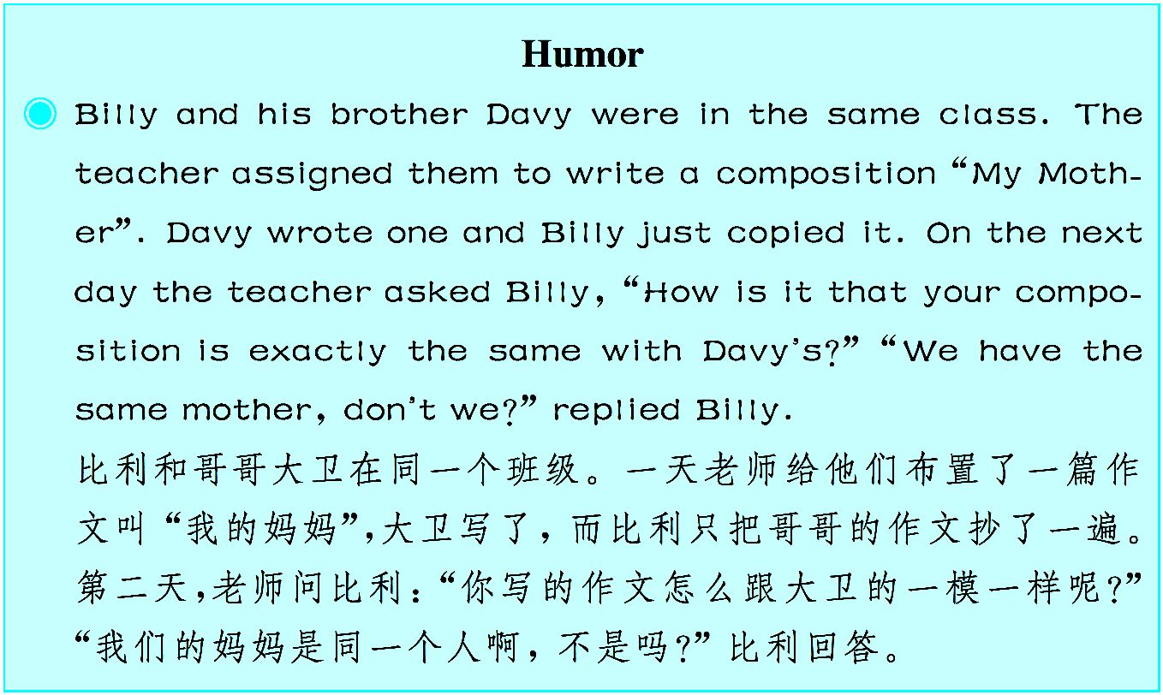

Slide 332
Unit 7
Red Culture in China
Dreamers and Their Fighting Spirit

Slide 333
1921年,中国共产党第一次全国代表大会在浙江嘉兴南湖的一条游船(后称“红船”)上胜 利闭幕,庄严宣告了中国共产党的诞生。中国革命的航船从这里扬帆起航,体现了“开天辟 地、敢为人先”的首创精神。

Slide 334
The CPC is a political party rising by arming itself with Marxism. The Party􀆳s birth endowed¹ the revolution in China with firm ideas and a power- ful spirit. The First National Congress² of the CPC, which was held in the White Terror and marked the official establishment of the CPC, was moved from Shanghai to a boat on South Lake of Jiaxing. This was accomplished through maintaining a firm stance³ on ideals and remaining undaunted⁴ by setbacks.
Maintaining a Firm Stance on Ideals. Remaining Undaunted by Set- backs, and Pursuing the Ideals of Communism and Unfailing⁵ Belief in Marx-

Slide 335
ism
In the face of difficulty and frustration, the members of the CPC carried out a long and extraordinary⁶ fight, and as a result, began a road of revolution and development with Chinese characteristics. The Russian October Revolution brought Marxism-Leninism to China. From a diversity⁷ of viewpoints and possible paths to be taken, after repeated comparison and differentiation⁸, some progressives resolutely⁹ chose Marxism-Leninism, and they clung to the lofty ideal of fighting for the realization of communism.^{①} From that time on, the CPC never wavered¹0 in its belief in or pursuit of Marxism, and its

Slide 336
members understood the importance of seeking truth from facts. They under- stood that adapting Marxism to Chinese conditions was indeed part of hold- ing fast to¹1 Marxism. In the 90-plus years since its birth, the CPC has ex- celled¹2 at integrating the universal truths of Marxism with China􀆳s condi- tions and has successfully united the maximum program and minimum pro- gram. It has remained constant on theoretical¹3 innovation¹4and keeping up with the times with a form of Marxism that fits the conditions in China. It holds fast to using the achievements of these theories to arm the Party and e- ducate the people, reflecting a firm dedication to ideals and an inexhaustible¹ 5 spirit of theoretical innovation.

Slide 337
Fighting Spirit of Maintaining a Firm Stance on Ideals and Remaining Undaunted by Setbacks Is the Pillar¹6 of the Red Boat Spirit and Foundation of Victory
China􀆳s road of development since modern times has been marked by un- common difficulties. In the face of such hardships and frustrations, some be- lieved the CPC was sure to fail, while others believed they would win with- out having to fight. Those within the Party who were weak gave up their ide- als and deserted¹7 or betrayed the revolution and allied¹8 themselves with the enemy. However, the CPC has always been able to overcome difficulties,

Slide 338
revived¹9 itself in the face of hopeless circumstances, and opened up new roads to revolution and development. This was accomplished through the spirit of maintaining a firm stance on ideals and remaining undaunted by set- backs.
It is only because of this fighting spirit that China was able to expel²0 in- vaders and establish the People􀆳s Republic of China; that a great many peo- ple including Chen Tanqiu, He Shuheng, Wang Jinmei, Xia Minghan, Fang Zhimin, Deng Zhongxia, Yun Daiying and Xiang Jingyu sacrificed their lives for the revolution; that Wang Jie gave his life for rescuing others during

Slide 339
a period of peace, Ouyang Hai gave his life to save a colliding train, Su Ning gave his life to save a fellow soldier, and countless other people per- formed heroic deeds; that the CPC won numerous victories along the borders from outside attacks; that the PLA soldiers built one barrier after another, using both flood bags and even their own bodies, to stop the floodwaters in 1 998, touching the hearts of hundreds of millions of Chinese people; that heroic feats²1 were witnessed during the Wenchuan and Yushu earthquakes in 2008 and 2010; that order was brought from chaos²2 and a new stage high- lighting²3 the reform and opening up was ushered²4 in; and that China has been able to carry on with the difficult fight of “Four-Pronged Comprehen-

Slide 340
sive Strategy” along the road of socialist modernization with Chinese char- acteristics so as to realize the Chinese Dream of the great rejuvenation²5 of the Chinese nation.^{②}
——From Spirit of the Red Boat, Lan Yingjie, Foreign Languages Press, 20 17
(648 words)

Slide 341
Notes
① From a diversity of viewpoints and possible paths to be taken, after re- peated comparison and differentiation, some progressives resolutely chose Marxism-Leninism, and they clung to the lofty ideal of fighting for the real- ization of communism.
经过反复的比较和辨别,一些进步人士在多种观点和可选的道路中,坚定 地选择了马克思列宁主义,和坚持为实现共产主义而奋斗的崇高理想。

Slide 342
② …and that China has been able to carry on with the difficult fight of “Four-Pronged Comprehensive Strategy” along the road of socialist mod- ernization with Chinese characteristics so as to realize the Chinese Dream of the great rejuvenation of the Chinese nation.
……中国能够在中国特色社会主义现代化道路上继续进行“四个全 面”战略的艰苦奋斗,实现中华民族伟大复兴的中国梦。
Exercises
Ⅰ. There are five questions or unfinished statements based on the passage.

Slide 343
For each of them choose the best answer from the four choices marked A, B, C and D.
1. According to the passage, what􀆳s the fighting spirit of the dreamers?
A. Resolutely choosing Marxism-Leninism.
B. Maintaining a firm stance on ideals and remaining undaunted by setbacks.
C. Seeking truth from facts.

Slide 344
D. Adapting Marxism to Chinese conditions.
2. The underlined word “deserted” in paragraph 3 means .
A. supported B. struggled against C. opposed to D. abandoned
3. Since its birth, which of the following isn􀆳t the accomplishment that CPC has achieved?
A. Integrating the universal truths of Marxism with China􀆳s conditions.

Slide 345
B. Constantly seeking theoretical and practical innovation.
C. Arm the Party with achievements of the theories.
D. Educate people with achievements of the theories.
4. Which of the following is not the reaction of those within the Party who were weak when facing hardships and frustrations?
A. Giving up their ideals.

Slide 346
B. Betraying the revolution.
C. Overcoming difficulties.
D. Ally with the enemy.
5. By means of this fighting spirit,China has made great achievement in the following except .
A. expelling invaders

Slide 347
B. establishing the People􀆳s Republic of China
C. realizing Chinese Dream
D. encouraging countless people to perform heroic deeds
Ⅱ. Fill in the blanks in the following sentences, using the words or phrases given below. Change the form where necessary.
endow stance characteristics cling to pursuit

Slide 348
constant expel witness revive dedication
1. Hostility towards outsiders is of both human and non- human animals.
2. Throughout the trial, she had the belief that he was innocent.
3. India has many political changes in recent years.
4. The little princess is with wealth, good health and a happy life.

Slide 349
5. She suggests that women are under pressure to be abnormally thin.
6. The conference drew up a five-point plan to the socialist cause.
7. He expressed the hope that he would a neutral and balanced policy for his country.
8. They had faced one difficulty after another with bravery and .

Slide 350
9. The Congress had agreed to reconsider its on the armed struggle.
10. An American academic (高校科研人员) was from the coun- try yesterday.
Ⅲ. Translate the following Chinese sentences into English.
1. 她要取得成功的决心从未动摇过。
2. 里克的烹饪技术一直不错,但这次简直是好上加好。

Slide 351
3. 报告特别强调了当今社会所面临的主要问题。
4. 尽管他的思想屡遭非难,他似乎仍然百折不挠。
Section A
In this section, you are going to read a passage with ten statements attached to it. Each statement contains information given in one of the paragraphs. I- dentify the paragraph from which the information is derived. You may choose a paragraph more than once. Each paragraph is marked with a letter.

Slide 352
Pioneering Spirit of the Revolutionaries
A) China hit its darkest point in the early 1920s as the people suffered greatly and there was no way out in sight. It was at this time that a new revolutionary fire was lit to shine on the vast, dark land of China. Thirteen progressives averaging only 28 years old held a meeting in an old Shanghai neighborhood, and moved the venue to a boat in South Lake of Jiaxing. On the last day, the birth of the CPC was proclaimed.

Slide 353
B) Thus, a completely new, united party of the proletariat (无产 阶级) emerged in the backward country of China. It was a party which held to the principles of Marxism-Leninism and main- tained its objectives as the establishment of a socialist, commu- nist government. Except the incident with the police in the French Concession (法租界), the establishment of the Party of only 58 members did not attract much attention; at first, it was as though nothing had ever happened.

Slide 354
C) However, the Party had the most progressive ideological weapon of Marxism, and it was fully confident in the fact that its responsibility was to change the country for the better, to gain independence for China, and to liberate the people. Bring- ing about the great ideals of communism required the Party to forge on with perseverance through difficult trials. For a country that was half-colonized and half-feudal, the founding of the CPC was an epoch-making event, an initiative toward a coura-

Slide 355
geous fight for the people.
D) During the First National Congress of the CPC at South Lake, the first Program and Resolution were passed, and these were full of the revolutionary spirit of the CPC to completely transform the country. The Resolution stated that the basic mis- sion of the Party was to organize trade unions, establish publica- tions and schools for workers, publicize socialism, awaken the working class, and begin the labor movement. The Program

Slide 356
stated that the CPC would thoroughly abolish classes and pri- vate ownership. It would also connect China􀆳s revolution with the worldwide proletarian revolution by means of an army of the proletariat and social revolution powered mainly by the work- ing class.
E) This is something that had never happened in Chinese histo- ry. Never had any social class (or any political party) in China directed a revolution to such an extent. The revolution reached a

Slide 357
completely new level, and the Chinese society was to go through an earthshaking transformation. The Program and Reso- lution passed by the First National Congress signaled the pio- neering spirit of the CPC in its progressive development and bold exploration.
The Pioneering Spirit Is the Essence of the Red Boat Spirit
F) How to cultivate a pioneering spirit? The first step is always the hardest. The transformation first required heroic progressives to hold to the lofty ide-

Slide 358
als of communism, to have the courage to brave storms and to save their country. These people were needed as organizers and leaders of the Chinese revolution. The first 58 members of the CPC were indeed outstanding figures in the Chinese society of their time.
G) These 58 people had all had at least secondary-school education, and most of them had been active participants in the May Fourth Movement. The majority of them were teachers, journalists, and students. Their committed efforts toward the revolution were by no means forced, nor were they seek- ing personal interests. Beginning with the New Culture Movement, their ide-

Slide 359
als exceeded their predecessors who also had lofty goals, and with the objec- tive of changing China and the world by means of Marxism, they joined the CPC.
H) Nevertheless, the road was full of hardships, and not every member could welcome the final victory. Of the early CPC members, 21 sacrificed their lives (including those who died of illness) during the revolution, and only 4 made it to witness the great victory. Of the 58 original members, some were always at the front lines of the revolution, some died for their cause and oth- ers abandoned their ideal. Choices and fate are affected and judged by the

Slide 360
storms of history.
I) Original intent must be held in order to achieve the ultimate goals.
The Innovative Spirit of Bringing about Development and Bold
Exploration
J) Recognizing the developments and trends of the times is crucial in form- ing innovative thoughts and concepts and in carrying out bold exploration. However, innovative concepts and staunch (坚定的) belief in ideals are by

Slide 361
no means of success in themselves; they must be put into practice. Speaking without action or giving up halfway accomplishes nothing.
K) It is imperative to identify the objectives, be resolute on ideals, never yield, maintain a footing on solid ground, take a step-by-step approach, and never falter, shrink back, nor give way because of obstacles or setbacks. On- ly through such means can the difficulties and challenges on the road ahead be overcome by the goals achieved.
L) The founding of the CPC was a manifestation of the pioneering spirit to develop and make bold exploration. From Li Dazhao􀆳s earliest efforts at

Slide 362
propagating Marxism to Chen Duxiu􀆳s formation of the first Party organiza- tion in Shanghai, from Chen Wangdao􀆳s first translation of the Communist Manifesto that “stole” the fire for the Chinese revolution to Mao Zedong􀆳 s opening of a new road to revolution and adapting Marxism to China􀆳s con- ditions, and from Miao Boying􀆳s becoming the first female CPC member to Yu Xiusong􀆳s establishing the Socialist Youth League of China, the found- ing of the CPC could not have been accomplished without the steps that these people had taken.
——From Spirit of the Red Boat, Lan Yingjie, Foreign Languages Press, 20

Slide 363
17
(925 words)
1. With defined objectives, resolute ideals and perseverance, difficul- ties and challenges can be overcome.
2. The founding of the CPC ended the half-colonized and half-feudal China.
3. Initially, young progressives held a meeting in an old Shanghai

Slide 364
neighborhood.
4. Only few CPC members witnessed the final victory.
5. Beginning the labor movement, publicizing socialism, awakening the working class are some of the basic missions of the Party.
6. The Party􀆳s responsibility was to liberate China and its people as well.
7. The founding of the CPC demonstrated its pioneering spirit to de-

Slide 365
velop and make bold exploration.
8. The progressives were those who set their first step on the road of Chinese revolution.
9. Innovative concepts and firm ideas must be put into practice.
10. The CPC led China􀆳s revolution to a new level, which no other classes had ever achieved.
Time required: 15 minutes

Slide 366
Time used: minutes
Section B
In this section, there is a passage with ten blanks. You are required to select one word for each blank from a list of choices given in the word bank.Read the passage through carefully before making your choices. You may not use any of the words in the bank more than once.

Slide 367
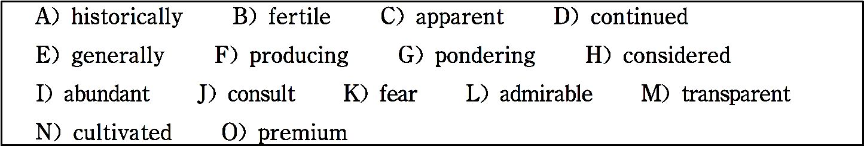
The People in Jiaxing
Jiaxing is located between Suzhou and Hangzhou. The follow- ing is what people said about it in the past: “It is known for its 1 land and the kindness of its people. It is a place where

Slide 368
one needs to 2 neither cold nor hunger. The people are not crafty schemers. They hold to what is just, and their diligence in agriculture and textiles is 3 . There, every piece of land is 4 , and the sound of looms never ceases.”
The people in Jiaxing are known to be kind, gentle, and intelli- gent. Their intelligence is not only 5 in their clever and re- fined manner, but also in their highly-skilled work. 6 speaking, agricultural and artisan techniques of Jiaxing people

Slide 369
were always of high standards and creativity. During the Yuan Dynasty, in addition to silk products, Jiaxing also produced 7 lacquerware and vessels of gold and silver. For example, the carved red lacquer made in Xitang and Silver Cups made by Zhu Bishan are 8 national treasures, and they put Jiaxing􀆳s craftsmanship on par with(与……平分秋色) that of Jiangsu and Hangzhou.
Since ancient times, Jiaxing has been known for 9 numer-

Slide 370
ous scholars, and this tradition has 10 to the present day. It became known as a place of cultural relics in the Song Dynasty, and even the common people were well-educated. Their cloth- ing was known to be beautiful. It was said that even in a village of just three houses, the classics would be sure to be found. They worked in the fields, yet they made sure their children were well-educated.
——From Spirit of the Red Boat, Lan Yingjie, Foreign Lan-

Slide 371
guages Press, 2017
(262 words)
Time required:8 minutes
Time used: minutes
Section C

Slide 372
In this section there is a passage followed by some questions or unfinished statements. For each of them choose the best answer from the four choices marked A, B, C and D.
South Lake: Classic Jiangnan Water Town
South Lake, which is located in the southeastern section of Jiax- ing City, not only boasts about its breathtaking landscape, but was also a witness to an important period of history. This place was also known as Luwei Pond, Machang Lake, and Biaohu

Slide 373
Lake during the Three Kingdoms Period. The lake is divided in- to two sections, one to the west and the other to the east, and to- gether, they look like two mandarin ducks with their necks crossed over each other. In ancient times, this lake was indeed a place where mandarin ducks lived, hence, it had another name: Mandarin Duck Lake. Beginning in the Song Dynasty, South Lake in Jiaxing, West Lake in Hangzhou, and Xuanwu Lake in Nanjing were collectively known as the “Three Great Lakes”

Slide 374
in Jiangnan Region, and they became popular tourist attractions for many people.
South Lake covers an area of over 53 hectares, and there are two artificial islands in the lake. One of them is Huxin Island (island at the heart of the lake), which is located in the center of the lake and has a collection of ancient buildings, and the most notable is Yanyu Pavilion(pavilion of mist and rain). The build- ings, closely situated and picturesquely arranged, make the is-

Slide 375
land look like a sparkling gem that has been inset into the lake. The other island is located in the northeastern part of the lake and is the site of the Cangsheng Shrine (also known as the “Lesser Yanyu Pavilion”).
In early August, 1921, the First National Congress of the CPC was concluded on a pleasure boat in South Lake. It was the place where the CPC was formally established. Thus, the Chi- nese Revolution set sail from South Lake, and Jiaxing became

Slide 376
the birthplace of the CPC.
——From Spirit of the Red Boat, Lan Yingjie, Foreign Lan- guages Press, 2017
(292 words)
1. The word “boasts” in the first paragraph means .
A. brags B. has C. talks about D. exaggerates

Slide 377
2. Which of the followings does not form part of the breathtak- ing landscape of South Lake?
A. Mandarin Duck Lake. B. Huxin Island.
C. Yangyu Pavilion. D. Cangsheng Shrine.
3. Why did South Lake become the birthplace of the CPC?
A. Because it not only boasts about its breathtaking landscape,

Slide 378
but it also witnessed an important period of history.
B. Because the Chinese Revolution set sail from South Lake.
C. Because Jiaxing is one of the most important cities in the Delta Region of the Yangtze River.
D. Because it was the place where the CPC was formally estab- lished.

Slide 379
4. What rhetorical device is used in the sentence (in paragraph 2) “The buildings, closely situated and picturesquely arranged, make the island look like a sparkling gem that has been inset in- to the lake” ?
A. Simile. B. Metaphor C. Metonymy. D. Personi- fication.
5. Why is South Lake known as the classic Jiangnan water

Slide 380
town?
A. Because from the Song Dynasty, South Lake, West Lake and Xuanwu Lake were collectively known as “Three Great Lakes” in Jiangnan Region.
B. Because the First National Congress of the CPC was con- cluded on a pleasure boat on South Lake.

Slide 381
C. Because it covers a large area of water.
D. Because it has the appearance of two mandarin ducks with their necks crossed over each other.
Time required: 8 minutes
Time used: minutes

Slide 382
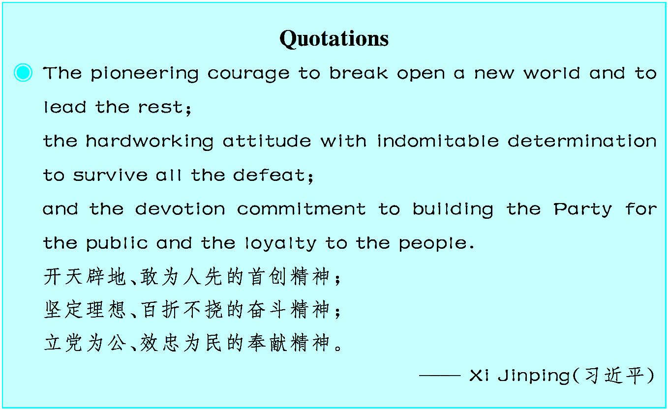

Slide 383
Unit 8
Chinese Philosophies
The Intellectual Foundations—Legalism¹,
Taoism² and Confucianism³

Slide 384
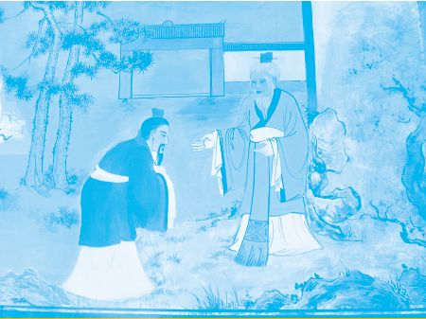
中国古代的主要哲学思想早在先秦时期就已经基本形成,如儒家、道家、法家、墨家等。 通过本文的学习,您就可以用英语向外国人介绍它们了。

Slide 385
There were three most influential⁴ schools⁵ of thoughts in traditional Chinese history: Legalism, Taoism, and Confucian- ism. They all aimed at the ideal of peace and harmony but their approaches were different.
Legalism aimed at the unity⁶ of the political kingdom and worked for peace and harmony of the empire⁷. The Legalists⁸ felt that human nature was selfish and inevitably produced con- flicts. Severe laws and punishments were the only means of

Slide 386
bringing them the order and security which they were eager for. The ruler could not rely on moral virtues⁹ but had to control the people by clearly defined rewards and punishments.^{①} Anyone who failed to achieve what he was assigned to do must be pun- ished. People were to be made “mutual¹0responsible” for one another􀆳s actions, and those who failed to denounce¹1 a law- breaker were to be considered guilty of the same crime. The Le- galists believed that if the penalties¹2 were made severe, the

Slide 387
people would be forced into complete obedience¹3 and that there would, in fact, be no penalties but order, unity, peace and har- mony. Their philosophy was designed to help the ruler in con- solidating¹4 his position and power. However, Legalism left a lasting mark on Chinese civilization. Through the triumph of Ch 􀆳in and the imperial¹5 system that Ch􀆳in created, it became a vi- tal part of Chinese society, accounting for the highly centralized ¹6 state of later times.^{②}

Slide 388
Directly opposite to Legalism was Taoism which laid stress on individual freedom and “being natural”. Although the politi- cal ideas of Taoism were opposite to Legalism, they aimed at order for great unity, and a universal¹7 organization of peace and harmony, too. They tried to destroy man-made things in or- der to achieve greater harmony. Primitivity¹8 was the ideal of the Taoists, and their expressive term for it was “pu” mean- ing literally an uncarved¹9 block of wood.^{③} The political ideal of

Slide 389
the Taoists was a small state from which the cocks and dogs of a nearby state could be heard,and where the people were so sat- isfied that none had ever bothered to visit the neighboring vil- lages. Taoism had served as an admirable balance wheel²0 to the dominant concepts of Chinese culture: the centralization of power which placed sharp limits on human freedom. But in Tao- ism, the individuals could achieve full self-expression and the intellect²1 of the Taoists was free to wander²2 at will²3.

Slide 390
Between the two extremes of Legalism and Taoism was Confu- cianism. While the “laws” of Legalism were impersonal and inhuman, and the “nature” of Taoism lacked control, Confu- cianism took care of both individual needs and social needs. In a broad sense, Confucianism may be said to be humanism²4. Confucianism aimed at peace and harmony and its key to solve human problems was “education”. By Confucian education, the teaching would have no alienation²5, no separation, no clas-

Slide 391
sification²6, no grading, all in all²7, no discrimination²8. In Con- fucianism, there were zhong (loyalty), xiao (filial piety²9), li (ritual³0), yi (righteousness³1), ren (benevolence³2) and ai (love). The balancing of inner virtues and external polish was characteristic of the “moderation³3” of Confucian ideas.
If we compare and contrast the three schools of thoughts on “individual freedom and control”, we would find that Taoism was extremely free, while Legalism was extremely strict with

Slide 392
Confucianism in the middle. On political theory and concepts of progress, Legalism was the most advanced and directing to the future, while Taoism was reactionary³4 and returning to the primitive nature with again Confucianism in the middle. Indeed, moderation and balance were perhaps the major reasons for the final triumph of Confucianism in traditional Chinese history.
—— http//ihome.cuhk.edu.hk/s050326/legalismtaoismconf.doc

Slide 393
(600 words)
Notes
① The ruler could not rely on moral virtues but had to control the people by clearly defined rewards and punishments.
统治者不能依靠高尚的品德而应通过明确的奖惩以控制人 民。

Slide 394
② Through the triumph of Ch􀆳in and the imperial system that Ch􀆳in created, it became a vital part of Chinese society, ac- counting for the highly centralized state of later times.
通过秦朝所取得的胜利和创建的帝国体系,法家思想成为中 国社会的重要组成部分,成为后来高度中央集权制国家产生 的根源。
③ Primitivity was the ideal of the Taoists, and their expressive

Slide 395
term for it was “pu” meaning literally an uncarved block of wood.
原始状态是道家的理想,他们用以表达的术语是“朴”,字面 意思是一块未经雕琢之木。
Exercises
Ⅰ. There are five questions or unfinished statements based on the passage. For each of them choose the best answer from the four choices marked A, B,

Slide 396
C and D.
1. Which one of the following does not belong to the Chinese ancient philosophies?
A. Taoism. B. Legalism.
C. Confucianism. D. Materialism.
2. According to Legalism, if your brother were found guilty of a certain crime, what would happen to you?

Slide 397
A. You would be punished because you were made mutual responsible for the crime.
B. You had nothing to do with the crime committed by your brother.
C. You should help to capture your brother in order to escape the punish- ment.
D. You could escape the punishment if you had fled away early.
3. What were the political ideas of Taoism?

Slide 398
A. Individual freedom and “being natural”.
B. Great unity and a universal organization of peace and harmony.
C. Greater harmony.
D. Primitivity.
4. According to Confucianism, is/are the key to solve human prob- lems.

Slide 399
A. punishment B. education
C. emperor D. law and order
5. Among the three schools of thoughts in traditional Chinese history, which one has the characteristic of the “moderation”?
A. Taoism. B. Legalism.
C. Confucianism. D. All of above.

Slide 400
Ⅱ. Fill in the blanks of the following sentences, using the words or phrases given below. Change the form where necessary.
influential account for mutual virtue universal
harmony achieve rely on criticize wander
1. He for his lack of leadership.
2. She was one of the most figures in local politics.

Slide 401
3. You may it that I shall help you.
4. Such problems are a feature of old ages.
5. The river through some beautiful countries.
6. The ability to recognize differences between facts and opinions can help us to a deeper level of understanding in our reading.
7. The cashier was asked to every penny of the money that was entrusted to him.

Slide 402
8. They seemed to have a happy life in with nature.
9. Bill disliked the man immediately, and the feeling was .
10. Among her many are loyalty, courage and truthfulness.
Ⅲ. Translate the following Chinese sentences into English.
1. 严刑峻法是实现他们渴望的长治久安的唯一手段。
2. 道家的政治理想是国小民安,鸡犬相闻,老死不相往来。

Slide 403
3. 儒家的“中庸”思想以内修外炼的平衡为特征。
4. 在传统的中国历史上,儒家思想最终获胜的主要原因是中庸和平衡。
Section A
In this section, you are going to read a passage with ten statements attached to it. Each statement contains information given in one of the paragraphs. I- dentify the paragraph from which the information is derived. You may choose a paragraph more than once. Each paragraph is marked with a letter.

Slide 404
Traditional Chinese Philosophy and
Traditional Chinese Medicine
A) Traditional Chinese medicine is based on the concept of the universe outlined in the philosophy of Taoism. Taoism is both a religion and a philosophy. Taoists searched for immortality (不 朽) by exploring the use of breathing exercises, meditation (冥 想) techniques, and herbal (药草的) or mineral material, which

Slide 405
had profound influence on the theoretical (理论的)development of traditional Chinese medicine.
B) Since 600 B.C., Taoists had observed the natural laws and their relationship to human beings for thousands of years. This observation yielded five basic principles:
There are natural laws that govern the universe.

Slide 406
·The natural order of the universe is harmonious and organized.
·The universe is dynamic (动态的);change is constant.
·All life is interconnected and interdependent.
·Humans are a part of the universe and are closely connected to the environment.
C) These principles form the foundations for Yin and Yang,

Slide 407
Five Elements and Qi. These concepts in turn became the theo- retical backbone of traditional Chinese medicine.
Yin and Yang
D) The theory of Yin and Yang said that all things have two opposite sides, Yin and Yang, which are both opposite and at the same time interdependent. Anything moving, hot, bright and hyperactive (极度活跃的) is Yang, and anything stagnant, cold, dim and hypoactive is Yin.

Slide 408
E) The Yin and Yang qualities of things are not absolute but relative, are not stationary but in constant motion. As an object or person changes, so do the Yin and Yang components. For example,as night (Yin) fades it becomes day (Yang), and as Yang fades it becomes Yin. Yin and Yang are therefore changing into each other as well as balancing each other.
F) Yin and Yang each have their own areas within the human body. Yin con- trols the internal and the lower part of the body; while Yang dominates the external and the upper part. Half of the vital organs (器官) belong to Yin and half to Yang. A healthy person is in a state of harmony and such a state of

Slide 409
harmony is a balance between Yin and Yang. When this balance is de- stroyed, we will feel ill and diseases will occur. By correcting the Yin Yang imbalance, the body can return to a healthy state.
Five Elements
G) The concept of Five Elements is an integrated part of Yin Yang Theory. Five Elements are a tool used to explain the physiological (生理的) and pathological (病理的) relationship between the internal organs, their rela- tionship with the environment, the treatment and the property of herbs. The Five Elements are symbolic representations of basic forces. Huang Ti Nei

Slide 410
Ching states the five elements Wood, Fire, Earth, Metal and Water include all the phenomena of nature.
H) The most important part of these forces is their interplay. These forces in- teract in specific patterns according to their natural relationships. Each force has a generative (能生产的) influence on another force and, in turn, is gen- erated by a different one.
I) The generative cycle proceeds as follows:
·Wood burns to generate Fire.

Slide 411
·Fire produces ashes, which generates Earth.
·Earth generates Metal, which is mined under the ground.
·When heated, Metal becomes molten, like Water.
·Water promotes growth of plants, making Wood.
J) By nature, each vital organ of human beings belongs to one of the Five El- ements. For example, heart and small intestine (肠) are categorized (将…… 分类) as Fire, spleen (脾) and stomach are categorized as Earth, lungs and

Slide 412
large intestine are categorized as Metal, kidneys (肾) and urinary bladder (膀 胱) are categorized as Water, and liver and gallbladder (胆囊) are catego- rized as Wood.
K) Using these generative cycles, Chinese doctors were able to explain how vital organs interact and influence each other. For example, the heart (corre- sponding to Fire) is the producer of spleen (corresponding to Earth), so when the heart is weakened by a weakening liver (corresponding to Wood), the spleen may also be weakened through the heart. Therapy (治疗) is therefore based on stimulating or inhibiting certain reactions caused by these Five El-

Slide 413
ements correspondences.
Qi
L) Qi is a complex concept. Qi literally means breath or air and is the essen- tially vital energy in all forms of life. There are different forms of Qi. Dis- tinctive prefix is added to Qi to describe its nature. Qi is both transferable and transmutable (可变形的). For example, digestion extracts Qi from food and then transfers the energy to the body; breathing extracts Qi from air and transfers it to the lungs. These two forms of Qi change in the bloodstream to become human Qi which then moves throughout the body as vital energy. It

Slide 414
is the quality, quantity and the balance of Qi that determine the state of health.
M) Another concept of Qi is often associated with the invisible, intercon- nected channels called meridians (经络) under the skin. There are 12 main meridians, six of which are Yin and six are Yang, which form a network through which Qi moves throughout the body. Each meridian is named after an organ or function: lung, kidney, gallbladder, stomach, spleen, heart, small intestine, large intestine, liver, urinary bladder and pericardium (心包).
N) When the flow of Qi is interrupted along the path of meridian, illness oc-

Slide 415
curs. The symptoms of a diseased organ can be detected through the inter- connected meridians. A combination of proper diet, exercise, breathing tech- niques, acupuncture (针灸), and use of herbal medicine help to restore the diseased organ to its original natural function, thereby corrects the imbalance of vital energy.
—— http://www.virtualsciencefair.org/2003/lijam3j/public_html/theory.html
(882 words)
1. The idea of the universe summarized in the philosophy of Taoism

Slide 416
is the main foundation of the traditional Chinese medicine.
2. Yin, Yang, Five Elements and Qi are the main theories to support traditional Chinese medicine.
3. In order to be immortal, Taoists took such measures as the use of breathing exercises, the application of meditation techniques and the practice of herbal or mineral material.
4. According to the theory of Yin and Yang, the head is controlled by Yang.

Slide 417
5. Six Yin meridians and six Yang ones form a network through which Qi moves throughout the body.
6. Five Elements can be used to explain the human relationship with the environment.
7. Large intestine belongs to metal according to traditional Chinese medicine.
8. Five Elements can be used to explain the physiological and patho- logical relationship between the internal organs.

Slide 418
9. The quality, the quantity and the balance of Qi determine whether one is healthy or not.
10. The diseased organ can be restored to its original natural function through proper diet, exercise, breathing techniques, acupuncture and herbal medicine.
Time required: 15minutes
Time used: minutes

Slide 419
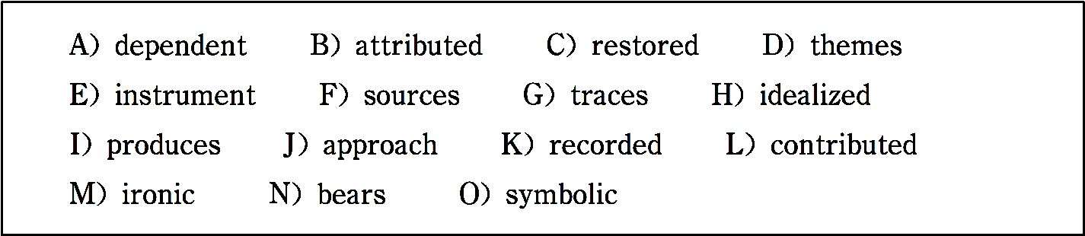
Section B
In this section, there is a passage with ten blanks. You are required to select one word for each blank from a list of choices given in the word bank. Read the passage through carefully before making your choices. You may not use any of the words in the bank more than once.
Better known in China as “Master Kong” (Chinese: Kongzi), Confu-

Slide 420
cius was a fifth-century B.C. Chinese thinker whose influence upon East Asian intellectual and social history is immeasurable. As a culturally 1 figure, he has been alternately 2 , deified (神化), dismissed, abused, and 3 over thousands of years by both Asian and non-Asian thinkers and regimes. Given his extraordinary impact on Chinese, Korean, Japanese, and Vietnamese thought, it is 4 that so little can be known about Confucius. The tradition that 5 his name — “Confucianism” (Chinese: Rujia) — ultimately traces itself to the sayings and biographical fragments 6 in the text known as the Analects (Chinese: Lunyu). As to Confucius himself, scholars disagree about the origins and character of the Analects, but it re-

Slide 421
mains the traditional source for information about Confucius􀆳 life and teach- ing. Most scholars remain confident that it is possible to extract (提取,引用) from the Analects several philosophical 7 and views that may be safely 8 to this ancient Chinese sage. These are primarily ethical, rather than analytical — logical or metaphysical (形而上学的) in nature, and include Confucius􀆳 claim that Tian (“Heaven”) is aligned (使结盟,使一致) with moral order but 9 upon human agents to actualize its will; his concern for li (ritual propriety) as the 10 through which the family, the state, and the world may be aligned with Tian􀆳s moral order; and his belief in the “contagious” nature of moral force, by which moral rulers spread morality

Slide 422
to their subjects, moral parents raise moral children, and so forth.
——http://www.iep.utm.edu/confucius
(246 words)
Time required: 8 minutes
Time used: minutes
Section C

Slide 423
In this section there is a passage followed by some questions or unfinished statements. For each of them choose the best answer from the four choices marked A, B, C and D.
Chinese Culture and Traditions
China has enjoyed a long and rich history. Much of the culture and traditions of China have come down through the ages large- ly unchanged. It is a culture full of beauty, balance, creativity and contrasts. Although visitors to modern China will see the

Slide 424
modern world on the forefront, an abundance of traditional Chi- nese culture still permeates (渗透) the lives of Chinese citizens.
Philosophy/Values
Traditional Chinese philosophy is derived from a combination of several schools of thought that were developed based on the teachings of scholars, philosophers and thinkers. The most common sources are Confucianism, Buddhism and Taoism. Chinese philosophy centers around moral ethics, benevolence, wisdom, family and harmony. Heavy emphasis is also placed

Slide 425
on honoring ancestors. Chinese philosophy values the “internal” and views human desires as less important. These values are applied to all as- pects of Chinese society.
Martial Arts
Although traditional Chinese philosophy values benevolence and coopera- tion, martial arts is among the traditions associated with Chinese culture. The Chinese have been practicing martial arts for thousands of years. Martial arts is a distinct sport because it helps the development of the mind and the muscles. Martial arts presents a contrast between fierce fighting techniques

Slide 426
and mental cultivation. It also serves as a form of exercise and physical con- ditioning to promote health, energy and strength.
Art
Chinese art is appreciated all over the world. Chinese artists are skilled in a variety of mediums and techniques including painting and calligraphy. Chi- nese paintings are known, admired and respected for their graceful strokes and fine detail. Traditional subjects of Chinese paintings include serene (宁 静的) landscapes and aspects of nature such as plants and animals. Chinese calligraphy is as well known as other painting techniques. To create works of

Slide 427
calligraphy, artists must possess a sharp eye and a steady hand.
Food
For the Chinese people dining is more than just satisfying hunger. In tradi- tional Chinese culture, food is viewed as a form of art. From the ingredients used to the preparation techniques, Chinese chefs emphasize the beauty as well as the taste of food. Traditional Chinese culture also emphasizes the medicinal aspects of food. In addition to having visual appeal and delicious flavoring, Chinese food also seeks to promote health and is used to treat a variety of illnesses.

Slide 428
——http://www.ehow.com /about_5076891_chinese-culture-traditions.html
(372 words)
1. What can visitors enjoy when they visit China according to the passage?
A. They can enjoy both a modern prosperous China and rich Chinese culture.
B. They can learn a great deal about Chinese philosophy.

Slide 429
C. They can enjoy many Chinese foods and arts.
D. They can learn different kinds of Chinese martial arts, such as Taiji and Qigong.
2. Where does traditional Chinese philosophy come from?
A. Long and rich traditions.
B. A combination of different cultures.

Slide 430
C. A variety of eastern and western values.
D. A collection of several schools of thought, such as Confucianism, Bud- dhism and Taoism.
3. Why is martial arts a different sport?
A. Because it symbolizes a contrast between violent fighting skills and men- tal alertness.
B. Because it is a form of exercise promoting health.

Slide 431
C. Because it practices your mind and body.
D. Because it helps you become more aggressive and boastful.
4. Why are Chinese paintings known and admired?
A. Because they need a sharp eye and a steady hand.
B. Because they cost painters much energy.
C. Because they require elegant strokes and fine detail.

Slide 432
D. Because there are many natural landscapes in them.
5. Chinese food mainly focuses on all the following except .
A. satisfying hunger
B. heavy protein and vitamins
C. the medicinal aspects of food
D. the beauty as well as the taste of food

Slide 433
Time required: 8 minutes
Time used: minutes

Slide 434
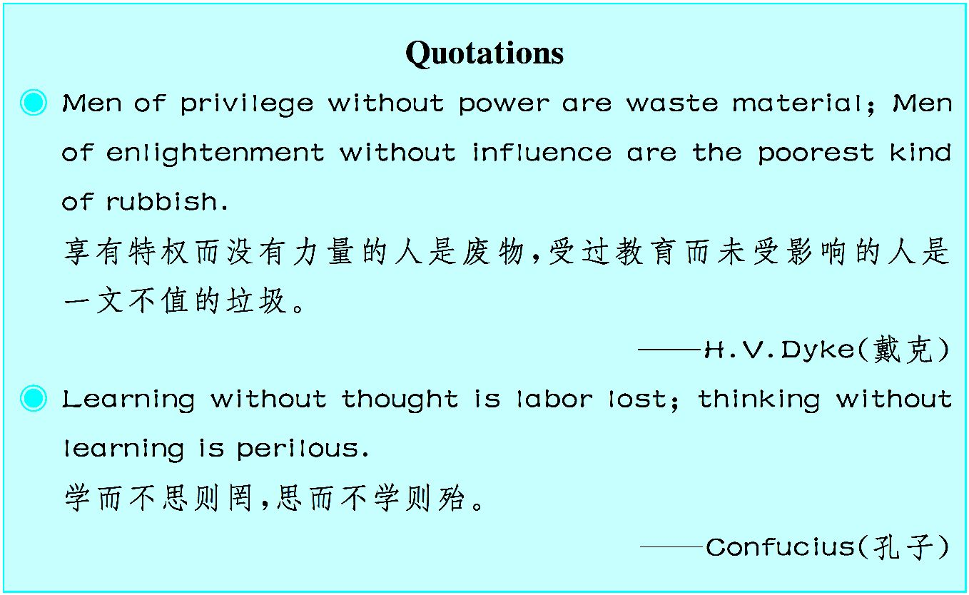

Slide 435
Unit 9
Chinese Kungfu
An Introduction to Chinese Kungfu

Slide 436
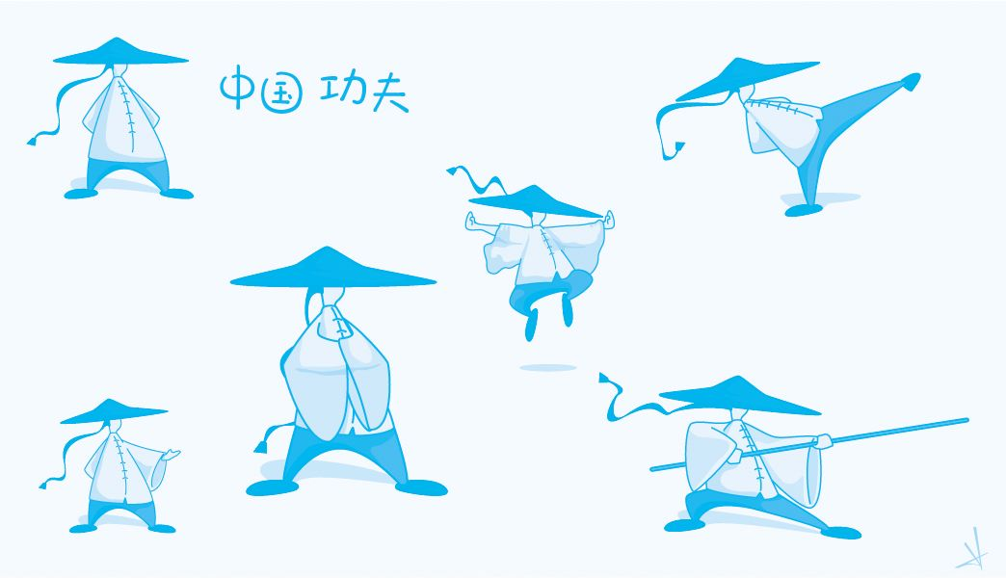
武术不只是踢打蹦跳,其中还蕴含着中国的民族精神和道德观念。对中国武术很感兴趣的 西方人也不少,学习了本课,您可以试着用英语向他们说说中国功夫。

Slide 437
Brief history
Kungfu is a term that has been borrowed into English to refer to Chinese martial arts¹. According to legend², Chinese martial arts originated³ during the semi-mythical⁴ Xia Dynasty more than 4,000 years ago. It is said the Yel- low Emperor introduced the earliest fighting systems to China. The earliest references to Chinese martial arts are found in The Spring and Autumn An- nals (5th century B.C.), where a hand to hand combat⁵ theory is men- tioned.^{①} A combat wrestling⁶ system called Jueli is mentioned in the Classic of Rites. Jueli became a sport during the Qin Dynasty (221 B.C.~207 B.C.).

Slide 438
Starting from the Tang Dynasty (618~907), Kungfu examination was pro- posed⁷ and implemented⁸. The Song (960~1279) and Yuan (1206~1368) Dy- nasties witnessed the climax of Kungfu development. The modern concepts of Kungfu were fully developed by the Ming (1368~1644) and Qing (1644~ 1912) Dynasties.
Philosophical⁹ influences
The ideas associated with Chinese martial arts changed with the evolution of Chinese society and over time acquired some philosophical bases from the Zhuangzi concerning the psychology and practice of martial arts and the Tao

Slide 439
Te Ching, another Daoist text that contains principles applicable¹0 to martial arts. According to one of the classic texts of Confucianism, Zhou Li, archery¹ 1 and charioteering¹2 were part of the “six arts”^{②}, including rites, music, calligraphy and mathematics of the Zhou Dynasty (1122 B.C.~256 B.C.).
Daoist practitioners¹3 have been practicing Tao Yin^{③}, physical exercises sim- ilar to Qigong from as early as 500 B.C. Also, the noted physician, Hua Tuo, composed¹4 the “Five Animals Play”^{④} — tiger, deer, monkey, bear, and bird, around 220 A.D.. Daoist philosophy and their approach to health and exercise have influenced the Chinese martial arts to a certain extent. Direct

Slide 440
reference to Daoist concepts can be found in such styles as the “Eight Im- mortals”^{⑤} which uses fighting techniques that are attributed¹5 to the charac- teristics of each immortal.
Shaolin and temple-based martial arts
The Shaolin style of Wushu is regarded as among the first institutionalized¹6 Chinese martial arts. The oldest evidence of Shaolin participation in combat is a stele¹7 from 728 A.D. that gives evidence of a defense of the Shaolin Temple from robbers around 610 A.D.. Between the 16th and 17th centuries, no fewer than forty sources exist to provide evidence both that monks of

Slide 441
Shaolin practiced martial arts, and that martial practice became an integral¹8 element of Shaolin monastic life.
References of martial arts practice in Shaolin appear in various literary styles of the late Ming: martial-arts manuals¹9, military encyclopedias, historical writings, fiction and poetry. These sources, in contrast to those from the Tang period, refer to Shaolin methods of armed combat. This include a skill for which Shaolin monks had become famous — the staff²0. The Ming Gen- eral Qi Jiguang included description of Shaolin Quan Fa and staff techniques in his book.

Slide 442
Martial morality²1 and culture
Traditional Chinese schools of martial arts, such as the famed Shaolin monks, often dealt with the study of martial arts not just as a means of self- defense or mental training, but as a system of ethics.^{⑥}Martial morality deals with two aspects: morality of deed and morality of mind. Morality of deed concerns social relations; morality of mind is meant to cultivate the inner harmony between the emotional mind and the wisdom mind. The ultimate goal is reaching “no extremity²2”, where both wisdom and emotions are in harmony with each other.

Slide 443
References to the concepts and use of Chinese martial arts can be found in popular culture. Historically, the influence of Chinese martial arts can be found in books and in the performance arts specific to Asia. Recently, those influences have extended to the movies and television that targets a much wider audience. As a result, Chinese martial arts have spread beyond its eth- nic roots and have a global appeal.
——http://en.wikipedia.org/wiki/Chinese_martial_arts
(619 words)

Slide 444
Notes
① The earliest references to Chinese martial arts are found in The Spring and Autumn Annals ⁽5th century B.C.), where a hand to hand combat theory is mentioned.
《春秋》(公元前 5 世纪)中最早提到中国武术以及肉搏战理论。
② six arts

Slide 445
六艺,指中国古代儒家要求学生掌握的六种基本才能:礼、乐、射、御、 书、数。
③ Tao Yin
导引:古代的一种健身方法,由意念引导动作,配合呼吸,由上而下或由下 而上地运气。相当于现在的气功或体育疗法。
④ Five Animals Play
五禽戏,是通过模仿虎,鹿,熊,猿,鸟(鹤)五种动物的动作,以保健强身的一

Slide 446
种气功功法。这是中国古代医学家华佗在前人的基础上创造的,故又称 华佗五禽戏。
⑤ Eight Immortals
八仙,是指民间广为流传的道教八位神仙:铁拐李、汉钟离、张果老、何 仙姑、蓝采和、吕洞宾、韩湘子、曹国舅。
⑥ Traditional Chinese schools of martial arts, such as the famed Shaolin monks, often dealt with the study of martial arts not just as a means of self-defense or mental training, but as a system of ethics.

Slide 447
传统的中国武术各大流派,如著名的少林和尚,经常研究武术。(他们)不 仅仅(把武术)当作自卫或心理训练的手段,也当作伦理系统进行研究。
Exercises
Ⅰ. There are five questions or unfinished statements based on the passage. For each of them choose the best answer from the four choices marked A, B, C and D.
1. According to the text, when was Chinese Kungfu first referred to in a book?

Slide 448
A. More than 4,000 years ago. B. 5th century B.C..
C. 221 B.C.~207 B.C.. D. 618~907.
2. When did Kungfu make the greatest achievement in its development?
A. In the Tang Dynasty.
B. In the Ming and Qing Dynasties.
C. In the Qin Dynasty.

Slide 449
D. In the Song and Yuan Dynasties.
3. What can be inferred about Hua Tuo from the passage?
A. Hua Tuo was not a Daoist practitioner.
B. Hua Tuo was only a noted physician.
C. Hua Tuo was a Daoist practitioners as well as a famous physician.
D. Hua Tuo was either a Daoist practitioner, or a noted physician.

Slide 450
4. We can know from the passage that .
A. The literary sources in the Tang Dynasty refer to Shaolin methods of armed combat.
B. The literary sources in the Ming Dynasty do not refer to Shaolin methods of armed combat.
C. The literary sources in the Tang Dynasty do not refer to Shaolin methods of armed combat.

Slide 451
D. The literary sources around 610 A.D. refer to Shaolin methods of armed combat.
5. The underlined word “monastic” in paragraph 4 means .
A. connected with monks B. connected with fighting
C. complex and noisy D. simple and quiet
Ⅱ. Fill in the blanks in the following sentences, using the words or phrases given below. Change the form where necessary.

Slide 452
manual staff attribute principle in harmony with
ultimate compose propose implement in reference to
1. Almost unconsciously she dressed this note of simplici- ty.
2. She began to songs when she was very young.
3. I have nothing to say that incident.

Slide 453
4. Her designs will be put on ice (搁置起来) until money is available to them.
5. I have arranged that one of my will meet you at the airport.
6. A is a book which tells you how to do something or how a piece of machinery works.
7. We adhere to the that everyone should be treated fairly.
8. Our objective is the removal of all nuclear weapons.

Slide 454
9. It was George who first that we dry clothes in that locker.
10. Most historians such declines to wars and conquests.
Ⅲ. Translate the following Chinese sentences into English.
1. 中国武术起源于古代的摔跤与搏斗。
2. 该理论最早见于他在1920年出版的《科学和自然》这部著作中。
3. 这些报告,不同于网上的那些,提到他早年艰苦的训练和取得的成就。

Slide 455
4. 中国武术是中国所特有的一种表演艺术。
Section A
In this section, you are going to read a passage with ten statements attached to it. Each statement contains information given in one of the paragraphs. I- dentify the paragraph from which the information is derived. You may choose a paragraph more than once. Each paragraph is marked with a letter.
Benefits of Studying Wushu

Slide 456
Health and fitness
A) Wushu is one of the few sports/exercises that one can participate in. It will build all the sought-after (很受欢迎的,吃香的) aspects of fitness, name- ly, all-around strength, flexibility (柔韧性), balance, coordination, stamina (耐力), reflexes and body awareness — all wrapped up into one fun exciting package!
Self-defense
B) Self-defense is one of the first reasons many people will consider when

Slide 457
taking martial arts classes. In fact, it􀆳s probably safe to say that most people believe it is the point of taking such a class. However, Wushu, as a fighting system, will take many years of practice and repetition before it can serve as a self-defense system. And this is true of any martial arts — Chinese, Japanese, Korean, Brazilian. While the other benefits of taking martial arts classes (fitness, discipline, challenge, etc.) have immediate results, a martial arts system takes years of learning before it can be used effectively to fight with. Self-defense classes, women􀆳s in particular, generally have a different aim from martial arts classes. They try very hard to teach confidence, aware- ness, confrontation skills and a few simple strikes in a very short period of

Slide 458
time, in order to make the average person more likely to be able to defend themselves in case of a physical attack. Journals have shown that a large number of attacks can be avoided by using good verbal (言语的) and spatial (空间的) skills and that is what a good self-defense class should focus on. That being said, taking Wushu classes does tend to raise confidence fairly quickly — which raises awareness — and you are constantly learning tech- niques that, given enough practice, will be much more effective than any technique you could learn in a “self-defense” class, as long as you are willing to put in time. Most Wushu Guan (武术馆) teach the practical appli- cation for every technique you want to learn, so deciding to take a Wushu

Slide 459
class for self-defense is fine as long as you are aware of the difference and can enjoy the other aspects of practicing it until proficiency (熟练) is reached.
Self-confidence
C) What may be the most important benefit of martial arts training is the in- creased self-confidence one gains while training. How you see yourself di- rectly affects how you carry yourself, and that influences how others see you. A person with a great deal of self-confidence is more likely to speak up and make his opinions known, more likely to stand up for himself, and less

Slide 460
likely to let an opportunity pass him by. A high self-confidence is also an ef- fective form of self-defense, as a person who carries himself with pride is less likely to be chosen as a victim than one who is timidly (胆怯地) creep- ing along, hoping no one notices him.
Self-discipline
D) Learning self-discipline and focus is another reason many people study Wushu, and a primary reason many parents will place their children in it. Wushu teaches self-discipline and focus very naturally. It is the side effect of learning to use our mind to make our body do things that are not always

Slide 461
comfortable. Surely it would not injure your body, and even astonishing re- sults would be achieved if you ask more of yourself to do that under the guidance of a trained instructor. In fact, one of the most well-kept secrets of people who study Wushu is the feeling of satisfaction that comes from know- ing that you have mastery over your body and that anything you set for your- self have accomplished. That􀆳s a healthy understanding that can benefit any- one at any age!
Competitions
E) Some people love the structure of sports and enjoy training for competi-

Slide 462
tions for the love of challenges. Many people will play all through college and then suddenly find there are no more structured sports offered to them. They may try to get together with friends but find it difficult to keep things going on an informal basis. Wushu as a sport has been organized for some time and there are both national and international Wushu competitions. In fact, Wushu is on the docket (在考虑中) to become an Olympic sport and will be an exhibition sport in the 2008 Beijing games. Competitions are comprised (由……组成) of floor routines (自由套路) (similar to a gymnas- tics competition) with empty hands and weapons as well as Sanshou (散手),a type of sparring (拳击) and are divided by age and levels from beginner to

Slide 463
master, so anyone who desires can start competing after a few months of training.
Comradeship
F) When you are surrounded by people with the same interest as you, who can appreciate how hard you are working to make improvements in your Wushu, a natural comradeship develops. Many of our students actually name the social aspect as one of the main reasons they keep coming back. As a Wushu practitioner (实践者) you do not rely on your teammates to win or get better, which is up to you and how hard you are willing to train. Howev-

Slide 464
er, their support is still there and makes learning and growing much more en- joyable.
G) Martial arts training has so many great benefits covering physical, mental and emotional aspects that it􀆳s no wonder why it has become one of the most popular activities for both adults and children. However, it is important to point out that not all martial arts programs will produce the range of benefits discussed. Programs that teach just combat fighting techniques may not re- sult in the desired mental and spiritual benefits so it is important to search around for the right martial arts training center that will offer the benefits one

Slide 465
wishes to achieve.
—— http://www.chicagowushu.com
(916 words)
1. It will take learners many years to practice Wushu before they can defend themselves.
2. Wushu can bring us strength, flexibility, balance, stamina and in- stin-ctive reaction as far as fitness is concerned.

Slide 466
3. When a lady takes a self-defense class, she will master confronta- tion skills and a few simple strikes in a very short period of time.
4. The feeling of his mastery over his body and of his accomplish- ment of his goals can benefit anyone at any age when he practices Wushu.
5. One of the most important benefits of martial arts training is the gained self-confidence while training.
6. Because there are different levels of competition, anyone who de- sires can start competing after a short period of time of training.

Slide 467
7. Wushu has become one of the most popular activities for both adults and children mainly because martial arts training has many benefits.
8. When we learn to use our mind to make our body do things that are not always comfortable, the side effect is self-discipline.
9. Many college students find there are no more structured sports of- fered to them, so they try to get together with friends but finally find it diffi- cult to keep things going on an informal basis.
10. During martial arts training, comradeship makes learning and

Slide 468
growing much more enjoyable.
Time required: 15 minutes
Time used: minutes
Section B
In this section, there is a passage with ten blanks. You are required to select one word for each blank from a list of choices given in the word bank. Read the passage through carefully before making your choices. You may not use

Slide 469
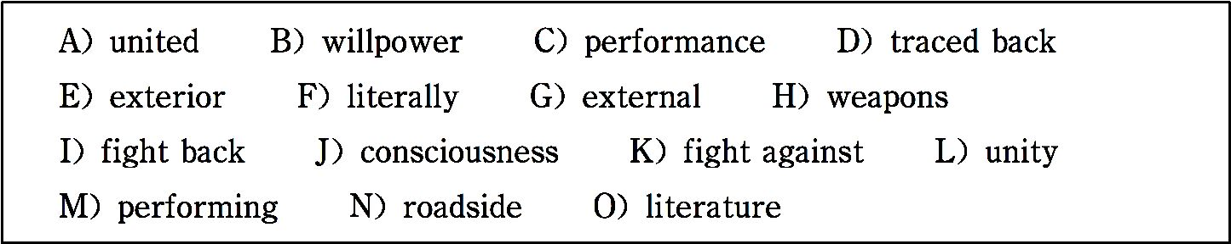
any of the words in the bank more than once.
Brief Introduction to Wushu (Chinese Kungfu)
Most visitors to China are deeply impressed by the enormous popularity of Wushu in this country. Going out early in the morning, they can see people doing this traditional form of ex-

Slide 470
ercise barehanded or with 1 in parks and on 2 open grounds.
Wushu, which 3 means “martial arts” and is sometimes called “Kungfu” abroad, may be 4 to pre-historical times when our ancestors had to 5 wild animals and among themselves for existence and subsistence. Wushu is a very im- portant aspect that represents the spirit of Chinese culture and art. According to the philosophy of traditional Chinese

Slide 471
medicine, Wushu exercises consist of both “ 6 ” and “in- ternal” work, the former meaning movements of the body, the hands and the feet and expressions of the eyes, and the latter be- ing related to “the spirit, 7 , vital energy and strength.” The two aspects are combined as movements guided by 8 so as to achieve “a 9 of body and mind”.
Wushu is very rich in form and content, encompassing (包含) hundreds of styles and thousands of routines, each with its own

Slide 472
special features.
However, as Wushu is becoming worldwide popular, it􀆳s a common wish of all Chinese people to watch kungfu competi- tions at the Beijing Olympic Games. In 2008 Olympic Games, Wushu is not an official event nor a 10 event, but it is al- lowed to hold an international competition with the permission of Olympic Organizing Committee.

Slide 473
——http://www.china-fun.net/2008/history/20061220/011711. shtml
(238 words)
Time required: 8 minutes
Time used: minutes
Section C

Slide 474
In this section there is a passage followed by some questions or unfinished statements. For each of them choose the best answer from the four choices marked A, B, C and D.
Shaolin Wushu (Shaolin Martial Arts) is one of the most influential types of Chinese martial arts, and it􀆳s named after the Shaolin Temple located in Dengfeng County, Henan Province. It is famous both at home and abroad, as a highly effective method of self-defense and health-building. Combining both external and internal, and “hard” and “soft” exercises, Shaolin Wushu involves various methods of fighting techniques, consisting of bare-

Slide 475
handed boxing and weaponry combat. The Shaolin boxing has compactly (紧 凑地) designed routines (成套动作). Its movements are quick, powerful and flexible — both practical for defense and attack.
The most distinctive characteristic of Shaolin boxing is that the practitioner works on one straight line. It means that his movements of advancing, re- treating, turning around, or jumping are restrained on one line. His arms are kept slightly bent so that he can stretch out to attack or withdraw freely for self defense. Another characteristic of Shaolin Wushu is to maintain the body in perfect balance, as stable as a mountain. The practitioner should

Slide 476
keep a calm mind but strike with great force and speed. He should be good at “borrowing” force from the opponent (对手). That is, he should not meet the opponent􀆳s strikes head-on, but take advantage of the striker􀆳s force and go along with it to bring him to ward off a force of a thousand weights. The practitioner should know how to make feigned strikes (佯攻) and when strik- ing, hit the vital parts of the opponent. The movements should be as skillful as a cat, the shaking as a tiger, the moving as a dragon, the advancing as lightning and the yelling as thunder.
Shaolin Wushu is a very convenient sport, for the practice does not need a

Slide 477
large space and is not affected by weather or the kind of weapons used.
There are many routines. External exercises include Minor Hong Boxing, Greater Hong Boxing, Old Hong Boxing and Chang Boxing etc.; for internal exercises there are Xingyi Boxing and Juji Boxing. Shaolin boxing can be practiced singly or in pairs. The dual routines include: Yaoshou Liuhe Box- ing and Kick and Strike Liuhe Boxing.
—— http://www.estudychinese.com
(351 words)

Slide 478
1. Why is Shaolin Wushu so famous at home and abroad according to this passage?
A. Because it can provide the practitioners with both courage and strength.
B. Because it can strengthen the practitioners􀆳 bodies and defend them- selves.
C. Because it was passed down from ancient China and should be passed on.
D. Because it has compactly designed routines.

Slide 479
2. A practitioner can withdraw freely for self-defense because he .
A. keeps balance
B. stands on one straight line
C. keeps his arms slightly bent
D. yells as loud as thunder
3. Which of the following statements is true?

Slide 480
A. The practitioner should not keep a calm mind.
B. The practitioner should not meet the opponent􀆳s strikes head-on.
C. The practitioner should not “borrow” force from the opponent.
D. The practitioner should not know how to make strikes.
4. The underlined phrase “ward off” in paragraph 2 probably means .

Slide 481
A. turn aside B. defeat
C. endure D. fight bravely
5. Which of the following can serve as the best title of this passage?
A. Characteristics of Shaolin Wushu.
B. Different Routines of Shaolin Wushu.
C. The Origin of Shaolin Wushu.

Slide 482
D. An Introduction to Shaolin Wushu.
Time required: 8 minutes
Time used: minutes

Slide 483
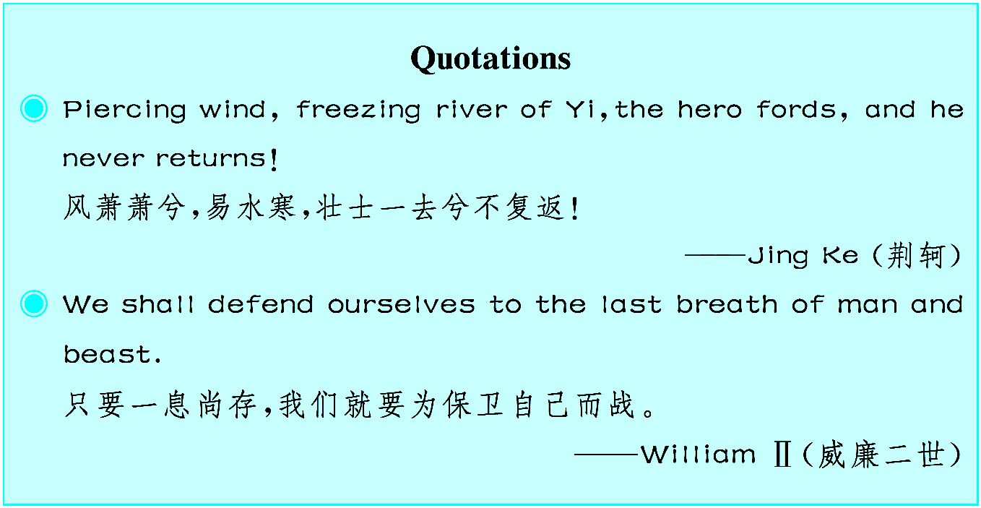

Slide 484
Unit 10
Non-verbal¹ Communication
Non-verbal Communication

Slide 485

由于受到不同地域和文化的影响,世界各国、各民族的肢体语言不尽相同,从本文中您可以 了解到其形成的社会的以及人们心理上的原因。

Slide 486
If anyone asks you what are the main means of communication between people, what will you say? That isn􀆳t a catch question.^{①} The answer is sim- ple and obvious. It would almost certainly refer to means of communication that involve the use of words. Speakers and listeners use the means of oral² communication, and writers and readers use the means of written communi- cation. There is, however, another form of communication which we all use most of the time, usually without knowing it. This is sometimes called body language or non-verbal communication (NVC for short).^{②}
When someone is saying something with which he agrees, the average Euro-

Slide 487
pean will smile and nod approval. On the other hand, if you disagree with what they are saying, you may frown³ and shake your head. In this way you signal your reactions, and communicate them to the speaker without saying a word. We referred a moment ago to “the average European”, because body language is very much tied to culture, and in order not to misunder- stand, or not to be misunderstood, you must realize this. A smiling Chinese, for instance, may not be approving but somewhat embarrassed⁴.
Quite a lot of work is now being done on the subject of NVC, which is obvi- ously important, for instance, to managers, who have to deal every day with

Slide 488
their staff⁵, and have to understand other people􀆳s feeling. Accordingly⁶, body language is sometimes categorized⁷ into five kinds:
① body and facial⁸ gestures;
② eye contact;
③ body contact or “proximity⁹”;
④ clothing and physical appearance;

Slide 489
⑤ the quality of speech.
You are expected to understand all those, except perhaps “proximity” which simply means “closeness”. In some cultures this is a cultural fea- ture¹0and not an individual one and it is quite normal for people to stand close together, or to more or less thrust¹1 their faces into yours when they are talking to you. In other cultures, this is disliked; Americans, for instance, always talk about invasion¹2 of their space.
Some signals are probably common to all of us. If a public speaker (like a professor, for example) is all the time fiddling with a pencil, or with his

Slide 490
glasses while he is talking to you, he is telling you quite clearly that he is nervous. A person who holds a hand over his mouth when he is talking is signaling that he is lacking in confidence. If you start wriggling¹3 in your chairs, looking secretly at your watches or yawning¹4 behind your hands, we shall soon get the message that I am boring you. We􀆳re sure you could make a whole list of such signals — and it might be fun if you did.
All the signals mentioned so far can be controlled. If you are aware that you are doing these things, you can stop. You can even learn to give false signals. Most public speakers are in fact nervous, but a good speaker learns to hide

Slide 491
this by giving off signals of confidence. Other kinds of NVC, eye contact, for instance, are not so easy to control. Unless you are confessing¹5 intense love, you can hardly look into someone else􀆳s eyes for quite a long time. If you try it, you􀆳ll find they will soon look away, probably in embarrassment.
We􀆳ve already mentioned proximity, so now we will give a brief word about our last two categories, which concern the way people dress and the way they speak. These are both pretty obvious signals. People may dress casually ¹6 and speak casually, which signals that they are relaxed. Or they can dress formally and speak formally, showing their tenseness. In fact, non-verbal

Slide 492
communication can, as the saying goes¹7, speak volumes.
—— http://www.estudychinese.com
(613 words)
Notes
① That isn􀆳t a catch question.
那不是刁难的问题。

Slide 493
② Body language or non-verbal communication (NVC for short).
身体语言或者非语言交际(简称NVC)。
Exercises
Ⅰ. There are five questions or unfinished statements based on the passage. For each of them choose the best answer from the four choices marked A, B, C and D.
1. Traditionally, is(are) regarded as the means of communica-

Slide 494
tion.
A. oral communication
B. written communication
C. non-verbal communication
D. both A and B
2. According to paragraph 2, when a Chinese is smiling, he or she may be

Slide 495
.
A. happy
B. embarrassed
C. approving
D. shy
3. Which of the following does not belong to non-verbal communication?

Slide 496
A. When you understand what the teacher is saying, you show an interested look.
B. He glared at his teacher when he was scolded.
C. The bride is always dressed in red on the wedding day in China.
D. The students are asked to hand in their homework early in the morning.
4. When a listener looks secretly at his watch or yawns behind his hands, he gives the speaker the message that .

Slide 497
A. what he is saying is uninteresting
B. what he is saying is interesting
C. he wants to sleep
D. he has an important thing to do
5. The phrase “speak volumes” in the last paragraph probably means “ ”.

Slide 498
A. speak loudly
B. express something very clearly with the use of words
C. express something very clearly without using words
D. express one􀆳s opinion loudly
Ⅱ. Fill in the blanks in the following sentences, using the words or phrases given below. Change the form where necessary.

Slide 499
frown refer to involve feature confess
approval embarrass give off thrust … into staff
1. I climbed the ladder, heard my dive(跳水) announced, and started the moves that would me the air.
2. He at her anxiously.
3. The weekend party is an interesting of college life.

Slide 500
4. The chairman has also given his for an investigation into the case.
5. When I said that some people are stupid, I wasn􀆳t you.
6. Arthur seemed by the question.
7. If there was a cover-up, it people at the very highest levels of government.
8. The man finally to having told a lie to the manager of the hotel.

Slide 501
9. Natural gas less carbon dioxide than coal.
10. Since Christmas is coming, we need more in our supermarket.
Ⅲ. Translate the following Chinese sentences into English.
1. 大多数时候我们通常都在不知不觉地使用体态语。
2. 演讲者说话声音颤抖表明他很紧张。
3. 一个优秀的演讲者知道如何通过发出有信心的信号来掩饰自己的紧

Slide 502
张。
4. 人们随意的穿着和言谈通常表明他们是放松的。
Section A
In this section, you are going to read a passage with ten statements attached to it. Each statement contains information given in one of the paragraphs. I- dentify the paragraph from which the information is derived. You may choose a paragraph more than once. Each paragraph is marked with a letter.

Slide 503
Non-verbal Communication
Really Matters in Our Daily Work
A) There are many well-recognized forms of communicating without words, and even when the main intentional messages are through spoken or written language they are always trans- mitted or received in non-verbal contexts which may help or hinder the recipient (接受者) in receiving exactly the message

Slide 504
the sender intended. Whether or not the two participants com- municate effectively depends just as much on their sharing an understanding of the non-verbal signs as on their having a common vocabulary of words.
B) The kinds of non-verbal signs we easily recognize are facial expressions, gestures, bodily postures, and variations (变化) in pitch and tone of voice. Actors are skilled in the strict control of these. They are supported by costumes, stage set, furniture,

Slide 505
lighting and so on, but the audience must already have learnt to interpret the whole, as any who have attended a Japanese opera will agree. Doctors, like actors, deliberately use many non-ver- bal signs such as dress. With the transition from preclinical to clinical (临床的) stage, medical students tend to adopt smooth, dark suits along with the stethoscope (听诊器). A doctor is usu- ally sensitive to the different meanings of receiving patients sit- ting or standing, of getting up to shake hands or to show them to

Slide 506
the door, and of his touch being rude or gentle, and realizes that an anxious mother will more readily hear doom in his pro- nouncements than will a self-confident one.
C) But the doctor-parent relationship is also influenced by rather less well recognized non-verbal cues — the spatial (空间的) distance between them, for instance, real or symbolic, and the way in which furniture affects this. Some of these non-verbal factors are well illustrated by a story that the wife of a colleague

Slide 507
told me in a recent visit to hospital. She herself had been trained as a nurse and was by no means unsophisticated in med- ical ways. She was nevertheless frightened and discouraged more than was necessary, and almost certainly more than the doctor intended, by the non-verbal factors that permeated (渗透, 弥漫) the whole climate of the clinical interview. The furniture was arranged so that she sat immediately opposite him at the table. It is well known that conversation takes place more easily

Slide 508
when people sit across the corner of a table than opposite each other. Ultimately a round table was agreed upon.
D) The importance of furniture in establishing dominance, or making clear what differences of status exist between people who come together to converse, is well illustrated by a court of law. Here the judge sits in a special chair, well above the rest of the people, and has his own door in and out of the court, so that he does not need to mix with the other members, thus stressing

Slide 509
his aloofness (置身事外) and authority. This matter of exits and entrances may seem very slight, but sometimes it acquires great importance.
E) Returning to my colleague􀆳s wife, another non-verbal indica- tion of the patient􀆳s lower status was the presence of a row of medical students sitting beside the consultant; this emphasized that she was there not only for herself but as an object on which to teach. She would be questioned and interrupted but would not

Slide 510
do so herself.
F) What upset her most, however, was that the doctor, sitting at his table and bending over her notes, questioned her without ev- er raising his head to look into her face. Now perception (感知) of the human face, and especially mutual eye-to-eye contact, is of enormous importance in communication. It begins very early with feeding; a mother tends automatically to look at the baby, and the baby tends automatically to look at her face, as he takes

Slide 511
the nipple into his mouth. Normal babies prefer to look at a pic- ture of a human face rather than any other target. In contrast, autistic (患自闭症的) children, given the choice, prefer to look at animal faces, and enjoy playing with environmental stimuli such as door knobs or electrical switches more than normal children; in social situations their gestures are normal, except that they tend to lower their heads, avoiding their gaze, so that they do not engage in eye-to-eye contact—just as the doctor did

Slide 512
in the interview described above.
G) The feeling that face-to-face contact is necessary in under- standing the person one is talking to is well accepted, but rather less so is the fact that one feels that one is better understood if the other person is or seems to be looking at one.
H) My informant􀆳s account shows many ways in which the doc- tor􀆳s non-verbal communications isolated him from the patient.

Slide 513
Distance between doctor and patient, real or symbolic, spatial or psychological, may be helpful in some cases; but modern doc- toring more and more requires cooperation. The witch-doctor is maybe the more powerful for being kept apart, spatially, by dress, habits and reputation; he commands the magic which he uses on behalf of the patient. But in modern medicine the patient has to do a great deal of the curing himself, especially in the area of preventive medicine. Many more subtle clues which

Slide 514
convey to the patient that his way to health is through domina- tion rather than self-reliance linger on in the ordinary clinical in- terview. In many cases, because the doctor is not aware of their power, the symbols are working against him, and not for him. It is very important that the spatial arrangements between doctor and patient, the furniture, equipment and building should all ex- press cooperation and participation rather than domination.
——http://www.ncbi.nlm.nih.gov/pmc/articles/PMC1644201

Slide 515
(901 words)
1. The signs of non-verbal communication include facial expressions, gestures, postures, changes in pitch and tone of voice.
2. The effective communication between two partici- pants partly relies on their common understanding of the non- verbal signs.

Slide 516
3. Comparatively, the spatial distance is one of the less noticeable factors that influence doctor-patient relationship.
4. Sometimes even when the messages are conveyed through spoken or written language, they are always transmitted in non-verbal contexts.
5. We all know that conversation occurs more easily when people sit next to one anther around a table.

Slide 517
6. The presence of a row of medical students sitting be- side the consultant shows that the patients􀆳 status was lower than the doctors.
7. In a court of law, the judge sits in a special chair, which shows the importance of furniture in building up high sta- tus.
8. The fact that the doctor sat at his table bent over her

Slide 518
notes and asked her questions without looking up at her made her feel upset.
9. It is vital that cooperation and participation rather than domination should be expressed through the spatial arrange- ments between doctor and patient, the furniture, equipment and building.
10. Unlike normal babies who prefer to look at a human

Slide 519
face rather than any other target, autistic children prefer to look at animal faces.
Time required: 15 minutes
Time used: minutes
Section B
In this section, there is a passage with ten blanks. You are required to select

Slide 520
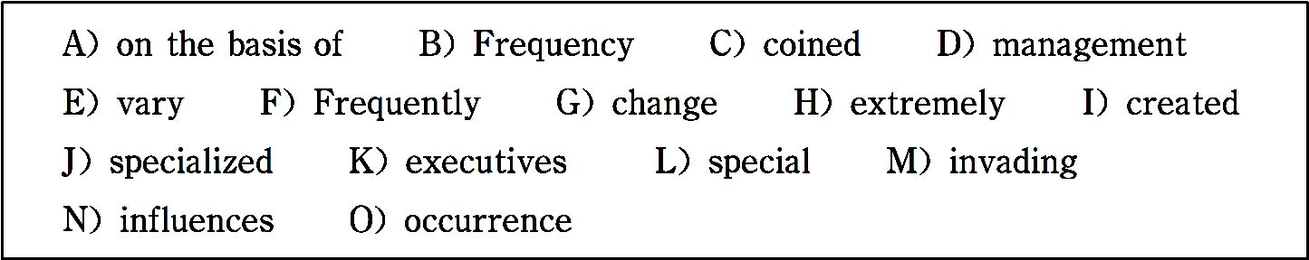
one word for each blank from a list of choices given in the word bank. Read the passage through carefully before making your choices. You may not use any of the words in the bank more than once.
In an interesting book entitled The Hidden Dimension, anthropologist (人类 学家) Edward T. Hall discusses space, how people structure it, and how space influences communication.

Slide 521
“Proxemics” is the term Hall has 1 for the interrelated observations and theories of man􀆳s use of space as a 2 elaboration of culture.
One use of space with which most of you are familiar is someone􀆳s favorite chair. 3 it is Dad who has a chair which is his, and it is 4 dangerous for anyone else to sit in it. The person who sits in “Dad􀆳s chair” without asking permission seems to be 5 personal territory.
When such an 6 takes place, we frequently think of the intruder as ill- mannered. You will even find some people who become quite upset at this invasion of their private space.

Slide 522
Another place where most of you have observed special treatment of space is in business offices. Office space is usually allotted (分配) 7 a person􀆳s position in the structure and on the organization chart. This is such a com- mon occurrence that it receives special attention in office 8 textbooks. Some have noted that private offices 9 from 600 square feet for senior 10 to 200 feet for senior assistants, and 75 to 100 square feet for cubi- cles (小卧室) in an open office space.
—— http://www.leehopkins.net
(216 words)

Slide 523
Time required: 8 minutes
Time used: minutes
Section C
In this section there is a passage followed by some questions or unfinished statements. For each of them choose the best answer from the four choices marked A, B, C and D.
Visual elements are a major part of your business􀆳s brand identity design.

Slide 524
The keystone of that design is the logo (徽标), but in many cases, the logo isn􀆳t enough to convey all of your brand attributes. A visual vocabulary is a way to reinforce and add to the message that is contained in your logo.
A company􀆳s visual vocabulary consists of the secondary design elements that are used together with your logo to form your brand identity. The visual vocabulary is composed of font styles, colors, shapes, layout conventions, backgrounds, photographic library, text treatments and even the type of pa- per you choose.
These elements should be used consistently throughout your stationery set

Slide 525
and marketing collateral (担保物) and have more advantages than the use of a logo and text alone.
The elements of your visual vocabulary become a graphic (图形的) lan- guage, which takes your viewer deeper into your graphics and materials. They add visual interest and continue to tell your business􀆳s story. They are another way that you can communicate about your business with potential clients and prospects, aside from the actual words and text about your busi- ness.
Graphics in a visual vocabulary are a method of communication that􀆳s more

Slide 526
quickly understood than text alone. A viewer can absorb the meanings of colors, symbols, photos, shapes and even font types much more quickly than by reading text. So, in cases where time is very important — when you􀆳re marketing to busy people, creating motion graphics such as car graphics or billboards (户外公告牌) is an important consideration.
Adding some visual vocabulary elements to your brand identity makes communicating with your audience easier, quicker and more emotionally charged. This gives you a highly effective way to increase your visibility (可 观性) and memorability. When used correctly, they can increase your credi-

Slide 527
bility as well. They even can help add some personality to your brand identi- ty and can make future marketing materials easier to develop. And, unlike your company logo, you can modify (修正) the visual vocabulary elements you use from time to time to spice up your business communications.
—— http://www.leehopkins.net
(342 words)
1. is (are) the most important part of a business􀆳s brand identity de- sign.

Slide 528
A. Visual elements B. A visual vocabulary
C. A logo D. Both B and C
2. Which of the following elements does not belong to the visual vocabulary according to the passage?
A. Font styles. B. Layout conventions.
C. The type of paper. D. The size of paper.

Slide 529
3. Graphics are an important way of communication because .
A. viewers can understand them more quickly than by reading text
B. viewers don􀆳t like reading text
C. graphics can tell clients anything about a company
D. viewers have more knowledge about visual elements
4. The underlined phrase “aside from” (paragraph 4) most probably means

Slide 530
“ ”.
A. except B. except for
C. apart from D. outside
5. Which of the following can not be modified as far as a company is con- cerned?
A. Its logo. B. Its visual vocabulary.

Slide 531
C. Its visual elements. D. Its products.
Time required: 8 minutes
Time used: minutes

Slide 532
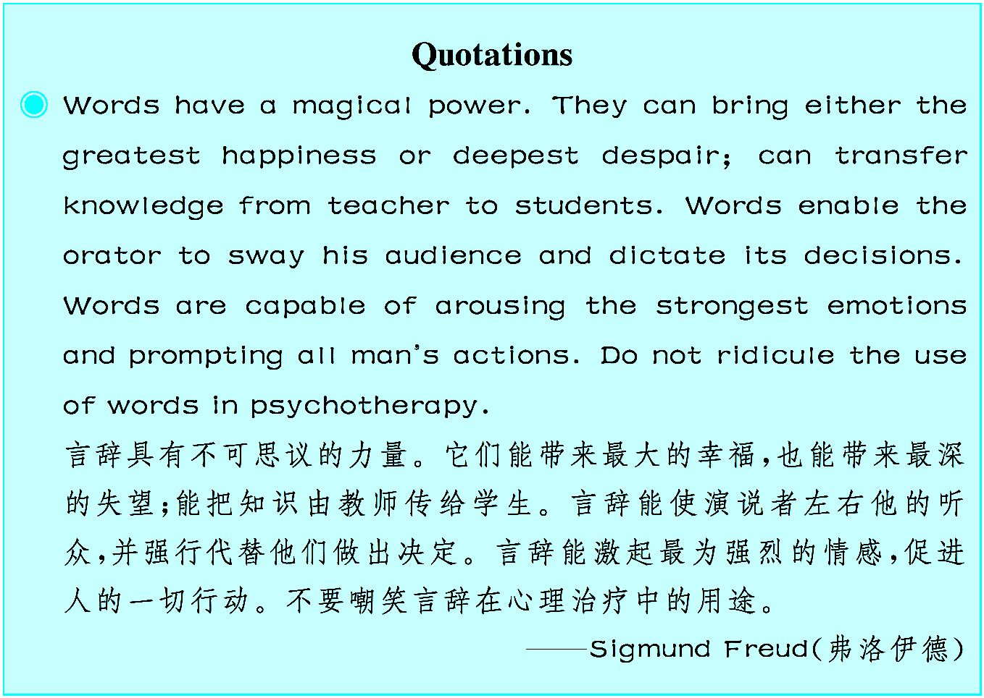

Slide 533
Unit 11
Reading Strategies
Critical Reading Strategies

Slide 534

怎样才能进行积极、有效、深入的阅读呢?那就是:在与作者产生共鸣的同时还要有异 议。因此,批判性阅读至关重要。

Slide 535
1. Previewing: Learning about a text
before really reading it
Previewing enables¹ readers to get a sense of what the text is about and how it is organized before reading it closely. This simple strategy includes seeing what you can learn from the head notes or other introductory material, skimming to get an overview of the content and organization, and identify- ing² the rhetorical³ situation.

Slide 536
2. Contextualizing⁴:Placing a text in its historical,
biographical⁵, and cultural contexts
When you read a text, you read it through the lens of your own experi- ence. Your understanding of the words on the page and their significance is informed by what you have come to know and value from living in a particu- lar time and place. To read critically, you need to contextualize, to recognize the differences between your contemporary values and attitudes and those represented in the text.^{①}

Slide 537
3. Questioning to understand and remember:
Asking questions about the content
The questions are designed to help students understand a reading and respond to it more fully. When you need to understand and use new informa- tion, it is most beneficial if you write down the questions. Each question should focus on a main idea, and each should be expressed in your own words, not just copied from parts of the paragraph.
4. Reflecting on⁶ challenges to your beliefs and

Slide 538
values: Examining your personal response
The reading might challenge your attitudes, your unconsciously held be- liefs, or your positions on current issues. As you read a text for the first time, mark an X in the margin⁷ at each point where you feel a personal challenge to your attitudes, beliefs, or status. Make a brief note in the margin about what you feel or about what created the challenge in the text. Now look a- gain at the places you marked where you felt personally challenged.
5. Outlining⁸ and summarizing⁹: Identifying

Slide 539
the main ideas and restating¹0 them in
your own words
Outlining and summarizing are especially helpful strategies for under- standing the content and structure of a reading selection. Whereas outlining reveals the basic structure of the text, summarizing synopsizes¹1 a selection􀆳 s main argument in brief. The key to both outlining and summarizing is be- ing able to distinguish between the main ideas and the supporting ideas and examples.

Slide 540
Summarizing begins with outlining, but a summary recomposes them to form a new text. Putting ideas together again — in your own words and in a condensed¹2 form — shows how reading critically can lead to deeper under- standing of any text.
6. Evaluating an argument: Testing the logic
of a text as well as its credibility¹3 and
emotional impact

Slide 541
As a critical reader, you should not accept anything on face value but to rec- ognize every assertion¹4 as an argument that must be carefully evaluated.^{②} An argument has two essential parts: claim and support. The claim asserts¹5 a conclusion — an idea, an opinion, a judgment, or a point of view — that the writer wants you to accept. The support includes reasons and evidence that give readers the basis for accepting the conclusion. When you assess an argument, you are concerned with the process of reasoning as well as its truthfulness. At the most basic level, in order for an argument to be accept- able, the support must be appropriate to the claim and the statements must be consistent ¹6 with one another.

Slide 542
7. Comparing and contrasting¹7 related readings:
Exploring likenesses and differences
between texts to understand them better
Many of the authors we read are concerned with the same issues, but approach how to discuss them in different ways. Fitting a text into an ongo- ing dialectic¹8 helps increase understanding of why an author approached a special issue in a particular way.^{③}

Slide 543
——http://www.salisbury.edu/counseling/new/7_critical_reading_strategies. html
(619 words)
Notes
① To read critically, you need to contextualize, to recognize the differences between your contemporary values and attitudes and those represented in the text.

Slide 544
要进行批判性阅读,你需要将事件、活动等融入背景,需要识别当代价 值、 态度与那些在文章中所阐述的之间的差异。
② As a critical reader, you should not accept anything on face value but to recognize every assertion as an argument that must be carefully evaluated.
作为一个批判性的读者,你不应该根据表面价值接受任何东西,而是要认 识到对每一个作为论点的断言都必须进行仔细评估。
③ Fitting a text into an ongoing dialectic helps increase understanding of why an author approached a special issue in a particular way.

Slide 545
运用辩证的方法阅读文章,有助于增进理解为什么作者以特定方式处理 一个特别的问题。
Exercises
Ⅰ.There are five questions or unfinished statements based on the passage. For each of them choose the best answer from the four choices marked A, B, C and D.
1. What benefits can previewing bring to readers?

Slide 546
A. A general idea of the content of the passage.
B. An overview of the organization of the passage.
C. A general understanding of stylistic features of the passage.
D. All of the above.
2. When you feel personally challenged while reading, what is it advis- able to do in general?

Slide 547
A. To think deeply of the challenges and make personal comments on them.
B. To make a brief note in the margin about what you feel about the chal- lenge.
C. To mark an X in the margin where you feel a personal challenge.
D. To read over and over again the places you marked.
3. How can reading critically bring about deeper understanding of a text?

Slide 548
A. By writing an outline of the text.
B. By writing a summary of the text.
C. By making a brief note in the margin.
D. By reading it again.
4. The underlined word “recompose” in the second paragraph of part 5 probably means .

Slide 549
A.make calm B. rethink C. rewrite D. reproduce
5. When a critical reader evaluates an argument, he should do all the following except .
A. examining whether the support can reasonably draw the conclusion
B. examining the truthfulness of the claim
C. examining whether the statements are consistent with one another

Slide 550
D. examining his personal response to challenges
Ⅱ. Fill in the blanks in the following sentences, using the words or phrases given below. Change the form where necessary.
issue unconscious status distinguish contrast
contemporary reflect on enable identify be consistent with
1. My promotion brings into question the of certain other

Slide 551
members of staff.
2. Her actions sharply with her promises.
3. What they have said humanity.
4. Parliament will debate the nationalization next week.
5. He is a of mine, but our experiences are completely different.
6. You should not wealth with happiness.

Slide 552
7. I always life when listening to Beethoven􀆳s symphony.
8. The twins were so much alike that it was impossible to one from the other.
9. He was on the receiving end in the fight and was knocked .
10. The hot sun the grapes to reach optimum ripeness.
Ⅲ. Translate the following Chinese sentences into English.

Slide 553
1. 在批判性阅读中,你的当代价值观和态度与文章中所阐述的价值观和 态度之间存在差异,这些差异必须放在上下文中加以辨别。
2. 进行批判性阅读时,你应该识别每个作为论点的断言并认真评估。
3. 基本说来,为了使论点能够被接受,论据必须能够证明你提出的论点,论 证必须相互一致。
4. 你会发现,你的态度、你无意识坚持的信仰或者你对当前问题的立场, 在阅读时都会受到挑战。

Slide 554
Section A
In this section, you are going to read a passage with ten statements attached to it. Each statement contains information given in one of the paragraphs. I- dentify the paragraph from which the information is derived. You may choose a paragraph more than once. Each paragraph is marked with a letter.
Reading Efficiently by Reading Intelligently

Slide 555
A) Whether they􀆳re project documents, trade journals, blogs, business books or e-books, most of us read regularly as part of our jobs and to develop our skills and knowledge.
B) But do you ever read what should be a useful document, yet fail to gain any helpful information from it? Or, do you have to re-read something several times to get a full understanding of the content?

Slide 556
C) In this article, we􀆳re looking at strategies that will help you read more effectively. These approaches will help you get the maximum benefit from your reading with the minimum (最小) effort.
Think About What You Want to Know
D) Before you start reading anything, ask yourself why you􀆳re reading it. Are you reading with a purpose or just for pleasure? What do you want to know after you􀆳ve read it?

Slide 557
E) Once you know your purpose, you can examine the resource to see whether it􀆳s going to help you. For example, with a book, an easy way of do- ing this is to look at the introduction and the chapter headings. The introduc- tion should let you know who the book is intended for, and what it covers. Chapter headings will give you an overall view of the structure of the sub- ject.
F) Remember that this also applies to content that you subscribe (订阅) to, such as journals or magazines.
Know How Deeply to Study the Material

Slide 558
G) Where you only need the shallowest knowledge of a subject, you can skim the material. Here you read only chapter headings, introductions, and summaries.
H) If you need a moderate level of information on a subject, then you can scan the text. This is when you read the chapter introductions and summaries in detail. You can then speed reading the contents of the chapters, picking out and understanding key words and concepts.
I) Only when you need full knowledge of a subject is it worth studying the text in detail. Here it􀆳s best to skim the material first to get an overview of

Slide 559
the subject. This gives you an understanding of its structure, into which you can then fit the detail gained from a full reading of the material.
Read Actively
J) When you􀆳re reading a document or a book in detail, it helps if you prac- tice “active reading” by highlighting (强调) and underlining key informa- tion, and taking notes as you progress. This emphasizes information in your mind and helps you to review important points later.
K) Doing this also helps you keep your mind focused on the material, and

Slide 560
stops you thinking about other things.
Know How to Study Different Types of Material
L) Different types of documents hold information in different places and in different ways, and they have different depths and breadths of coverage.
M) By understanding the layout of the material you􀆳re reading, you can ex- tract the information you want efficiently.
Magazines and Newspapers

Slide 561
N) These tend to give a fragmented (零碎的) coverage of an area. They will typically only concentrate on the most interesting and glamorous (富有魅力 的) parts of a topic — this helps them boost circulation (发行)! As such, they will often ignore less interesting information that may be essential to a full understanding of a subject, and they may include low value content to “pad out” (拉长) advertising.
O) The most effective way of getting information from magazines is to scan the table of contents or the index and turn directly to interesting articles. If you find an article useful, then cut it out and file it in a folder specifically

Slide 562
covering that sort of information. In this way you will build up sets of related articles that may begin to explain the subject.
Reading Individual Articles
There are three main types of article in magazines and newspapers:
P) News Articles — these are designed to explain the key points first, and then flesh these out(使有血有肉) with details. So, the most important infor- mation is presented first, with information being less and less useful as the article progresses.

Slide 563
Q) Opinion Articles — these present a point of view. Here the most impor- tant information is contained in the introduction and the summary, with the middle of the article containing supporting arguments.
R) Feature Articles — these are written to provide entertainment or back- ground on a subject. Typically the most important information is in the body of the text.
S) If you know what you want from an article and recognize its type, you can get information from it quickly and efficiently.

Slide 564
Make Your Own Table of Contents
T) When you􀆳re reading a document or a book, it􀆳s easy to accept the writer 􀆳s structure of thought. This means that you may not notice when important information has been left out, or that an irrelevant detail has been included.
U) An effective way to combat this is to make up your own table of contents before you start reading. Ask yourself what sections or topics you are expect- ing to see in this document and what questions you want to have answered by the end of the text.

Slide 565
V) Although doing this before you start reading the document may sound like a strange strategy, it􀆳s useful because it helps you spot holes in the au- thor􀆳s argument. Writing out your own table of contents also helps you ad- dress your own questions, and think about what you􀆳re expecting to learn from the text.
Use Glossaries(汇编,集注) with Technical Documents
W) If you􀆳re reading large amounts of difficult technical material, it may be useful to use or compile a glossary. Keep this beside you as you read.

Slide 566
X) It􀆳s also useful to note down the key concepts in your own words, and re- fer to them when necessary.
——http://www.mindtools.com/rdstratg.html
(918 words)
1. Reading effectively means getting the greatest benefit from your reading with the least effort.
2. We should make sure what we want to know before we start read-

Slide 567
ing.
3. An easy way to know the main idea of a book is to look at the intro -duction and the chapter headings first.
4. If we need full knowledge of a subject, we should read the text in detail.
5. Active reading means focusing on the most important information and taking notes as you read.

Slide 568
6. If you need a moderate level of information while reading, you can read through the text quickly but not very carefully.
7. We can improve the circulation of magazines and newspapers by focusing on the most interesting parts of a topic.
8. Entertainment or background on a subject is offered to readers in feature articles.
9. Making up your own table of contents is an effective way to fight against the missing of important information before you start reading.

Slide 569
10. It may be beneficial to use or compile a word list if you􀆳re read- ing a great number of challenging technical books.
Time required: 15 minutes
Time used: minutes
Section B
In this section, there is a passage with ten blanks. You are required to select one word for each blank from a list of choices given in the word bank. Read

Slide 570
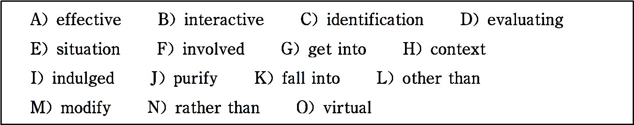
the passage through carefully before making your choices.You may not use any of the words in the bank more than once.
Reading Strategies VS Reading Skills
In simplest terms,the instruction of reading skills usually focus- es on word identification and the instruction of reading strategy

Slide 571
focuses on creating meaning. Reading skills generally 1 five categories (种类), including word 2 , fluency, vocabu- lary, comprehension and study skills. Many times, when readers learn these skills, they learn them in isolation (隔离,孤立) and in most cases they􀆳re unsure when or why to use one skill 3 another in a real reading situation.
A reading strategy can be described as any 4 process of getting meaning from context. Good reading instruction should

Slide 572
teach readers to use reading skills in the 5 of the thinking strategies described above. For example, when a reader is taught a word identification skill, he/she should be taught to use many different contexts to predict what should come next, to examine the visual qualities of the word, to confirm or 6 their pre- diction and then to move on.
Good reading teachers should not only introduce appropriate reading skills to students but also present them within the con-

Slide 573
text of 7 reading strategies. The critical thinking strategies of predicting, confirming, monitoring, reflecting and 8 must be brought to a conscious level in the readers􀆳 mind. Then, by providing readers with a 9 “toolbox” of procedures and making each reader responsible for choosing an appropriate strategy, students will be more actively 10 in their own reading comprehension and self-correction.
Time required: 8 minutes

Slide 574
Timeused: minutes
Section C
In this section there is a passage followed by some questions or unfinished statements. For each of them choose the best answer from the four choices marked A, B, C and D.
Marking Your Textbook

Slide 575
Reading is an active process. Marking or annotating (给……做 注释/评注) a text is your response to what you are reading, and it might prove valuable to you later as you begin to organize and plan your essay. Marking a text is not the same thing as high- lighting or underlining words. Marking a text is your way of discovering what you find important, what you want to explore, and/or what puzzles you about a text.
Think of this process as having a dialogue with a text. Although

Slide 576
the text cannot speak verbally(口头地), the written words can communicate — sometimes the meaning is clear, while at other times it is not. As you underline the words and sentences, make notes in the margins, and raise questions, you are keeping a written record of your dialogue with the text. If you don􀆳t record your reactions, the wonderful, insightful ideas or impor- tant questions you have while reading may be lost. If you anno- tate (注释,注解) a text, you can return to it later to rethink what

Slide 577
you consider important.
Annotating a text is a technique to help you become a more thoughtful reader. Think of marking up your text as the begin- ning of your dialogue with a text, which will lead you to an ex- tended writing project. In this dialogue, you will be doing most of the work because as you ask questions, bring up inconsisten- cies, or try to explore ideas more deeply, you have to rely on the text and your reasoning to respond to your inquiry. What

Slide 578
seemed so puzzling the first time around may make more sense with subsequent readings, or you may discover why a particular section seems so important to you. Clearing up one point may lead to another question or to a conclusion. Class or small group discussions may give you insights or raise more questions or spark (激发) an interest in something you had not noticed be- fore. This is an exciting process. Marking up your text is an es- sential part of the process. Thinking about and reviewing your

Slide 579
annotations can be extremely important as you move on to more extended and sustained (支撑的) writing.
—— http://www.csupomona.edu/~lrc/crsp/handouts/marking_ textbook.html
(347 words)
1. Marking a text while reading is regarded as .

Slide 580
A. a verbal dialogue with the text
B. an organization of the text
C. a reader􀆳s response to the text
D. a modification of the text
2. In order to record your dialogue with a text, you can .

Slide 581
A. underline the words
B. make notes in the margins
C. put forward questions
D. All of the above
3. The purpose of marking a text is to .

Slide 582
A. show that you are hard-working
B. remind you of the important parts during the later reading
C. indicate that you have read the text
D. make your book more beautiful
4. The underlined word “inconsistencies” in the third para- graph probably means .

Slide 583
A. disagreement
B. indifference
C. incontinence
D. inconvenience
5. Which of the following is not true about class discussions?

Slide 584
A. They may give you insights.
B. They may raise more questions.
C. They may make the class noisy.
D. They may stimulate your interest.
Time required: 8 minutes

Slide 585
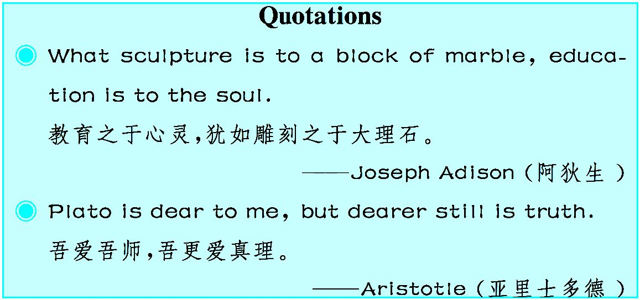
Time used: minutes
Unit 12

Slide 586
Chemistry
Printing in Ancient China

Slide 587
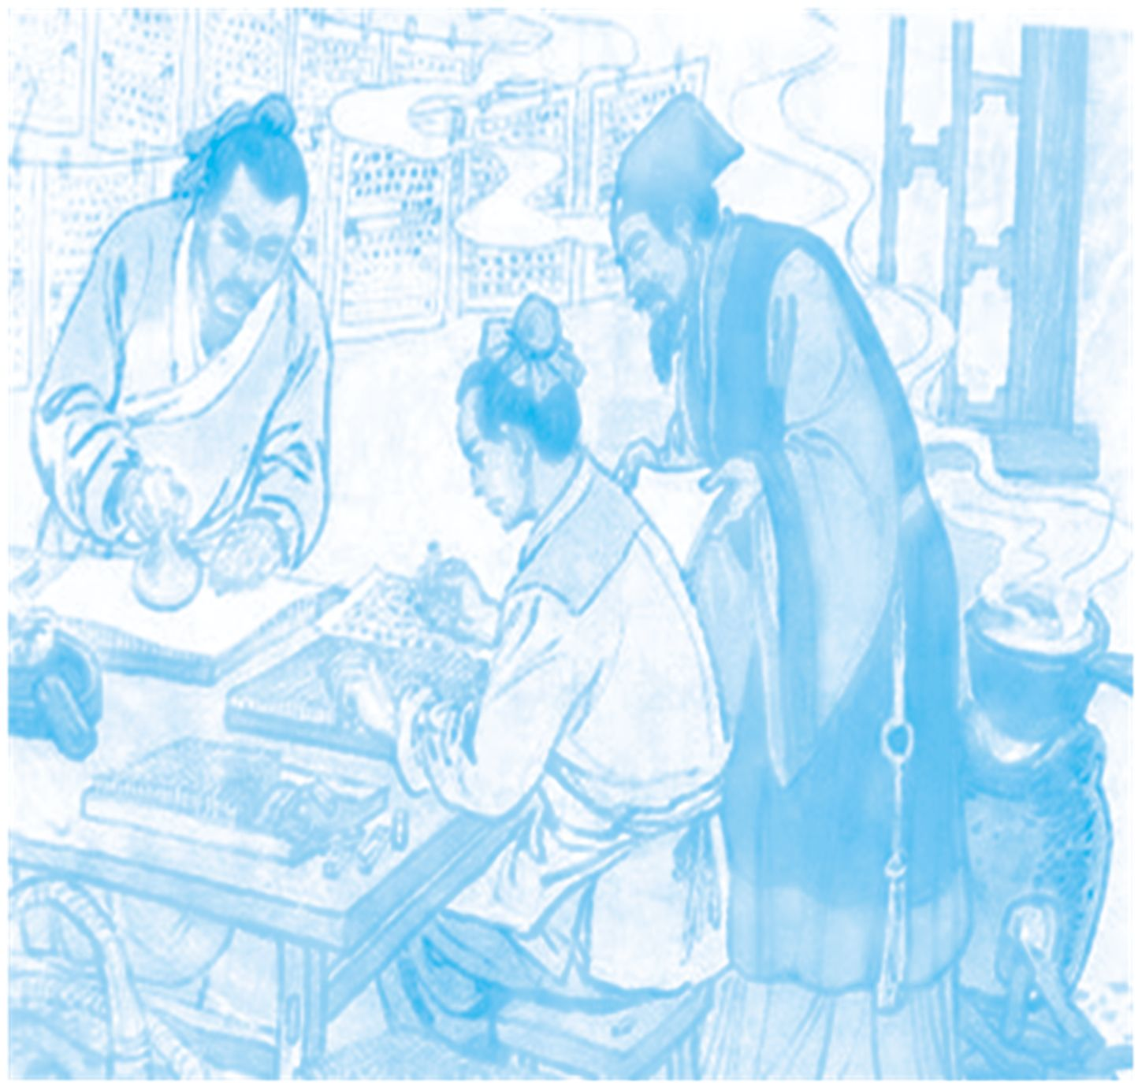
中国古代“四大发明”为人类社会生活带来了革命性的变化,是中国人对世界文明的伟大 贡献。本单元将带您一起了解火药、指南针、造纸术、印刷术这“四大发明”。

Slide 588
Printing is a technique with a long history. The technique we are discussing includes both block printing and movable type printing. Block printing was probably invented between the Sui and Tang Dynasties, based on the technique of transferring¹ texts and pictures cut in relief on seals and stone pillars to other surfaces^{①}. This technique was developed in the Spring and Au- tumn and Warring States periods². The invention of paper and improvement of ink led to the development of block printing.

Slide 589
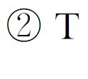
The process of block printing started with the cutting of wood into blocks. The text was first written in ink on a sheet of fine paper; then the written side of the sheet was applied to the smooth surface of a block of wood, coated with a paste that re- tained³ the ink of the text; thirdly, an engraver⁴ cut away the blank areas so that the text stood out in relief and in reverse. o
make a print, the wood block was inked with a paintbrush, and a sheet of paper was spread on it, then brushed with a clean

Slide 590
brush on its back, leaving an image when the paper was re- moved.
The earliest extant⁵ work from block printing in China is the Jin Gang Jing (Diamond Sutra) printed in 868 during the Tang Dy- nasty. In the Five Dynasties (907~960) period, government-run cultural institutions engraved⁶ and printed ancient classics on a large scale, and non-governmental publishing was also quite popular. In the Song Dynasty, the Buddhist work Da Zang Jing⁷

Slide 591
(Tripitaka) was printed, and a total of 130,000 wood blocks were engraved for the project. The technique of block printing first spread to Japan and Korea, then to Egypt in the 12th centu- ry, and to Europe in the 14th century. In Japan, the Daranikyo Sutra printed in 770 is the oldest extant work from block print- ing. As block printing was so complicated and difficult, it would take several years to print a book, and the engraved blocks had to be stored in a big house.

Slide 592
Movable type printing was then invented. Bi Sheng, a worker in a printing shop in the Song Dynasty, devoted great efforts to his invention of movable type printing. The principle⁸ of Bi􀆳s in- vention is the same as that of typeset printing widely used in the 20th century. In his Mengxi Bitan (Dream Pool Essays), Shen Kuo writes about Bi􀆳s movable type printing: The first known movable type system was invented in China by Bi Sheng out of ceramic between 1041~1048. Bi Sheng conceived of a movable

Slide 593
type which was made of a mixture of clay and glue and hard- ened by baking.
He composed⁹ texts by placing the types side by side on an iron plate coated with a mixture of resin¹0, wax, and paper ash. Gen- tly heating this plate and pressing the types with a smooth plate to ensure they were on the same level, he then let the plate cool so that the type was solidified¹1 and became a piece of print. Once the impression had been made, the type could be detached¹

Slide 594
2 by reheating the plate. Bi Sheng prepared two iron plates to be used in turn to speed up the whole printing process. He also prepared different numbers of types for characters according to their frequency of use in texts, and arranged them in an orderly way to facilitate¹3 the speed of composing. Shen Kuo noted that this technique was most efficient in printing several hundred or several thousand copies.
After Bi Sheng, other people invented types cut out of wood. In

Slide 595
about 1313, Wang Zhen, an agronomist¹4 of the Yuan Dynasty, printed his work Nong Shu (Treatise¹5 on Agriculture) with movable wood types, and wrote about his innovation¹6 in an ap- pendix¹7 to the treatise.
The technique of movable type printing was introduced to Japan and Korea in the 14th century. In the West, German printer Jo- hannes Gutenberg is credited with the invention of typographic¹ 8 printing in the mid-15th century.

Slide 596
——From Ancient Chinese Inventions, Deng Yinke (Author)/ Wang
Pingxing (Translator), China Intercontinental Press, 2010
(660 words)
Notes
① Block printing was probably invented between the Sui

Slide 597
and Tang Dynasties, based on the technique of transferring texts and pictures cut in relief on seals and stone pillars to other sur- faces.
雕版印刷术很可能是隋朝至唐朝之间发明的,这种技术可以 将印章和石柱上浮雕的文字和图片转移到其他表面。
② … an engraver cut away the blank areas so that the text stood out in relief and in reverse.

Slide 598
……雕刻师将木版上的空白部分剔除,这样文字就凸出来 了。
Exercises
Ⅰ. There are five questions or unfinished statements based on the passage. For each of them choose the best answer from the four choices marked A, B, C and D.
1. Which of the following statements is not true about block print- ing?

Slide 599
A. The text was written in ink on a sheet of fine paper.
B. The types were placed side by side on an iron plate coated with a mixture of resin, wax, and paper ash.
C. The written side of the sheet was applied to the smooth surface of a block of wood.
D. An engraver cut away the blank areas so that the text stood out in re- lief and in reverse.

Slide 600
2. Non-governmental publishing in the Five Dynasties period was .
A. forbidden B. depressed C. popular D. uncommon
3. The phrase “conceived of” in paragraph 4 most probably means “ ”.
A. used B. printed
C. composed D. formed an idea in the mind

Slide 601
4. The technique of transferring texts and pictures cut in relief on seals to other surfaces was developed in .
A. the Spring and Autumn and Warring States periods
B. the Sui Dynasty
C. the Tang Dynasty
D. the Song Dynasty

Slide 602
5. Why did Bi Sheng prepare two iron plates in movable type printing?
A. Because more types could be put in them.
B. Because they could be heated easily.
C. Because they could be used for speeding up the printing process.
D. Because the types could be arranged in an orderly way.
Ⅱ. Fill in the blanks in the following sentences, using the words or phrases

Slide 603
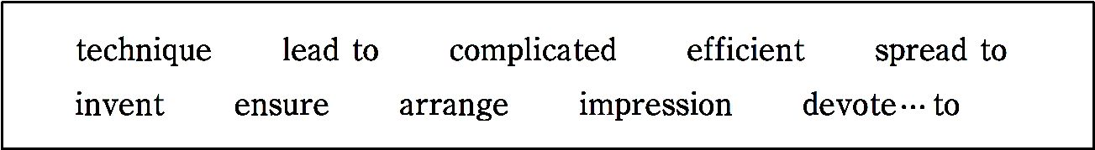
given below. Change the form where necessary.
1. Fax machines were a wonderful at that time.
2. His first speech as President made a strong on his audience.
3. There are various for dealing with industrial pollution.
4. She all her business affairs before going on holiday.

Slide 604
5. This is the most way to transmit certain types of data like electronic mail.
6. The strike has already other factories in nearby provinces.
7. Please that all the lights are switched off at night.
8. He himself the revolutionary cause of the Chi- nese people.
9. This practice of eating too much sugar always health prob-

Slide 605
lems.
10. Mental illness is a very disease for many doctors.
Ⅲ. Translate the following Chinese sentences into English.
1. 中国古代的印刷术包括雕版印刷术和活字印刷术。
2. 由于雕版印刷技术使用起来又难又复杂,所以要花费几年时间才能印 好一本书。

Slide 606
3. 他根据字在文中的使用频率准备了不同数量的字模。
4. 活字印刷技术在14世纪传入日本和朝鲜。
Section A
In this section, you are going to read a passage with ten statements attached to it. Each statement contains information given in one of the paragraphs. I- dentify the paragraph from which the information is derived. You may choose a paragraph more than once. Each paragraph is marked with a letter.

Slide 607
The Four Great Inventions of Ancient China
Papermaking
A) China was the first nation who invented paper. The earliest form of paper first appeared in the Western Han Dynasty (206 B.C.~8 A.D.), but the paper was generally very thick, coarse and uneven in their texture. It was made from pounded and disintegrated hemp fibers(捣碎、分解的麻质纤维). The paper unearthed in a Han tomb in Gansu Province is by far the earliest exist- ing ancient paper, tracing back to the early Western Han Dynasty.

Slide 608
B) In the Eastern Han Dynasty (25~220), a court official named Cai Lun made a new kind of paper from bark, hemp, rags, fishnet, wheat stalks and other materials. It was relatively cheap, light, thin, durable and more suitable for brush writing.
C) The art of papermaking spread east to Korea and Japan at the beginning of the seventh century (the end of the Sui Dynasty and the beginning of the Tang Dynasty). In the eighth century, along with the Silk Road, the Arabian countries began to learn how to make paper. It took about 400 years for pa- per to traverse the Arab world to Europe. In the 14th century, many paper

Slide 609
mills were established in Italy, then the workmanship of papermaking spread from Italy to the European countries such as Germany. The Italians vigor- ously produced the material and exported large amounts of it, dominating the European market for many years. In the 16th century, the art of papermak- ing appeared in Russia and Holland, and it spread to Britain in the 17th cen- tury.
D) Before paper was invented, Qin Shihuang, the first emperor in Chinese history, had to go over 120 kilos of official documents written on bamboo or wooden strips. With the invention of paper, the popularization of knowledge

Slide 610
has turned into reality. The invention of paper is an epoch-making event in human history.
Printing
E) Before the invention of printing, dissemination of knowledge depended either on word of mouth or handwritten copies of manuscripts. Both took time and were liable to errors. Beginning 2,000 years ago in the Western Han Dynasty, stone-tablet rubbing was in vogue for spreading Confucian classics or Buddhist sutras. This led in the Sui Dynasty to the practice of engraving texts or pictures on a wooden board, smearing it with ink and then printing

Slide 611
them on pieces of paper page-by-page. This became known as block print- ing.
F) The first book with a verifiable(可证实的) date of printing appeared in China in the year 868, or nearly 600 years before that happened in Europe. In the Tang Dynasty, this technology was gradually introduced to Korea, Japan, Vietnam, the Philippines. Yet block printing had its drawbacks. All the boards became useless after the printing was done and a single mistake in carving could ruin a whole block. From 1041 to 1048 in the Song Dynasty, a man named Bi Sheng carved individual characters on identical pieces of fine

Slide 612
clay which he hardened by a slow baking process, resulting in pieces of movable type. When the printing was finished, the pieces of type were put away for future use. This technology then spread to Korea, Japan, Vietnam and Europe. Later, a German named Johann Gutenberg invented movable type made of metal from 1440 to 1448.
Gunpowder
G) The invention of gunpowder had a close relationship with the advanced ancient workmanship of smelting industry. People began to know a lot of chemistry knowledge about the nature of different mineral materials during

Slide 613
the process of smelting operation. With the knowledge, ancient necro- mancers (巫师) tried to seek the elixir of immortality (长生不老之药) from certain kinds of ores and fuel. Although they failed to get what they were looking for, they discovered that an explosive mixture could be produced by combining sulfur, charcoal, and saltpeter (硝酸钾 ). This mixture finally led to the invention of gunpowder although its exact date of invention still re- mains unknown.
H) Many historical materials indicate that gunpowder first appeared before the Tang Dynasty (618~907). From 300 A.D. to 650 A.D., several recipes

Slide 614
were written about inflammable (易燃的) mixtures. Some historians date back the invention of gunpowder to 850 A.D. when a Taoist book warned of three specific elixir formulas as too dangerous to experiment.
I) The military applications of gunpowder began in the Tang Dynasty. Ex- plosive bombs filled with gunpowder and fired from catapults(弹弩) were used in wars. During the Song and Yuan Dynasties (960~1368), the military applications of gunpowder became common and some other weapons like “fire cannon, rocket, missile and fireball” were introduced.
J) In the Yuan Dynasty (1271~1368), the method of making powder was in-

Slide 615
troduced to the Arab world and Europe, bringing a series of revolutions to weapon manufacturing, as well as to stratagem and tactics on the battlefield. From Italy the making of gunpowder soon spread to other European coun- tries, and by the 1350s, it had become an effective weapon on the battlefield.
Compass
K) Early the Spring and Autumn and Warring States periods (770 B.C.~221 B.C.), while mining ores and melting copper and iron, Chinese people chanced upon a natural magnetite that attracted iron and pointed fixedly north. In the Warring States Period (475 B.C.~221 B.C.), after constant im-

Slide 616
provement, the round compass came into being. Referred to as a “south- pointer”, the spoon- or ladle-shaped compass is of magnetic lodestone, and the plate is made of bronze(青铜). The circular center represents Heaven, and the square plate represents Earth. The handle of the spoon points south. The spoon is a symbolic representation of the Great Bear. The plate bears Chinese characters which denote the eight main directions of north, north- east, east, etc. This type of compass has been scientifically tested and found to work tolerably well.
L) By the time of the Tang Dynasty and the beginning of the Northern Song

Slide 617
Dynasty (960~1127), Chinese scholars had devised a way to magnetize iron needles, by rubbing them with magnetite, and then suspending them in wa- ter. They also observed that needles cooled from red heat and held in the north-south orientation (the earth􀆳s axis) would become magnetic. These more refined needle compasses could then be floated in water (wet com- pass), placed upon a pointed shaft (dry compass) or suspended from a silk thread, etc. Consequently, they were much more useful for navigation pur- poses since they were much more portable.
M) During the Song Dynasty (960~1279), many trading ships were then able

Slide 618
to sail as far as Saudi Arabia without getting lost. The compass was intro- duced to the Arab world and Europe during the Northern Song Dynasty. The spread of the compass to Europe opened the oceans of the world to travel and led to the discovery of the New World.
——http://www.chinaesljob.com/blog/four-great-inventions-of-ancient-china
(1114 words)
1. The earliest primitive magnetic compass in China was probably invented during the War States Period.

Slide 619
2. Block printing was probably invented in the Sui Dynasty.
3. China􀆳s papermaking technique was first introduced to Korea and Japan.
4. Cai Lun used bark, hemp, rags, fishnet, wheat stalks and other ma- terials to make a new kind of paper.
5. The spread of the compass to Europe had a tremendous impact on world civilization.

Slide 620
6. The invention of gunpowder was closely related to the advanced ancient workmanship of smelting industry.
7. The invention of paper made contributions to the popularization of knowledge.
8. The pieces of movable type that Bi Sheng invented were put away for future use.
9. The earliest existing ancient paper was found in Gansu Province.

Slide 621
10. In the 13th century, gunpowder reached the Arab world and then Europe.
Time required: 15 minutes
Time used: minutes
Section B
In this section, there is a passage with ten blanks. You are required to select one word for each blank from a list of choices given in the word bank. Read

Slide 622
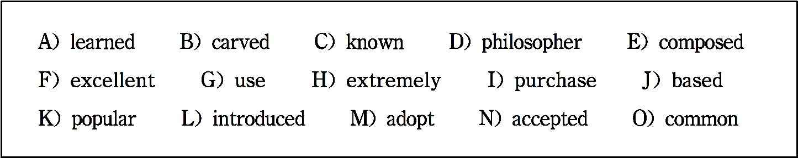
the passage through carefully before making your choices. You may not use any of the words in the bank more than once.
Papermaking
The invention of papermaking is a great contribution to the world􀆳s cultural development and international communication.

Slide 623
In the Shang Dynasty, the Chinese had already had their own written characters, which were 1 as the “oracle bone” because the words were 2 on animal􀆳s bones or tortoise􀆳s shell. During the Warring States Period, bamboo and wooden plates replaced bones. However, bones, bamboo and wood were too heavy to carry. Hui Shi, a 3 , had to hire five carriages to carry bamboo and wooden plates which were all his “books” when he went abroad to teach.

Slide 624
During the Western Han Dynasty, the noble caste wrote on thin paper made of silk or cotton. It􀆳s easy to write and even 4 for painting on this kind of paper. However, it was 5 ex- pensive, no civilian had the financial power to 6 it.
In 105 A.D., Cai Lun, a high ranking official in the Eastern Han Dynasty, 7 on the knowledge of papermaking in the past, invented a kind of cheap plant fiber paper, which was made of cortex(树皮), broken fishnets and cloths. Since then, paper has

Slide 625
been 8 among common people.
The papermaking technique was 9 to Korea and Japan in the 7th century and the Arab World in the 8th century. In the 12 th century, the Europeans began to 10 this technique.
——From http://www.absolutechinatours.com/china-travel/ Four-Inventions.html

Slide 626
(237 words)
Time required: 8 minutes
Time used: minutes
Section C
In this section there is a passage followed by some questions or unfinished statements. For each of them choose the best answer from the four choices

Slide 627
marked A, B, C and D.
Gunpowder, as a pre-eminent representative of science and technology in ancient China, was invented by alchemists. Its ingredients include sulfur, saltpeter, and charcoal. The invention was made in the Tang Dynasty and improved in the Song Dynasty.
The Chinese name for gunpowder is huoyao, which literally means fire drug, or the drug that fires. In Shennong􀆳s Herbal Classic of the Han Dynasty, sulfur and saltpeter were listed as important drugs. The most well-known man of Chinese medicine, Li Shizhen (1518~1593) of the Ming Dynasty,

Slide 628
wrote in his Bencao Gangmu (Compendium of Materia Medica) that it could cure the infection of the skin and kill pests.
The Chinese alchemists failed to turn out an elixir of life, but they did ac- cumulate rich knowledge of chemistry. Since they knew that sulfur was quite chemically active, toxic and inflammable, they mixed it with saltpeter and charcoal before heating. Saltpeter as a strong oxidant would cause partial combustion (燃烧、氧化) of sulfur, thus reducing its toxicity and inflamma- bility. This method was called “controlling sulfur” by medical scientist Sun Simiao (581~682) of the Tang Dynasty in his Classic of Alchemy.

Slide 629
While trying to “control sulfur”, Sun found that a mixture of certain pro- portions of sulfur, saltpeter and charcoal would result in explosion. When this knowledge was passed to the defense-related handicraft industry, craftsmen made further studies and tests to find out the best ratios of mix- tures, thus turning the material into a practical explosive that burned and ex- ploded in a sealed container.
In the Northern Song Dynasty, Zeng Gongliang, an engineering expert of the time, recorded three formulas of gunpowder in his Wujing Zongyao (Com- pendium of Military Classics): one for cannons, another for poisoning smok-

Slide 630
ing bombs, and the third for fireballs, with detailed ratios of ingredients. The formulas showed that the proportion of saltpeter was larger than the combi- nation of sulfur and charcoal, which was similar to the ratios of modern black powder. In the Northern Song Dynasty, various weapons that used gunpowder were developed, and the most noted among them was “fire gun”, which was said to be the initiation of modern firearms. In the 13th century, the Yuan Empire sent troops on a military expedition to Central A- sia, and gunpowder and firearms thus reached the Arab world and then Eu- rope. The first European formula of gunpowder was made in 1327.

Slide 631
——From Ancient Chinese Inventions, Deng Yinke (Author)/Wang Pingxing (Translator),
China Intercontinental Press, 2010
(409 words)
1. Which of the following statements is true?
A. Gunpowder was invented by militarists in ancient China.

Slide 632
B. Gunpowder was invented in the Song Dynasty.
C. Sun Simiao wrote in his Bencao Gangmu that gunpowder could be used to kill pests.
D. A certain ratio of the mixtures of sulfur, saltpeter and charcoal would ex- plode in a sealed container.
2. The underlined word “accumulate” in the third paragraph most proba- bly means .

Slide 633
A. to understand something over a period of time
B. to collect materials to make something
C. to gradually get more and more knowledge over a period of time
D. to update the knowledge they had
3. Why did the Chinese alchemists mix sulfur with saltpeter and charcoal be- fore heating?

Slide 634
A.Because this method could increase sulfur􀆳s toxicity and inflammability.
B. Because this method could help to explode quickly.
C. Because this method could cause complete combustion of sulfur.
D. Because this method could reduce sulfur􀆳s toxicity and inflammability.
4. Who found out the best proportions of sulfur, saltpeter and charcoal?
A. Alchemists. B. Craftsmen.

Slide 635
C. An engineering expert. D. A medical scientist.
5. The initiation of modern firearms was developed .
A. in the Northern Song Dynasty B. in the Tang Dynasty
C. in the Han Dynasty D. in the Ming Dynasty
Time required: 8 minutes
Time used: minutes

Slide 636
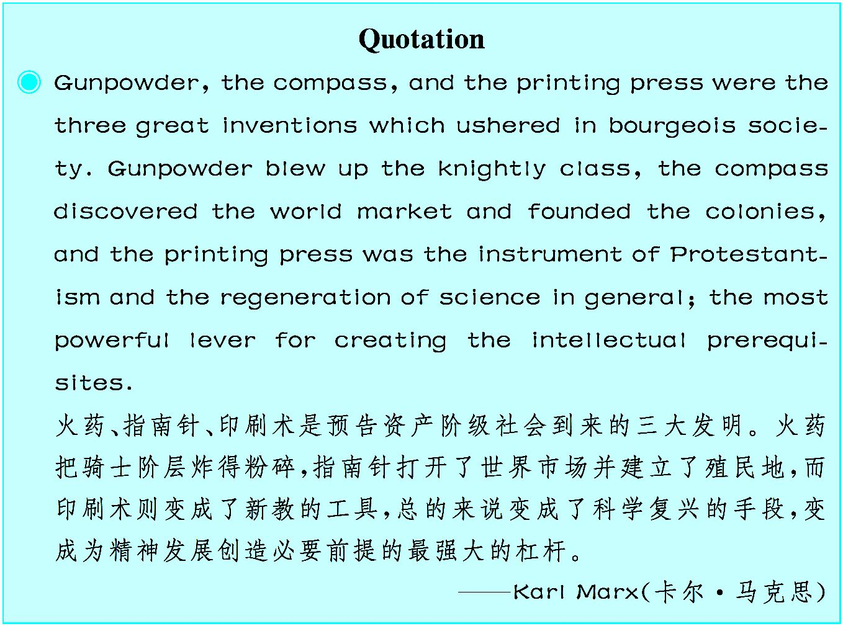

Slide 637
Unit 13
Finance
Lehman Brothers

Slide 638

由于受次贷危机影响,雷曼兄弟公司出现巨额亏损并导致破产,成为越演越烈的经济危机的 导火线。经济危机不仅严重影响了世界经济的发展,而且也严重影响了人们的生活。

Slide 639
When the Lehman Brothers declared their bankruptcy¹ on 15th Septem- ber, 2008, the response of the business world was pied². Some of them were anxious about what the bankruptcy would cause while some found it appro- priate that the big performer on the financial market in the end had to face the consequences of its own stroke. ^{①}
The rise of this powerful investment bank started in 1844 and played a pre- cious role in the financial and commercial industry of the United States for more than 15 decades. In 1844 Henry Lehman set up a small dry goods shop and sold groceries to the nearby farmers. Six years later he was joined by his

Slide 640
two brothers and they named it Lehman Brothers. Soon after its founding, the Lehman Brothers evolved from merchandising³ business to commodities brokers⁴ that traded cotton to farmers. In the year 1898 Lehman Brothers un- derwrote⁵ its first public offering⁶ for the international steam pump company.
In the 1900􀆳s the firm became a financer of many top retailers. In the year 1 906 Lehman Brothers shook hands with Goldman Sachs in order to bring the general cigar company to the market. In the year 1929 Lehman Corporation was created which was a closed end investment company. ^{②} In the year 1975

Slide 641
Lehman brothers acquired Abraham & Co. and two years later in 1977 merged with Kuhn, Loeb & Co. to form Lehman Brothers Kuhn Loeb Inc. Later on in 1984 American Express acquired Lehman Brothers and merged it with Shearson. But in 1994 Lehman Brothers became independent through public stock offerings and Lehman Brothers Holding Inc. ^{③} In 2003 Lehman acquired Neuberger Berman for $2.6 billion and in 2007 Lehman Brothers recorded high revenues⁷ and income for the fourth consecutive⁸ year and the highest volume of trade on the London Stock Exchange.
Lehman Brothers provided a range of equity⁹ and fixed income services.^{④}

Slide 642
They were also a giant in investment banking services and underwriting ser- vices. However, because of the poor performance of residential¹0 mortgage¹1 origination¹2 and securitization¹3 business, it might need to restructure its business portfolio¹4.^{⑤}
Lehman Brothers had a portfolio consisting of a bulky share of loan connect- ed to the purchasing of real estate¹5, but the core business was investment banking and also financial services to corporations, government institutional clients¹6 and high net worth individuals. Lehman was the worldwide creator in certain equity and fixed income products. Its distribution aptitude¹7 in eq-

Slide 643
uity and fixed income products was based on client-flow business model which mainly focuses on the transaction of the client in the global capital markets across the world by advising on specified need of the client.
After the biggest accounting scandals faced by the USA in 2002 the Lehman brothers made a powerful comeback¹8 in the market in asset¹9 management with the net investment of $ 27,510,705,524.00 at nominal²0 interest rates of 7.18%. This increased the operating cost of the company but earnings per share reached $3.20 in 2003. Entering the PCS business, Lehman􀆳s private- equity business increased nominal discount rate to 8.03% with increased op-

Slide 644
erating cost and earnings per share to $4.00 in the year 2004.^{⑥} In 2005 Lehman Brothers put a huge investment in the subprime²1 markets with high operating cost but still made a good amount on their earnings per share of $5. 40.
However, because of the major investment in the subprime markets its oper- ating cash was declined.Early in 2007~2008 there was a decline in the prices of property²2 market (about 16 to 20 percent) which made the value of the property lesser than the loan value outstanding, which was the shattering for Lehman brothers. A steep decline in the NPV²3 of the company made them

Slide 645
file bankruptcy on September 15th, 2008.
——http://www.ukessays.com/essays/banking/sturdy-investment-bank.php
(618 words)
Notes
① Some of them were anxious about what the bankruptcy would cause while some found it appropriate that the big performer on the financial mar- ket in the end had to face the consequences of its own stroke.

Slide 646
商界中有些人担心破产将会导致的后果,但也有一些人觉得这正合时宜, 让金融市场上的这个大玩家最终不得不自食其果。
② In the year 1929 Lehman Corporation was created which was a closed end investment company.
1929年雷曼股份有限公司成立,这是一家封闭型投资公司。
③ But in 1994 Lehman Brothers became independent through public stock offerings and Lehman Brothers Holding Inc.

Slide 647
但在 1994 年,通过公开发行股票和成立雷曼兄弟控股公司,雷曼兄弟公 司成为独立的公司。
④ Lehman Brothers provided a range of equity and fixed income ser- vices.
雷曼兄弟公司提供一系列股票和固定收益服务。
⑤ However, because of the poor performance of residential mortgage origi- nation and securitization business, it might need to restructure its business portfolio.

Slide 648
但是由于其住宅按揭贷款和资产证券化业务不佳,可能需要调整其证券 投资组合。
⑥ Entering the PCS business, Lehman􀆳s private-equity business in- creased nominal discount rate to 8.03% with increased operating cost and earnings per share to $4.00 in the year 2004.
进入个人电脑行业,随着经营成本增加以及2004年每股收益达到4美元, 雷曼兄弟公司把私募股权业务的名义贴现率提高到了8.03%。

Slide 649
Exercises
Ⅰ. There are five questions or unfinished statements based on the passage. For each of them choose the best answer from the four choices marked A, B, C and D.
1. What are the reactions to the bankruptcy of the Lehman Broth- ers?

Slide 650
A. Some were worried about the destructive effects while some thought the Lehman Brothers deserved it.
B. Some were worried about the financial world while some thought the Lehman Brothers shameful.
C. Some were anxious about their own business while some thought the Lehman Brothers a laughing stock.
D. Some were anxious about the consequences while some thought the Lehman Brothers pitiful.

Slide 651
2. When was the Lehman Brothers officially named?
A. In 1844 when Henry Lehman set up a small dry goods shop.
B. In 1850 when Henry Lehman was joined by his two brothers.
C. In 1898 when Lehman Brothers underwrote its first public offering for an international company.
D. In the 1900􀆳s when the firm became a financer of many top retailers.

Slide 652
3. The underlined word “merged” in paragraph 3 means .
A. separated B. appeared C. cooperated D. combined
4. How was the business when the company was engaged in the PCS busi- ness?
A. With increased operating cost,earnings per share were increased.
B. With rising operating cost,earnings per share were reduced.

Slide 653
C. With declining operating cost, operating cash was increased.
D. With declining net present value, operating cash was declined.
5. What is the main cause of its bankruptcy?
A. The poor performance of residential mortgage.
B. The ineffective financial services.
C. The huge investment in the subprime markets.

Slide 654
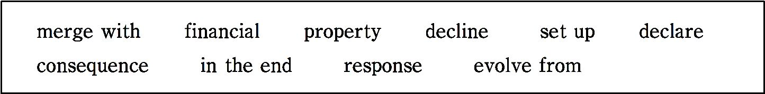
D. The high operating cost with low earnings per share.
Ⅱ. Fill in the blanks in the following sentences, using the words or phrases given below. Change the form where necessary.
1. The courts ordered the seizure of all her .
2. As a of smoking, my father coughs frequently.
3. It is said that they suffered huge losses in the crisis.

Slide 655
4. The scheme has to help homeless people.
5. If you insist, we have to the meeting off.
6. They advised their client to another company.
7. Great historical achievements often simple concepts.
8. Your positive will reinforce her actions.
9. You􀆳ll get there if you work hard!

Slide 656
10. The closure of the mine was the single most important factor in the town􀆳s .
Ⅲ. Translate the following Chinese sentences into English.
1. 150多年来,雷曼兄弟公司在美国金融业和商业中一直起着重要作用。
2. 通过公开发行股票以及成立雷曼兄弟控股公司,雷曼兄弟公司于1994 年成为独立的公司。
3. 雷曼兄弟公司可能需要调整其证券投资组合,因为其住宅按揭贷款和

Slide 657
资产证券化业务业绩不佳。
4. 雷曼兄弟公司破产的一个主要原因是它在次贷市场进行了大量的投 资,运营成本高昂。
Section A
In this section, you are going to read a passage with ten statements attached to it. Each statement contains information given in one of the paragraphs. I- dentify the paragraph from which the information is derived. You may choose

Slide 658
a paragraph more than once. Each paragraph is marked with a letter.
How Health Care Reform Will Affect
Your Wallet and Your Life
A) When the Supreme Court ruled that the Patient Protection Affordable Care Act — “Obamacare” — was constitutional (符合宪法的), many Americans simply wondered how this rul- ing would affect their daily lives.

Slide 659
Back to the Future
B) In some ways, the future is already here, and many portions of the PPACA have already been quietly carried out. The government has stream- lined (使……合理化) the approval process for basic drugs and expanded Medicare􀆳s prescription (药方) benefit. It has levied a 10% tax on tanning booths (紫外线保健房), and passed several rules that will make it easier for people with “pre-existing conditions” to get the lifesaving treatments they need. For insurance companies, lifetime limits on coverage, price cheating, and a host of other cost-cutting measures are now illegal. Slowly, medication

Slide 660
is getting cheaper, insurance coverage is getting easier to attain, and a healthy lifestyle is becoming more attainable.
C) Now, we can expect that over the next few months, more and more of the future will show up. Starting in August, treatments like colonoscopies (结肠 镜检查) and mammograms (乳房X线照片) will be free for patients who open new insurance policies. A few months later, people who make more than $200,000 per year will have to pay an extra 0.9% tax which will help fund health care.
The Big Changes You Will Hardly Notice

Slide 661
D) These are little things, increasing changes that most people won􀆳t notice, except perhaps occasionally wondering about when medications got cheaper or why achieving the Snooki (美国女明星) look has gotten more expensive. But the big transition will arrive in 2014. That􀆳s when everyone will either have to get insurance or pay a tax.
E) The funny thing is, creeping socialism probably won􀆳t feel much differ- ent from the current system. Imagine an ordinary middle class family. For mom and dad, who work full time, insurance will still be provided through work. They􀆳ll still go to the same doctor, pay the same co-pay, and head to

Slide 662
the same hospital when things get worse. Their kids will still get the same care, although they􀆳ll be able to take advantage of their parents􀆳 health in- surance until they􀆳re 26, if they need to.
F) As for grandpa and grandma, if they􀆳re over 65, they􀆳ll still be insured by Medicare, and their lives will largely go on as usual. If they􀆳re younger, and suddenly find themselves without insurance — if, for example, grandpa is laid off from his job — they will be able to get health insurance in spite of their pre-existing conditions.
The Big Changes You Will Notice

Slide 663
G) But what if grandpa􀆳s new job doesn􀆳t pay much and he can􀆳t afford in- surance? Well, the new law may still cover him. One aspect of PPACA is that people who make up to 133% of the poverty line — for a household of two adults and one child, this would be $23,344 — would be eligible (合格 的) for Medicaid at no cost. Meanwhile, families that make up to 400% of the poverty line — this would be $70,208 — would be eligible for some form of discounted insurance rate, scaled to their income.
H) What about Uncle Hank, the uninsured rebel with the ponytail and motor- cycle? Well, assuming he makes more than 400% of the poverty line, Hank􀆳

Slide 664
s going to face a tough decision: He can either get insurance or pay a tax that will probably be slightly higher than the cost of insurance.
I) Hank might be able to get insurance through his work, but if he can􀆳t, the new law will give him another choice — a health insurance exchange. If Un- cle Hank decides not to pay the health care tax, he would likely go to the ex- change, pick a plan, set up a direct deposit program to take money from his paycheck and get an insurance card.
J) And, later, if Hank gets into an accident on his bike, his insurance would cover his trip to the emergency room, as well as his ensuing operation and

Slide 665
physical therapy (治疗).
The Winners and the Losers
K) So who wins and who loses under the new insurance program? For insur- ance companies, it􀆳s going to be a mixed bag: On the plus side, they will get millions of new, relatively young customers like Uncle Hank who will be cheap to insure, and will add mightily to their coffers. On the opposite side, they􀆳ll also get millions of older, low income customers — like grandpa and grandma — who will be expensive to insure. Overall, they will probably make a tidy profit.

Slide 666
L) For the poor, the chronically ill, and the unemployed, the new insurance program will also be a definite win. Millions of people will be able to afford basic health care, get diagnostic tests and buy medications. Many will be covered by an expanded Medicaid program, and those who aren􀆳t will likely see a steep drop in the cost of insurance.
M) For the average taxpayer, the new program will also be a win. Right now, a lot of the basic health care in America takes place in emergency rooms, where uninsured people end up when their colds turn into pneumonia, or un- treated diabetes (糖尿病) turns into a coma or an amputation. Many of these

Slide 667
emergency rooms are already receiving taxpayer dollars. Preventing major, expensive crises while they are small, inexpensive-to-treat problems saves everyone money.
N) In fact, the biggest losers of the new health care program will be folks like Uncle Hank, who previously didn􀆳t worry about health insurance, but will now have to pay for it. On the other hand, many will now have access to preventative care and basic medical care that were previously unavailable.
——http://www.dailyfinance.com/2012/06/28

Slide 668
(917 words)
1. Because of PPACA, cheaper medication, more insurance coverage and healthier lifestyle are becoming more attainable.
2. Treatments like mammograms will be free of charge for patients who open new insurance policies.
3. PPACA doesn􀆳t seem to change the current medical care system for people from middle class families.

Slide 669
4. If a person earns more than $200,000 per year, he or she has to pay an extra tax of $1,800 to help fund health care.
5. The big change in medication in 2014 is that everyone will either have to buy insurance or pay an additional tax.
6. According to PPACA the unemployed will profit more from the new insurance program.
7. The previously uninsured people will be greatly affected by the new policy.

Slide 670
8. If Hank has got an accident on his bike, his trip to the hospital,his ensuing operation and physical therapy would be paid by the insurance com- pany.
9. Under the new insurance program, insurance companies will prob- ably make a big profit.
10. For the average taxpayers, they will get more profit from the new program.
Time required: 15 minutes

Slide 671
Time used: minutes
Section B
In this section, there is a passage with ten blanks. You are required to select one word for each blank from a list of choices given in the word bank. Read the passage through carefully before making your choices.You may not use any of the words in the bank more than once.

Slide 672
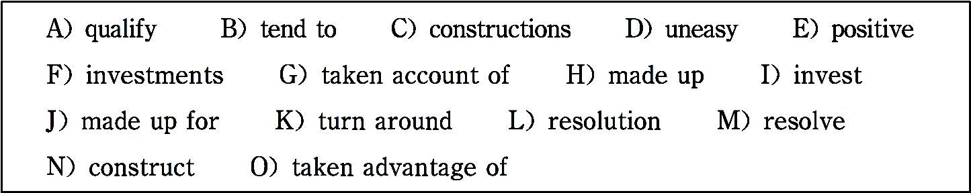
Mortgage Rates Fall to New Lows Again
Low mortgage rates haven􀆳t done much to boost home sales. Rates have been below 4% for all but one week since early De- cember. Yet sales of both previously occupied homes and new

Slide 673

homes fell in March.
There have been some 1 signs in recent months. January and February 2 the best winter for sales of previously occu- pied homes in five years. And builders are laying plans to 3 more homes in 2012 than at any other point in the past 3
years. That suggests some see the housing market slowly start- ing to 4 .

Slide 674
Still, many would-be buyers can􀆳t 5 for loans or afford higher down payments required by banks.
Home prices in many cities continue to fall, making those who can afford to buy 6 about entering the market. And for those who are willing to brave the troubled market, many have already 7 lower rates — mortgage rates have been below 5% for more than a year now.

Slide 675
Mortgage rates are lower because they 8 track the yield on 10-year Treasury notes. Slower USA job growth and uncertainty about how Europe will 9 its debt crisis have led investors to buy more Treasuries, which are considered safe 10 . As demand for Treasuries increases, the yield falls, as bond prices and yields move in opposite directions.
The average rate does not include extra fees,known as points, which most borrowers must pay to get the lowest rates. One

Slide 676
point equals 1% of the loan amount.
——http://www.usatoday.com/money/story/2012-05-10/mort- gage-rates/54872986/1
(249 words)
Time required: 8 minutes
Time used: minutes

Slide 677
Section C
In this section there is a passage followed by some questions or unfinished statements. For each of them choose the best answer from the four choices marked A, B, C and D.
For years,serious people have been issuing alarming warnings about the consequences of large budget deficits(预算赤字) — deficits that are over- whelmingly the result of our ongoing economic crisis. In May, 2009, Niall Ferguson of Harvard declared that the “tidal wave of debt issuance”

Slide 678
would cause USA interest rates to soar. In March, 2011, Erskine Bowles, the co-chairman of President Obama􀆳s ill-fated deficit commission, warned that unless action was taken on the deficit soon, “the markets will devastate(毁 灭) us”, probably within two years.
Well, I guess Mr. Bowles has a few months left. But a funny thing happened on the way to the predicted fiscal crisis: instead of soaring, USA borrowing costs have fallen to their lowest level in the nation􀆳s history. And it􀆳s not just America. At this point, every advanced country that borrows in its own currency is able to borrow very cheaply.

Slide 679
The failure of deficits to produce the predicted rise in interest rates is telling us something important about the nature of our economic troubles. Borrow- ing costs are so low that, in some cases, investors are actually paying gov- ernments to hold their money.
For the most part, this is happening with “inflation-protected securities” — bonds whose future repayments are linked to consumer prices so that in- vestors need not fear that their investment will be eroded by inflation.
So investors are, in a sense, offering governments free money for the next 10 years; in fact, they􀆳re willing to pay governments a modest fee for keeping

Slide 680
their wealth safe.
Yes, we have a long-run budget problem, and we should be taking steps to address that problem, mainly by reining in health care costs. But it􀆳s simply crazy to be laying off schoolteachers and canceling infrastructure (基础设 施) projects at a time when investors are offering zero- or negative-interest financing.
So it􀆳s time to stop paying attention to the alleged wise men who hijacked our policy discussion and made the deficit the center of conversation. They􀆳 ve been wrong about everything — and these days even the financial mar-

Slide 681
kets are telling us that we should be focused on jobs and growth.
——http://www.nytimes.com
(345 words)
1. According to the passage, how was the prediction made by Niall Ferguson of Harvard in May, 2009?
A. It turned out to be correct.

Slide 682
B. It turned out to be opposite.
C. It proved to be successful.
D. It proved to be useful.
2. What does the author imply as far as Erskine Bowles is concerned?
A. He will leave his post soon.
B. He will get promoted soon.

Slide 683
C. He will be ill-fated soon.
D. He will be arranged to tackle the deficit soon.
3. Why needn􀆳t investors fear that their investment will be reduced by infla- tion?
A. Because investors have offered governments free money for 10 years.
B. Because serious people have been issuing alarming warnings about the consequences of large budget deficits.

Slide 684
C. Because the government has taken action on the deficit.
D. Because the bonds they have bought are protected from inflation.
4. The underlined word “address” in the sixth paragraph means .
A. control B. tackle
C. write an address D. deliver a speech
5. What is the best way for us to deal with the budget problem?

Slide 685
A. Focus on the wise men􀆳s warnings on fiscal crisis.
B. Pay attention to policy discussion.
C. Pay attention to employment and development.
D. Make the deficit the center of conversation.
Time required: 8 minutes
Time used: minutes

Slide 686
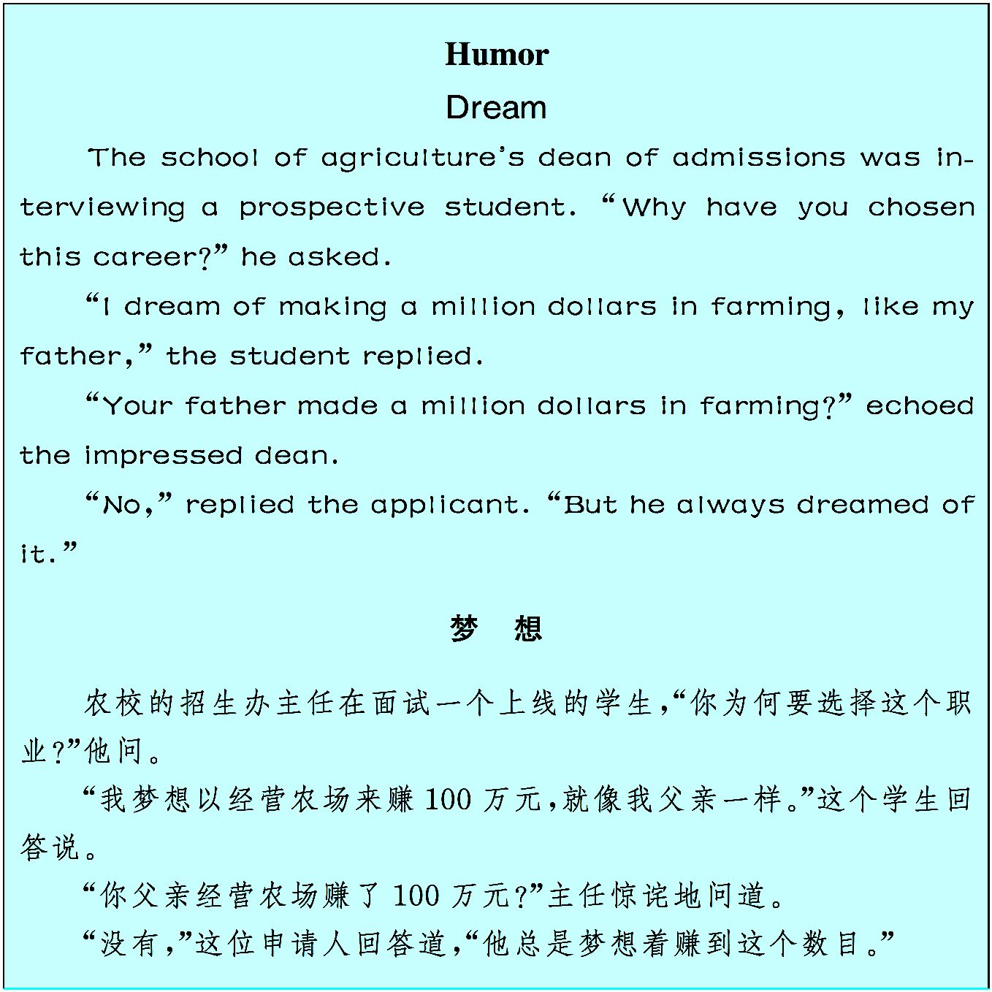

Slide 687
Unit 14
New Lifestyles in China
The Rise of Car-sharing in China

Slide 688

共享经济正在日益影响中国人的生活。从共享充电宝、共享单车发展到共享汽车。虽然 存在种种弊端,但不可否认这些给人们的生活带来了便利。

Slide 689

With the fast development of economy in China, people are becoming wealthy. There are more and more private cars and it seems unlikely that the country􀆳s growth in car ownership will stop any time soon. However, severe ¹ air pollution and traffic congestion² have led several large Chinese cities to take actions to stem³ the rising tide of private cars. For example, six big cities including Beijing have implemented⁴ license plate control policies.
Other management strategies such as congestion pricing are widely adopted to stop the rising tide of private cars. As part of the strategies to achieve sus- tainable⁵ urban mobility, car-sharing can help reduce the number of cars in Chinese cities and meet the increasing demand for personal mobility of the

Slide 690
middle class^{①}.
Car-sharing, one of the fastest growing urban mobility innovations⁶ world- wide, did not exist in China until 2009, but it is quickly becoming a main- stream⁷ in Chinese cities. The global car-sharing market has an estimated value of 1 billion USA dollars, with 272% growth in the number of car-shar- ing vehicles between 2006 and 2012.
The rise of station-based car-sharing in China
Car-sharing is still emerging⁸ in China, and in 2012 there were only two car-

Slide 691
sharing operators (CSOs), with a total of 39 vehicles in Chinese cities. To- day, the car-sharing network in China has grown to a total of 1,000 vehicles with five active operators in Beijing, Hangzhou, Wuhan, Shenzhen and Changsha. The composition⁹ of CSOs in China has evolved from domestic start-ups that operate independently from the government or established rental car companies together with municipal¹0 governments, foreign and domestic vehicle manufacturers^{②}.
Among these CSOs, Eduo Auto is popular with college students and even implements a membership system, while Weigongjiao and E-car receive

Slide 692
government support and operate only electric vehicles. Weigongjiao, which means “mini-bus”, creatively uses vending machines¹1-like parking garages with electric vehicle charging infrastructure¹2. Car2Go is the first car -sharing program supported by a foreign equipment manufacturer (OEM) in China.
The emergence of private peer-to-peer car-sharing
Peer-to-peer¹3 (P2P) car-sharing has existed in China for a short period of time though it has been operating in North America for more than a decade. P2P companies provide a platform¹4 for members to rent vehicles owned by

Slide 693
other members in the network. Car-sharing experts like ZipCar founder, Robin Chase, regard P2P car-sharing as the next revolution in the car rental industry, as it can cheaply mobilize¹5 ^{u}nused resources to provide vehicle ac- cess across a wide area. Two of the most notable P2P companies in China are PPZuche and ATZuche.
What role will car-sharing play in Chinese cities
in the future?
There are multiple¹6 challenges facing the car-sharing industry in Chi-

Slide 694
na. Cultural preference towards car ownership may make car-sharing less appealing¹7 in China than in other countries. It may take time for CSOs to develop an operational scheme¹8 that suits Chinese cities, and for city leaders to create supportive policies such as on-street parking for shared vehicles. Some local governments have supported electric vehicle car-sharing pro- grams, though most governments are generally unaware of car-sharing as a potential¹9 sustainable transport solution.
Businesses in China are innovating to create locally viable vehicle sharing programs that may reshape²0 private vehicle usage in the largest vehicle

Slide 695
market in the world. As the industry evolves, support from city governments through policies such as dedicated parking for shared vehicles and exemp- tion²1 to vehicle license restrictions will be vital to the growth of the indus- try. It is also important for CSOs and researchers to demonstrate the benefits of car-sharing services. If more governments can provide an accommodating² 2 policy environment, the rise of car-sharing programs in China could be part of a strategy to make cities more sustainable and livable while minimizing car ownership.
——http://thecityfix.com/blog/on-the-move-car-sharing-scales-up-

Slide 696
heshuang-zeng
(613 words)
Notes
① As part of the strategies to achieve sustainable urban mobility, car- sharing can help reduce the number of cars in Chinese cities and meet the in- creasing demand for personal mobility of the middle class.
共享汽车是实现中国城市交通可持续发展的远大战略之一,有助于减少

Slide 697
城市汽车数量,同时满足中产阶级不断增长的个人出行交通需求。
② The composition of CSOs in China has evolved from domestic start- ups that operate independently from the government or established rental car companies together with municipal governments, foreign and domestic vehi- cle manufacturers.
在中国,共享汽车运营商的构成从国内新兴私营企业或知名租车公司发 展成为政府和国内外汽车制造商共同运营。

Slide 698
Exercises
Ⅰ. There are five questions or unfinished statements based on the passage. For each of them choose the best answer from the four choices marked A, B, C and D.
1. Which of the following problem is mentioned as a result of the rising number of private cars in China?

Slide 699
A. Over-consumption of energy.
B. Higher infrastructure cost.
C. More car accidents.
D. Increasing air pollution.
2. Which of the following statements is true about the car-sharing market in China?

Slide 700
A. The car-sharing market in China is quite mature.
B. The number of car-sharing vehicles between 2006 and 2012 in- creased by 272% in China.
C. There are at least five active car-sharing operators in China.
D. Car-sharing operators in China run independently from government.
3. Which of the following statements is not the challenge facing the car-shar- ing industry in China?

Slide 701
A. In Chinese culture, people prefer to have their own cars.
B. Sharing vehicles cannot be maintained in time.
C. Dedicated parking is not available for sharing vehicles.
D. Most governments don􀆳t realize that car-sharing can help solve transport problems.
4. The underlined word “viable” in the last paragraph most probably means .

Slide 702
A. feasible B. reliable C. visible D. possible
5. What􀆳s the author􀆳s attitude towards the future of car-sharing industry in China?
A. Optimistic. B. Pessimistic. C. Doubtful. D. Neutral.
Ⅱ. Fill in the blanks in the following sentences, using the words or phrases given below. Change the form where necessary.
be vital to unlikely severe implement sustainable

Slide 703
emerge multiple appealing potential innovate
1. She is suffering from depression.
2. Cycling is a totally form of transport.
3. The attack left him with wounds to his upper limbs.
4. We are aware of the problems and have taken every precau- tion.

Slide 704
5. Good financial accounts the success of any enterprise.
6. Spending the holidays in Britain wasn􀆳t a prospect that I found particular- ly .
7. The government promised to a new system to solve the finan- cial problem.
8. The company has successfully new products and services.
9. It is that the thieves will be caught.

Slide 705
10. No new evidence during the investigation.
Ⅲ. Translate the following Chinese sentences into English.
1. 我们大家都必须采取行动来保护我们的生活环境。
2. 这种可持续发展不仅指经济的可持续发展,而且更为重要的应该指社 会的可持续发展。
3. 那家公司希望能够挺进有大量可用车辆的社区,尽可能将所有的车辆 发展成共用车。

Slide 706
4. 该研究所可以对一些问题进行研究,这些问题可能会促进一带一路的 发展效率。
Section A
In this section, you are going to read a passage with ten statements attached to it. Each statement contains information given in one of the paragraphs. I- dentify the paragraph from which the information is derived. You may choose a paragraph more than once. Each paragraph is marked with a letter.

Slide 707

Why China Leads the World in Mobile Payments
A) For consumers, it is clear that mobile devices are a mainstay (支柱) in our daily lives from connecting with friends over
social media, making dinner reservations, researching and shar- ing product recommendations to viewing online. Now, it is the explosive growth of mobile payments that is transforming our financial lives, and China is taking the lead! With a record of $1 2.8 trillion in mobile payment in China, transactions from Jan-

Slide 708
uary to October in 2017 surpasses the USA whose transactions were only $49.3 billion. But why?
Chinese consumers embrace mobile payments
B) Unlike the USA market where consumers have been hesitant to abandon their credit cards and debit cards, Chinese consumers are adopting cashless and e-commerce methods at a faster rate than the rest of the world. They have been fast adopters of online retail, financial and on-demand services and prefer the convenience of mobile payments.

Slide 709
C) In 2016,China had 731 million Internet users, more than the total users of the European Union and the United States. Nearly one in five Internet users in China relies on mobile payment, compared with just 5% in the United States. In China the share of Internet users who make mobile payments is around 68%, compared with only around 15% in the United States.
D) Whereas USA consumers are concerned about mobile security and even many merchants seem confused about accepting mobile wallets,China􀆳s e- commerce$ market is driven by its mobile-first consumer behavior. Accord- ing to a PWC report, 31% of Chinese consumers will click on an ad that is

Slide 710
relevant to them versus 16% globally. Chinese people appreciate the conve- nience and ease of payment that come with mobile wallets more than Ameri- cans do.
China􀆳s digital infrastructure supports mobile payments
E) China is now the largest e-commerce market in the world. It accounts for more than 40% of the value of worldwide e-commerce transactions, up from less than 1% about a decade ago. China has also become a major global force in mobile payments. The transaction value is 11 times that of the United States.

Slide 711
F) The Chinese government is playing an active role in building a world- class infrastructure to support digitization as an investor, developer, and con- sumer.China is being transformed into a world digital leader according to the McKinsey Global Institute.
G) Led by the popular mobile apps, AliPay and WeChat Pay, Chinese con- sumers go straight from cash to smartphones, skipping the use of credit cards and debit cards. Two of the world􀆳s most valuable companies are Alibaba Group Holding, Ltd and Tencent Holdings, Ltd respectively. By using mo- bile payments, people in China pay for what they buy through a digital sys-

Slide 712
tem that combines social media, commerce, and banking.
H) In contrast, the United States depends on banks for most non-cash pay- ments, and all are tied to consumers􀆳 bank accounts. With multiple firms in- volved in the process, from banks to credit card companies to payment pro- cessors, the cost of transactions goes up with their handling and processing fees. Wallets and payment systems like PayPal, Apple Pay, and Google Pay are also connected to this system, but neither commands the market that Ali- Pay and WeChat Pay do in China. As a result, USA merchants lose substan- tial amounts of money to these fees on purchases made with cards or mobile

Slide 713
payments in the USA.
I) If third party apps were to take hold in the USA at the same rate as in Chi- na, banks would lose $43 billion dollars. It􀆳s no wonder, Bloomberg report- ed “China􀆳s Payment Apps Give USA Bankers Nightmares(噩梦)”.
USA mobile payment opportunity
J) The USA received some 2.6 million Chinese visitors in 2015, according to National Travel and Tourism Office. The number is expected to reach 6 mil- lion by 2021, according to the USA Travel Association. Chinese tourists and

Slide 714
students in the USA represent a significant market opportunity for China􀆳s major mobile payment apps.
K) It is estimated that 61% of global mobile payment users this year will be from China, according to e-Marketer, with AliPay and WeChat Pay having 5 20 million and 1 billion monthly users respectively. Mobile payment ac- counts for about 41% of all transactions abroad. Nielsen found that over 90% of Chinese tourists would use mobile payment overseas if overseas mer- chants supported the use of Chinese mobile payment brands, and this would further increase their desire to shop. This, along with the significant growth

Slide 715
in per capita(人均) income of residents in China and the increasing number of Chinese citizens traveling overseas, makes USA merchants think that ac- cepting China􀆳s mobile payments is smart for their businesses.
AliPay targets USA market
L) Alipay entered the USA market in 2016. They announced a deal on May 8 th, 2018 with Atlanta-based payment processor First Data under which more than 4 million USA merchants will accept payment via the service. That puts AliPay in the same league as Apple Pay, which is at 4.5 million. However, the primary target is not Americans. It􀆳s the growing number of Chinese

Slide 716
tourists and students in the USA.
M) AliPay recently also partnered with FreedomPay, a global leader in pro- tected commerce technology and a keynote speaker at the Annual Mobile Payments Conference 2018. The partnership will provide Alipay with new customers focusing on the travel and hospitality sector and an ability to capi- talize on Chinese tourists. Meanwhile, China􀆳s other mobile wallet giant
Tencent􀆳s WeChat Pay will fight Alipay furiously for the American mar
ket.
——https://mobilepaymentconference.com/why-china-leads-the-world-in-

Slide 717
mobile-payments
(907 words)
1. With Chinese people in the USA as its target users, Alipay opened up the American market.
2. American consumers are unwilling to give up using credit cards and debit cards.
3. The involvement of many companies in the process of payment

Slide 718
causes the transactions to be more expensive in the USA.
4. Chinese consumers give priority to the use of mobile payment, which promotes its e-commerce market.
5. With more and more visitors and students going to the USA, Ali- Pay and WeChat Pay foresee a larger market share.
6. The number of Internet users who rely on mobile phones in China is four times as large as that in the USA.

Slide 719
7. Alipay and WeChat Pay will have fierce competition for the USA market.
8. People use mobile phones to contact friends,book dinners and pay for their purchases.
9. China achieved a growth of over 39% in the value of e-commerce transactions in the past ten years.
10. If Chinese mobile payments are accepted overseas, merchants there would make greater profits.

Slide 720
Time required: 15 minutes
Time used: minutes
Section B
In this section, there is a passage with ten blanks. You are required to select one word for each blank from a list of choices given in the work bank. Read the passage through carefully before making your choices. You may not use any of the words in the bank more than once.

Slide 721
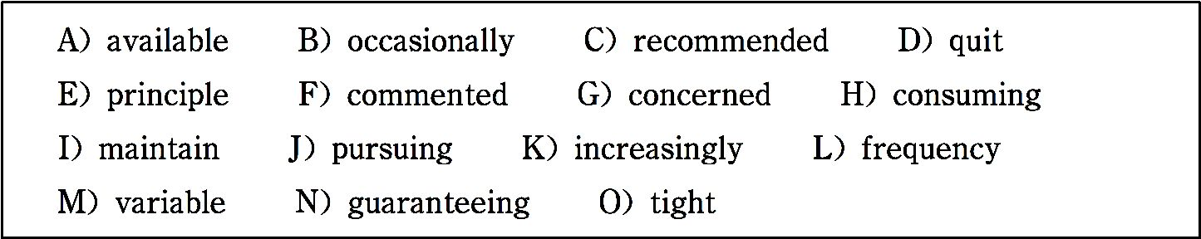
Over 60% of Chinese People Eat Takeouts
at Least Twice a Week
According to a survey of 2,005 interviewees by China

Slide 722
Youth Daily, 64.9% of them eat takeout food at least twice a week, while 52.4 percent consider the food to be harmful.
A total of 55.6% admit it􀆳s hard to stop 1 takeout food, and 63.8% hope the quality could be improved, especially 2 hygiene for the cooking oil and ingredients used. Wang Wei, a graduate of Renmin University of China, eats takeout food ev- ery noon as well as weekend evenings. “It􀆳s convenient to or- der takeout food. There are many types of foods 3 and the

Slide 723
price is not high,” he said.
When interviewees were asked about the 4 of eating take- out food, 4.7% said two or three times a day, 14.4% said once a day, 45.8% said two or three times a week, and 13.9% said once a week. Only 18.6% of the interviewees eat takeout food 5 , and 2.6% seldom eat it at all.
The survey shows that people have different reasons for choos-

Slide 724
ing takeout food. A total of 55.9% of them have 6 sched- ules, 36.7% consider takeout food cheaper than food in a restau- rant, and 30.9% think the restaurants outside are too far away.
Meanwhile, 28.9% don􀆳t know how to cook, 22.2% like eating and watching TV shows together, and 9% choose takeout food because it was 7 by friends.
However, many interviewees said they have 8 about the

Slide 725
quality of takeout food.
In the survey, 55.6% of interviewees admitted that it􀆳s difficult to 9 eating takeout food, so people 10 expect more from the quality of what they order.
——http://www.myzaker.com/article/5abcac5077ac645fca429be 2

Slide 726
(278 words)
Time required: 8 minutes
Time used: minutes
Section C
In this section there is a passage followed by some questions or unfinished statements. For each of them choose the best answer from the four choices

Slide 727
marked A, B, C and D.
Hong Kong􀆳s High-speed Rail Takes off
Around 75,000 passengers travelled through the controversial joint checkpoint, with over 42,000 mainland visitors travelling to Hong Kong, while around 33,000 Hong Kongers journeyed over the border.
The 141-kilometre-long railway, including 26 kilometers in

Slide 728
Hong Kong is a key part of the national high-speed railway network. The train from the West Kowloon Station over the border to China on the Guangzhou-Shenzhen-Hong Kong Ex- press Rail Link took off successfully on Sunday, September 23 rd, 2018.
The rail project cost 10.8 billion USA dollars. It connects Hong Kong with China􀆳s 25,000-kilometre-long national high-speed rail network for the first time. The Hong Kong Express Rail

Slide 729
Link will travel through 44 stations across China􀆳s high-speed rail network including Guangzhou, Shanghai and Beijing. Pas- sengers say that they have experienced some nagging issues at ticket counters in the West Kowloon Station, as well as confu- sion over baggage size limits and inadequately signed compart- ments. Despite these small hiccups, most passengers reported a smooth journey. Authorities were also quick to react to prob- lems. For example, when passengers faced lengthy queues, two

Slide 730
more counters were subsequently added on Monday to alleviate crowding issues.
To give passengers even more reasons to smile, Hong Kong Disneyland Resort also opened the “Magic Gateway” Guest Service Center at the West Kowloon Station on the same day to offer guests a series of services unique to Disney, such as in- town check-ins, baggage transfers and hotel reservations.

Slide 731
Overall, the journey was heralded a success by all the lawmak- ers on board, including Carrie Lam, chief executive of Hong Kong, who said,“I note there were still some teething prob- lems. But for such a large infrastructure project, especially a cross-border one, not all problems can be dealt with by us alone. MTR staff will review and see what improvements can be made in future.”
Trains will run at maximum speed of 200 kilometers per hour

Slide 732
and connects Hong Kong with Guangzhou South in just 48 minutes. It is expected that more passengers will travel south from the mainland to Hong Kong.
In terms of pricing, a second class ticket to Shenzhen is HK $8 6, Guangzhou at HK $247, and Beijing at HK $1,237.
Linking Hong Kong with the greater bay area, where 68 million people live, creates a potential GDP of 1.5 trillion USA dollars.

Slide 733
The link will also bring 270 million people to Hong Kong, help- ing the city achieve its goal of 60 million arrivals.
——http://page.renren.com/601318315/note/842358082
(393 words)
1. Which of the following was the problem encountered by the Guangzhou-Shenzhen-Hong Kong Express Rail Link?

Slide 734
A. It was too crowded at the ticket counters because of the lengthy queues.
B. Passengers complained that the tickets were too expensive.
C. Passengers were not sure whether their baggage was too large to be taken.
D. There were not enough seats on the train.

Slide 735
2. What did Hong Kong Disneyland Resort do to satisfy passen- gers?
A. Passengers could have their baggage sent anywhere.
B. It helped passengers book hotels.
C. Passengers were treated with smiles.
D. It took passengers less time to check in hotels.

Slide 736
3. The underlined word “teething” in paragraph 5 most prob- ably means .
A. disgusting B. messy C. complicated D. initial
4. Which of the following statements is true according to the passage?
A. The trip from Hong Kong to Guangzhou South took only 48

Slide 737
minutes.
B. Compared with the number of people traveling from the mainland to Hong Kong, more will travel in the opposite direc- tion.
C. Trains leave and arrive at Kowloon Station.
D. The ticket price from ticket to Beijing is HK $247.

Slide 738
5. What can be the benefit of Hong Kong􀆳s high-speed rail?
A. It can create a potential GDP of 1.5 trillion USA dollars for China.
B. There will be 68 million people traveling to the mainland.
C. There will be 270 million people traveling to Hong Kong.
D. Hong Kong􀆳s target of having 60 million travelers can be re-

Slide 739
alized.
Time required: 8 minutes
Time used: minutes

Slide 740
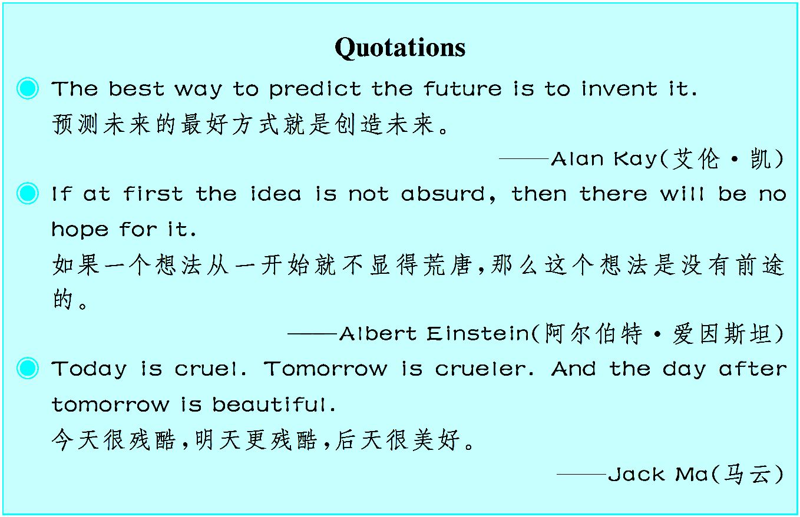

Slide 741
Unit 15
Sports
How Exercise Can Strengthen the Brain

Slide 742

随着生活水平的提高,体育锻炼已成为人们生活的重要部分。可是您知道锻炼除了能增强 体质外,还能强健大脑吗?

Slide 743
Can exercise make the brain more fit? That absorbing¹ question inspired a new study at the University of South Caroli- na during which scientists collected mice and let half to run for an hour a day on little treadmills², while the rest stayed in their cages without exercising.
Past experiments have shown persuasively³ that exercise stimu- lates the birth of new mitochondria⁴ in muscle cells and im- proves the vitality⁵ of the existing organelle⁶. This upsurge⁷ in

Slide 744
mitochondria, in turn, has been linked not only to improvements in exercise endurance⁸ but to increased longevity in animals and reduced risk for obesity, diabetes⁹ and heart disease in people. It is a very effective cellular¹0 reaction.
Brain cells are also fueled by mitochondria. But until now, no one has known if a similar response to exercise occurs in the brain.

Slide 745
Like muscles, many parts of the brain get a robust¹1 physiologi- cal workout¹2 during exercise. “The brain has to work hard to keep the muscles moving”, says J. Mark Davis, a professor of exercise science and senior author of the new mouse study. Scans have shown that metabolic¹3 activity in many parts of the brain rises sharply during workouts, but it was unknown whether those active brain cells were actually adapting and changing.

Slide 746
The South Carolina scientists exercised their mice for eight weeks.
At the end of the two months, the researchers had both groups complete a run to exhaustion¹4 on the treadmill. Not surprising- ly, the running mice displayed much greater endurance than the unexercised. They lasted on the treadmills for an average of 126 minutes, versus 74 minutes for the unexercised animals.

Slide 747
More interesting, though, was what was happening inside their brain cells. When the scientists examined tissue¹5 samples from different parts of the exercised animals􀆳 brains, they found markers of upsurging mitochondrial development in all of the tissues.^{①} Some parts of their brains showed more activity than others, but in each of the samples, the brain cells held newborn mitochondria.
There was no comparable activity in brain cells from the unex-

Slide 748
ercised mice. This is the first report to show that, in mice at least, two months of exercise training “is sufficient stimulus to increase mitochondrial biogenesis¹6”, Dr. Davis and his co-au- thors write in the study.
The finding is an important “piece in the puzzle implying that exercise can lead to mitochondrial biogenesis in tissues other than muscles”,^{②} says Dr. Mark Tarnopolsky, a professor of medicine at McMaster Children􀆳s Hospital.

Slide 749
The mitochondrial increase in the animals􀆳 brains has implica- tions that are wide-ranging and encouraging “There is evi- dence” from other studies “that mitochondrial shortage in the brain may play a role in the development of neurodegenerative¹7 diseases,” Dr. Davis says. “Having a larger storage of mito- chondria in your brain cells could provide some buffer¹8 against those conditions,” he says.
More immediately, Dr. Davis speculates¹9, reenergized brain

Slide 750
cells could become more resistant to fatigue and, since bodily fatigue is partly mediated²0 by signals from the brain, allowing you to withstand more exercise.^{③} In effect, exercising the body may train the brain to allow you to exercise more, amplifying the benefits.
Revitalized brain cells also, at least potentially, could reduce mental fatigue and sharpen your thinking “even when you􀆳re not exercising,” Dr. Davis says.

Slide 751
Of course, “mouse brains are not human brains,” Dr. Davis says. “But,” he continues, “since mitochondrial biogenesis has been shown to occur in human muscles, just as it does in an- imal muscles, it is a reasonable speculation that it occurs in hu- man brains.”
——http://dipmat.math.unipa.it/~grim/EBalderas.PDF
(582 words)

Slide 752
Notes
① When the scientists examined tissue samples from dif- ferent parts of the exercised animals brains, they found markers of upsurging mitochondrial development in all of the tissues.
在检测经常运动的动物大脑不同部位的组织样本时,科学家 们发现有迹象表明所有组织中的线粒体成长迅速。

Slide 753
② The finding is an important “piece in the puzzle imply- ing that exercise can lead to mitochondrial biogenesis in tissues other than muscle”…
这一发现是解开谜团的重要线索,“表明锻炼不仅有利于线 粒体在肌肉内生成,也能使其在组织中形成”……
③ More immediately, Dr. Davis speculates, reenergized brain cells could become more resistant to fatigue and, since

Slide 754
bodily fatigue is partly mediated by signals from the brain, al- lowing you to withstand more exercise.
紧接着,戴维斯博士推测由于人体疲劳感部分由大脑信号来 调节,因此脑细胞一旦重获能量,便能抵抗更多疲劳感,从而能 承受更大的运动量。
Exercises
Ⅰ. There are five questions or unfinished statements based on the passage.

Slide 755
For each of them choose the best answer from the four choices marked A, B, C and D.
1. What is the passage mainly about?
A. Scientists conducted an experiment on mice and proved that exercises can not only improve human exercise endurance but also reduce mental fatigue.
B. The difference between past experiments on mice and the recent study conducted by scientists in University of South Carolina.

Slide 756
C. Scientists conducted an experiment on mice and speculated that exercises can not only improve human exercise endurance but also reduce mental fa- tigue.
D. Scientists conducted an experiment on mice and speculated that exercises can not only improve animal exercise endurance but also reduce mental fa- tigue.
2. By saying “Brain cells are also fueled by mitochondria” in paragraph 3, the author probably means .

Slide 757
A. brain cells and muscle cells have the same function
B. scientists are sure that exercise will strengthen human􀆳s brain as it can strengthen human􀆳s body
C. exercises in brain cells can also reduce risk for obesity and diabetes
D. exercise may have similar benefits in the brain
3. What􀆳s the main purpose of the study conducted by scientists in the Uni- versity of South Carolina?

Slide 758
A. To find out whether it is possible that exercise can also reduce mental fa- tigue and sharpen people􀆳s thinking.
B. To find out whether it is possible that exercise can reduce physical fatigue and mental fatigue in human beings.
C. To find out that exercise training can stimulate the increase of mitochon- dria biogenesis in mice.
D. To find out whether exercised mice will display longer endurance than the unexercised.

Slide 759
4. The underlined word “amplifying” in paragraph 11 means .
A. proving B. multiplying C. exaggerating D. improving
5. What􀆳s the major evidence that can prove exercise can increase animal mitochondria biogenesis?
A. Scientists found exercised mice lasted on the treadmills for an average of 126 minutes, while 74 minutes for the unexercised mice.
B. There is evidence that mitochondrial shortage in the brain may cause neu-

Slide 760
rodegenerative diseases.
C. Since bodily fatigue is partly mediated by signals from the brain, reener- gized brain cells could become more resistant to fatigue.
D. Scientists found markers of upsurging mitochondrial development in all of the examined tissue samples from different parts of the exercised animals􀆳 brains.
Ⅱ. Fill in the blanks in the following sentences, using the words or phrases given below. Change the form where necessary.

Slide 761
puzzle imply inspire absorb sufficient
effective endure stimulate display resistant
1. It􀆳s the first time the painting has been to the public.
2. The money is not to cover everything that needs doing.
3. He showed remarkable throughout his illness.
4. Praise always him to make greater efforts.

Slide 762
5. Their reason for doing it is still a to me.
6. Nowadays,insects are becoming more and more to DDT.
7. Training is often much less than expected.
8. Exports in June rose by 1.5%, that the economy was stronger than many investors had realized.
9. His work suffered because of his total in computer games.

Slide 763
10. He many young people to take up the sport.
Ⅲ. Translate the following Chinese sentences into English.
1. 锻炼刺激肌肉细胞产生新的线粒体,改善已有细胞器官的活力。这已 得到证实并具有说服力。
2. 这些活跃的脑细胞是否真的在适应和变化尚不可知。
3. 事实上,可以通过锻炼身体来训练大脑,以使你能进行更多的锻炼。

Slide 764
4. 锻炼之后,人的精神疲劳减少,思维敏锐,甚至人不在锻炼的时候也是这 样。
Section A
In this section, you are going to read a passage with ten statements attached to it. Each statement contains information given in one of the paragraphs. I- dentify the paragraph from which the information is derived. You may choose a paragraph more than once. Each paragraph is marked with a letter.

Slide 765
Sports in Britain and the USA
Football in Britain and America
A) Football is a very popular sport in Britain, played between August and May. Professional football is controlled by two organizations, the Football League and the Football Association. In England and Wales, there are 93 teams in the League, organized into four divisions (区). In Scotland, there are 38 teams in the League, organized into three divisions. Teams play regu- larly against the other teams in their league or division according to a fixed

Slide 766
program. At the end of the season the team in the Premier League (英格兰足 球超级联赛) (or the Premier Division in Scotland) with the most points is the League Champion. This competition is called the League Championship.
B) The other important competition is the FA Cup, opening to all armature football teams that belong to the FA as well as the 93 professional teams. The teams play against each other in a knockout competition (淘汰赛) which starts in August and ends in May. The two teams left in the competition play in the FA Cup Final at Wembley Stadium in London. This is a very impor- tant national sporting occasion, watched by millions of people on television.

Slide 767
C) Team names usually include the name of the town or city where the team is based, e.g. Leeds United, Sheffield Wednesday, etc..
D) Football is a hot sport in the USA. Each team has a name, which usually includes the name of the town or city that the team is associated with. Some examples of names are: New York Jets, Washington Redskins, New England Patriots.
E) The season starts in early autumn and ends at the end of January with the Super Bowl (超级碗,即美国国家美式足球联盟,也称为国家橄榄球联盟), which is the NFL championship game. The two teams that play in the Super

Slide 768
Bowl are determined by games within the divisions and conferences. The Super Bowl is only one game and at the end of the game, they have a sudden -death play-off, in which the first team to gain points wins the game. Profes- sional football games are organized in the USA in the following way: Na- tional Football League is divided into two conferences: one is National Foot- ball Conference and the other is American Football Conference. Both of them have 14 teams and three divisions.
Basketball and Baseball in the USA
F) Basketball is a very popular sport in the USA. Each team has a name,

Slide 769
which usually includes the name of the town or city that the team is associat- ed with. Some examples of names are: Boston Celtics, Chicago Bulls, Den- ver Nuggets and Los Angeles Lakers.
G) The playing season runs from autumn to late spring. Teams with each di- vision play against each other and against teams from the other divisions within the conferences. The first team to win four of these games is the NBA champion. Professional basketball games are organized in the USA in the following way: National Basketball Association has two conferences: East- ern conference and Western conference. The Eastern conference has two di-

Slide 770
visions, Atlantic division with 6 teams and Central division with 7 teams and Western conference has two divisions, Midwest division with 7 teams and Pacific division with 7 teams.
H) Baseball is a very popular sport in the USA where it is often called the National pastime(消遣). Each team has a name, which usually includes the name of the town or city that the team is associated with. Some examples of names are: Boston Red Sox, Minnesota Twins, Chicago Cubs.
I) The two leagues together are known as the major leagues. The playing season runs from late spring to October. The winning team in each league is

Slide 771
called the pennant (锦旗) champion. In October, the two pennant champions play against each other in seven games called the world series. The team that wins four games is the champion. Professional baseball games are organized in the following way. There are two leagues, National League with 12 teams and American League with 14 teams. National League has Eastern division and Western division and American League also has Eastern division and Western division.
Cricket (板球) and Rugby (橄榄球) in Britain
J) Cricket is a very popular sport in Britain, played mainly in summer. Pro-

Slide 772
fessional cricket is controlled by the MCC (the Marylebone Cricket Club). The main competition is the county championship, in which the 18 county cricket clubs play against one another during the season. Each match takes 3 ~4 days to complete.
Many people consider cricket to be England􀆳s national game and to be typi- cal of a style of behavior thought to be very English which includes above all a sense of honor and fairness. It is traditionally played by men and boys and although there are some women􀆳s teams, including a national one, the most important cricket club in England (the MCC) voted in 1991 not to accept

Slide 773
women members.
K) There are two forms of rugby football played in Britain, rugby union and rugby league. Rugby union is played by amateurs. There are 15 players on each team. Rugby union is played internationally between many countries including Australia, Fiji, France, South Africa, Argentina, England, Ireland, Wales, Scotland, and New Zealand.
L) Rugby league is a professional game, played mainly in England and Aus- tralia. There are 13 players in each team, and the rules are slightly different from rugby union. It is thought to be a rough, hard game.

Slide 774
——http://www.crazyenglish.org/qingsongyingyu/quweiyingyu/2009/0311/47 548.html
(920 words)
1. In the FA Cup, the teams play against each other in a knockout competition which starts in August and ends in May.
2. Super Bowl from early autumn to the end of January is the NFL championship game.

Slide 775
3. There are 131 teams in Britain􀆳s Football League organized into seven divisions.
4. National Football League is composed of 28 teams in six divisions in two conferences.
5. Baseball which is called the National pastime is a well-received sport in the USA.
6. In National Basketball Association, there are 27 teams in four divi- sions.

Slide 776
7. Cricket is considered to be England􀆳s national game and to be typ- ical of very English style of behavior.
8. The seven games called the world series are played between the two pennant champions in October.
9. In 1991 in England, it was voted not to accept women members by the MCC, the most important cricket club in England.
10. Rugby union and rugby league are two forms of rugby football played in Britain.

Slide 777
Time required: 15 minutes
Time used: minutes
Section B
In this section, there is a passage with ten blanks. You are required to select one word for each blank from a list of choices given in the word bank. Read the passage through carefully before making your choices. You may not use any of the words in the bank more than once.

Slide 778
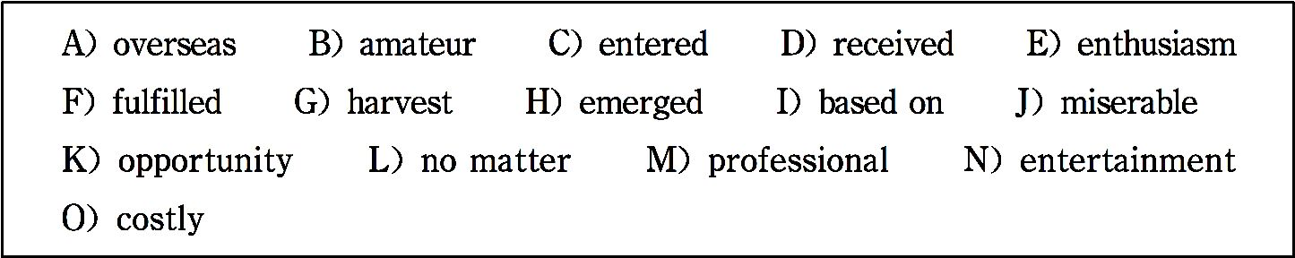
Children􀆳s Love for Football in Senegal
In Senegal, located on the western tip of the African continent, there must be soccer enthusiasts if there is an open area, dawn or dusk, sunny or rainy. Senegalese boys begin to play soccer

Slide 779
since five or six years old. Although most of them have no 1 to wear a pair of 2 plimsoll (橡胶底帆布鞋) or to play soccer on a professional field, their love for soccer cannot be stopped by anything.
Senegal started amateur soccer league matches from 1960, and there has been no professional league match until 2009. Howev- er, 3 the people􀆳s 4 for soccer, Senegal􀆳s national soccer team has entered the final eight of the World Cup 2002

Slide 780
and has won the champion of Africa Cup of Nations. A great number of Senegalese soccer talents have 5 in Senegalese history, among whom there are also some big stars who play in professional leagues 6 . Senegalese soccer stars 7 their achievements and have become the heroes in local children􀆳s eyes. Palmer, once a soccer player in professional leagues of Saudi Arabia and now a coach, said that becoming professional soccer player to change their own impoverished (穷困的) des-

Slide 781
tiny is some boys􀆳 dream, but the fact that soccer􀆳s popularity in Senegal is at first from the love for soccer at the bottom of people􀆳s heart. Playing soccer does not need 8 outfit and 9 whether you are rich or poor, all the players are equal and could 10 endless happiness from soccer.
——http://english.peopledaily.com.cn/90783/7770422.html
(250 words)

Slide 782
Time required: 8 minutes
Time used: minutes
Section C
In this section there is a passage followed by some questions or unfinished statements. For each of them choose the best answer from the four choices marked A, B, C and D.

Slide 783
Olympic Games
Every four years, the best athletes from countries around the world come together in the spirit of peace and friendship to compete in the Olympic Games. With the lighting of the Olympic flame the games begin — the Olympic spirit is kept alive. That flame has been brought all the way from Olympia in Western Greece, where the ceremony began 2700 years ago. This simple ceremony, and the lighting of the torch, is the spark

Slide 784
that renews the Olympic flame wherever the games are played. The games symbolized the early Greeks􀆳 ideal of man􀆳s unity, their vision of peace, and of human perfection.
The Olympic began as a religious ceremony. The First Games in recorded history took place in the year 776 B.C.. This was the time of the Western Zhou period in China. All the Greek city- states participated. States at war with each other would end hos- tilities for the duration (持续) of the Games.

Slide 785
The Olympic motto is universally accepted as “Swifter, High- er, Stronger”. One athlete from the host country takes an oath at the Opening Ceremony on behalf of all the competing ath- letes: “In the name of all competitors, I promise that we shall take part in these Olympic games, respecting and abiding by the rules which govern them, in the true spirit of sportsmanship, for the glory of sport and the honor of our teams.”
In ancient times, winners were crowned with wreaths (花环) of

Slide 786
the sacred olive (橄榄). Their names were proclaimed through- out the Greek city-states. Things have not changed much in this regard. Today, the first place winners are awarded gold medals, second place winners, silver medals, and third place gets the bronze medals. And, as in ancient times, Olympic stars become internationally famous.
Let us hope that this living experience of peace and friendship between all the peoples of the world that began in Olympia, in

Slide 787
ancient Greece, will continue for many centuries to come.
——Morning Reading the Thoughts to Keep in Mind 100 Arti- cles
(333 words)
1. The underlined word “hostilities” in paragraph 2 means .

Slide 788
A. hospitality B. cooperation C. wars and enmity D. peace
2. According to the passage, what was the aim of the first Greek Olympic Games?
A. It aimed for human􀆳s physical health.
B. It aimed for friendship and peace.

Slide 789
C. It aimed for cooperation between different countries.
D. It aimed for developing the economy of the host country.
3. What can we learn from the oath taken by the representative of athletes?
A. If the competing athletes think the rules of the Olympic Games are not scientific, they needn􀆳t obey them.

Slide 790
B. If an athlete breaks the world record and wins the gold medal, the others who lose the game should envy him and feel sorry for themselves.
C. If the competing athletes think the rules of the Olympic Games are not scientific, they still should obey them.
D. All the competing athletes can compete for the first prizes of Olympic Games by ruthless means.

Slide 791
4. According to the passage, which of the following statement is true?
A. All the Olympic stars become internationally famous.
B. All the competing athletes will take an oath at the Opening Ceremony of the Olympic Games.
C. All the western countries took part in the first Olympic

Slide 792
Games hosted by Greek.
D. The universally accepted Olympic spirit is “Swifter, Higher and Stronger”.
5. Why is it a tradition that the Olympic flame is kept burning during the games?
A. Because it stands for the hope of all competing athletes win-

Slide 793
ning the games.
B. Because it can keep the evils away during the Olympic Games.
C. Because it is a necessity for a religious ceremony.
D. Because it marks the beginning of the games and the Olympic spirit is kept alive.

Slide 794
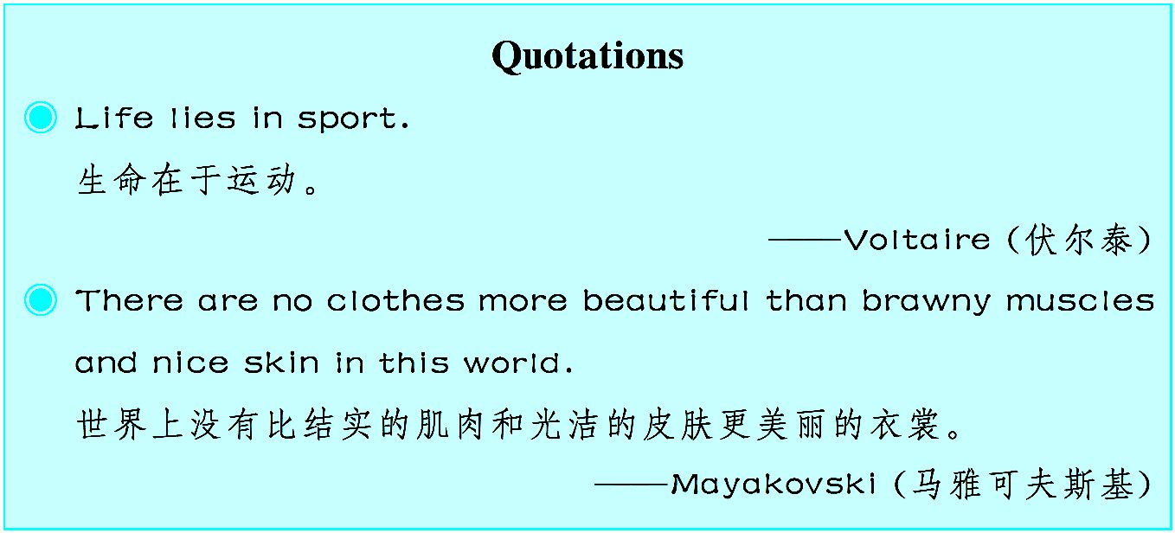
Time required: 8 minutes
Time used: minutes

Slide 795
Key
Unit 1
Part Ⅰ Text
Exercises
Ⅰ. 1. C 2. A 3. D 4. B 5. C
Ⅱ. 1. necessity 2. financial 3. In a way 4. go through

Slide 796
5. strengthened 6. dimension 7. have linked … with
8. impacted 9. tendency 10. is reduced
Ⅲ. 1. In the last decade, we have been witnesses of a gradual and complex process of integration of information technology in the different sectors of our societies.
2. Information technology cannot be reduced just to the concept of machines because it includes various dimensions.

Slide 797
3. These two transformations contribute in a final way to the spread of mod- ern information technology.
4. This is a global necessity of contemporary societies that interests all sec- tors, from the scientific to the industrial, from the commercial to the educa- tive, and so on.
Part Ⅱ Reading Comprehension
Section A

Slide 798
1. G 2. C 3. K 4. J 5. F 6. K 7. L 8. N 9. O 10. M
Section B
1. J 2. D 3. I 4. G 5. O 6. M 7. B 8. K 9. F 10. A
Section C
1. B 2. B 3. C 4. D 5. A
Unit 2

Slide 799
Part Ⅰ Text
Exercises
Ⅰ. 1. D 2. A 3. C 4. C 5. B
Ⅱ.1. concerning 2. referred to as 3. have been questing
4. universal 5. contemplated 6. dilemma 7. more than
8. occupy 9. obtain 10. debating

Slide 800
Ⅲ. 1. When people hear the term philosopher, they often imagine the philosophers of ancient Greece with long white beards dressed in flowing robes, all sitting around contemplating the meaning of life.
2. In order to understand what a philosopher is, it􀆳s important to understand a bit about philosophy.
3. He was put to death chiefly because the authorities were uncomfortable with the fact that Socrates caused others to question their own beliefs.
4. Although ancient Greece might be most well known for great philoso-

Slide 801
phers, other cultures developed their own philosophies as well, and there was no shortage of great thinkers around the globe.
Part Ⅱ Reading Comprehension
Section A
1. C 2. B 3. A 4. D 5. E 6. G 7. E 8. F 9. H 10. J
Section B

Slide 802
1. L 2. A 3. M 4. D 5. B 6. F 7. C 8. I 9. K 10. G
Section C
1. D 2. D 3. C 4. A 5. B
Unit 3
Part Ⅰ Text
Exercises

Slide 803
Ⅰ. 1. B 2. A 3. C 4. D 5. C
Ⅱ. 1. is dotted with 2. gazed 3. gave birth to 4. generations
5. depicts 6. prayed, for 7. loyalty
8. festival 9. in particular 10. observe
Ⅲ. 1. When he was going to catch up with his wife, the Queen Mother took off one of her gold hairpins and made a stroke and a big river appeared in front of the Cowherd.

Slide 804
2. In ancient times, Chinese women, especially unmarried ones, often took this festival quite seriously.
3. And there is a beautiful love story about them passed down from genera- tion to generation.
4. However, the legend of the Cowherd and the Weaving Maid has taken root in the hearts of the Chinese people.
Part Ⅱ Reading Comprehension

Slide 805
Section A
1. C 2. B 3. D 4. F 5. G 6. E 7. B 8. C 9. F 10. H
Section B
1. N 2. F 3. G 4. H 5. D 6. B 7. J 8. M 9. E 10. K
Section C
1. D 2. B 3. C 4. D 5. C

Slide 806
Unit 4
Part Ⅰ Text
Exercises
Ⅰ. 1. C 2. D 3. C 4. B 5. A
Ⅱ. 1. supplement 2. cultivate 3. solid 4. morality
5. in accordance with 6. immigrant 7. intensity

Slide 807
8. aspiration 9. molded 10. immerse
Ⅲ. 1. The Western education system has molded a lot of top talents in sci- ence and arts.
2. A public school education cannot meet the same standards as an elite edu- cation in terms of teaching equipment and faculty.
3. People do not approve of the spoon-feeding and rote learning education mode.

Slide 808
4. In foreign countries, the immigrants should immerse their children in the new culture so that they􀆳ll fit in with the modern society.
Part Ⅱ Reading Comprehension
Section A
1. H 2. B 3. D 4. J 5. E 6. G 7. A 8. I 9. C 10. F
Section B

Slide 809
1. G 2. A 3. N 4. D 5. I 6. K 7. J 8. M 9. C 10. F
Section C
1. D 2. A 3. D 4. B 5. C
Unit 5
Part Ⅰ Text
Exercises

Slide 810
Ⅰ. 1. D 2. B 3. C 4. A 5. B
Ⅱ. 1. competent 2. indispensable 3. strategy 4. connected with
5. promotion 6. resulted in 7. perceived
8. performance 9. enhances 10. be responsible for
Ⅲ. 1. Each member of a team is responsible not only for learning what is taught but also for helping the teammates learn, thus creating an atmosphere of achievement.

Slide 811
2. Positive interdependence is successfully structured when group members perceive that they are linked with each other in a way that one cannot suc- ceed unless everyone succeeds.
3. It is through promoting each other􀆳s learning that members become per- sonally committed to each other as well as to their mutual goals.
4. Groups need to describe what member actions are helpful or unhelpful and make decisions about what behaviors to continue or to change.
Part Ⅱ Reading Comprehension

Slide 812
Section A
1. B 2. C 3. D 4. A 5. C 6. L 7. D 8. M 9. L 10. I
Section B
1. K 2. M 3. B 4. H 5. N 6. D 7. A 8. I 9. E 10. O
Section C

Slide 813
1. C 2. B 3. B 4. D 5. A
Unit 6
Part Ⅰ Text
Exercises
Ⅰ. 1. D 2. B 3. C 4. B 5. A
Ⅱ. 1. back … up 2. is staying on 3. clarity 4. assimilate

Slide 814
5. is monitored 6. in collaboration with 7. argument
8. decide on 9. draft 10. take turns
Ⅲ. 1. In these groups, students read and respond to each other􀆳s drafts of a particular assignment and may, in the process, understand the assignment better.
2. The third step offers parameters for the workshop, establishing section rules that allow the group to use its time well and to get the most out of each other􀆳s comments.

Slide 815
3. Such questions allow the writer to guide the discussion of the response and force a more substantive response than “yes” or “no”.
4. Setting up Peer Response Groups can seem time-consuming and ensuring that such groups are productive, requires patience on the part of the teacher.
Part Ⅱ Reading Comprehension
Section A
1. F 2. A 3. I 4. J 5. K 6. L 7. Q 8. G 9. N 10. P

Slide 816
Section B
1. I 2. L 3. N 4. A 5. O 6. K 7. F 8. G 9. B 10. D
Section C
1. A 2. C 3. D 4. B 5. C
Unit 7

Slide 817
Part Ⅰ Text
Exercises
Ⅰ. 1. B 2. D 3. B 4. C 5. C
Ⅱ. 1. characteristic 2. clung to 3. witnessed 4. endowed
5. constant 6. revive 7. pursue
8. dedication 9. stance 10. expelled

Slide 818
Ⅲ. 1. She never wavered in her determination to succeed.
2. Rick􀆳s cooking was always good but this time he really excelled himself.
3. The report highlights the major problems facing society today.
4. He seemed undaunted by all the opposition to his idea.
Part Ⅱ Reading Comprehension
Section A

Slide 819
1. K 2. C 3. A 4. H 5. D 6. C 7. L 8. F 9. J 10. E
Section B
1. B 2. K 3. L 4. N 5. C 6. A 7. O 8. H 9. F 10. D
Section C
1. A 2. A 3. D 4. A 5. C
Unit 8

Slide 820
Part Ⅰ Text
Exercises
Ⅰ. 1. D 2. A 3. A 4. B 5. C
Ⅱ. 1. was criticized 2. influential 3. rely on 4. universal
5. wanders 6. achieve 7. account for
8. harmony 9. mutual 10. virtues

Slide 821
Ⅲ. 1. Severe laws and punishments were the only means of bringing them the order and security which they were eager for.
2. The political ideal of the Taoists was a small state from which the cocks and dogs of a nearby state could be heard, and where the people were so sat- isfied that none had ever bothered to visit the neighboring villages.
3. The “moderation” of Confucian ideas is characterized as the balancing of inner virtues and external polish.
4. The major reasons for the final triumph of Confucianism in traditional

Slide 822
Chinese history were moderation and balance.
Part Ⅱ Reading Comprehension
Section A
1. A 2. C 3. A 4. F 5. M 6. G 7. J 8. G 9. L 10. N
Section B
1. O 2. H 3. C 4. M 5. N 6. K

Slide 823
7. D 8. B 9. A 10. E
Section C
1. A 2. D 3. C 4. C 5. B
Unit 9
Part Ⅰ Text
Ⅰ. 1. B 2. D 3. C 4. C 5. A

Slide 824
Ⅱ. 1. in harmony with 2. compose 3. in reference to
4. implement 5. staff 6. manual 7. principle
8. ultimate 9. proposed 10. attribute
Ⅲ. 1. Chinese martial arts originated from combat wrestling and fighting in the ancient time.
2. The earliest references to the theory are found in his book Science and Na- ture published in 1920.

Slide 825
3. These reports, in contrast to those from the Internet, refer to his early hard practice and success.
4. Chinese martial arts is a performance art specific to China.
Part Ⅱ Reading Comprehension
Section A
1. B 2. A 3. B 4. D 5. C 6. E 7. G 8. D 9. E 10. F

Slide 826
Section B
1. H 2. N 3. F 4. D 5. K 6. G 7. B 8. J 9. L 10. M
Section C
1. B 2. C 3. B 4. A 5. D
Unit 10
Part Ⅰ Text

Slide 827
Exercises
Ⅰ. 1. D 2. B 3. D 4. A 5. C
Ⅱ. 1. thrust … into 2. frowned 3. feature 4. approval
5. referring to 6. embarrassed 7. involved
8. confessed 9. gives off 10. staff
Ⅲ. 1. Most of the time,we usually use body language without knowing it.

Slide 828
2. The speaker􀆳s shaking voice is telling us quite clearly that he is nervous.
3. A good public speaker knows how to hide his nervousness by giving off signals of confidence.
4. People􀆳s casual dress and speaking usually signal that they are relaxed.
Part Ⅱ Reading Comprehension
Section A

Slide 829
1. B 2. A 3. C 4. A 5. C 6. E 7. D 8. F 9. H 10. F
Section B
1. C 2. J 3. F 4. H 5. M 6. O 7. A 8. D 9. E 10. K
Section C
1. C 2. D 3. A 4. C 5. A
Unit 11

Slide 830
Part Ⅰ Text
Exercises
Ⅰ. 1. D 2. A 3. B 4. C 5. D
Ⅱ. 1. status 2. contrasted 3. is consistent with 4. issue
5. contemporary 6. identify 7. reflect on
8. distinguish 9. unconscious 10. enables

Slide 831
Ⅲ. 1. In critical reading, the differences between your contemporary values and attitudes and those represented in the text should be contextualized and recognized.
2. When reading critically, you should recognize every assertion as an argu- ment that must be carefully evaluated.
3. Basically, in order to make an argument acceptable, the support must be appropriate to the claim and the statements must be consistent with one an- other.

Slide 832
4. You will find that your attitudes, your unconsciously held beliefs, or your positions on current issues might be challenged in reading.
Part Ⅱ Reading Comprehension
Section A
1. C 2. D 3. E 4. I 5. J 6. H 7. N 8. R 9. U 10. W
Section B

Slide 833
1. K 2. C 3. N 4. B 5. H 6. M 7. A 8. D 9. O 10. F
Section C
1. C 2. D 3. B 4. A 5. C
Unit 12
Part Ⅰ Text

Slide 834
Exercises
Ⅰ. 1. B 2. C 3. D 4. A 5. C
Ⅱ. 1. invention 2. impression 3. techniques 4. arranged
5. efficient 6. spread to 7. ensure 8. devoted … to
9. leads to 10. complicated
Ⅲ. 1. The printing technique in ancient China includes both block printing

Slide 835
and movable type printing.
2. As block printing was so complicated and difficult, it would take several years to print a book.
3. He prepared different numbers of types for characters according to their frequency of use in the texts.
4. The technique of movable type printing was introduced to Japan and Ko- rea in the 14th century.

Slide 836
Part Ⅱ Reading in Depth
Section A
1. K 2. E 3. C 4. B 5. M 6. G 7. D 8. F 9. A 10. J
Section B
1. C 2. B 3. D 4. F 5. H 6. I 7. J 8. K 9. L 10. M

Slide 837
Section B
1. D 2. C 3. D 4. B 5. A
Unit 13
Part Ⅰ Text
Ⅰ. 1. A 2. B 3. D 4. A 5. C
Ⅱ. 1. property 2. consequence 3. financial 4. been set up

Slide 838
5. declare 6. merge with 7. evolve from
8. response 9. in the end 10. decline
Ⅲ. 1. The Lehman Brothers played a precious role in the financial and commercial industry of United States for more than 150 years.
2. Through public stock offerings and Lehman Brothers Holding Inc,Lehman Brothers became independent in 1994.
3. The Lehman Brothers might need to restructure its business portfolio be-

Slide 839
cause of the poor performance of residential mortgage origination and securi- tization business.
4. One of the major reasons for the bankruptcy of the Lehman Brothers is because it put a huge investment in the subprime markets with high operat- ing cost.
Part Ⅱ Reading Comprehension
Section A

Slide 840
1. B 2. C 3. E 4. C 5. D 6. L 7. H 8. J 9. K 10. M
Section B
1. E 2. H 3. N 4. K 5. A 6. D 7. O 8. B 9. M 10. F
Section C
1. B 2. A 3. D 4. B 5. C

Slide 841
Unit 14
Part Ⅰ Text
Exercises
Ⅰ. 1. D 2. C 3. B 4. A 5. A
Ⅱ. 1. severe 2. sustainable 3. multiple 4. potential
5. are vital to 6. appealing 7. implement

Slide 842
8. innovated 9. unlikely 10. emerged
Ⅲ. 1. All of us have to take action to protect our living environment.
2. The sustainable development refers to not only the sustainable develop- ment of economy, but also the development of society.
3. The company hopes to tap into the vast community with a lot of vehicles available, trying to turn all potential cars into shared vehicles.
4. The Institute can conduct research on some issues that are likely to pro-

Slide 843
mote the efficiency of the BNR Development.
Part Ⅱ Reading Comprehension
Section A
1. L 2. B 3. H 4. D 5. J 6. C 7. M 8. A 9. E 10. K
Section B

Slide 844
1. H 2. N 3. A 4. L 5. B 6. O 7. C 8. G 9. D 10. K
Section C
1. C 2. B 3. D 4. A 5. D
Unit 15
Part Ⅰ Text

Slide 845
Exercises
Ⅰ. 1. C 2. D 3. A 4. B 5. D
Ⅱ. 1. displayed 2. sufficient 3. endurance 4. stimulates
5. puzzle 6. resistant 7. effective
8. implying 9. absorption 10. inspired
Ⅲ. 1. It has been shown persuasively that exercise stimulates the birth of

Slide 846
new mitochondria in muscle cells and improves the vitality of the existing organelles.
2. It was unknown whether those active brain cells were actually adapting and changing.
3. In fact, human brains can be trained by exercising the body to allow you to exercise more.
4. After doing exercises, one􀆳s mental fatigue can be reduced and thinking can be sharpened even when one is not exercising.

Slide 847
Part Ⅱ Reading Comprehension
Section A
1. B 2. E 3. A 4. E 5. H 6. G 7. J 8. I 9. J 10. K
Section B
1. K 2. M 3. I 4. E 5. H 6. A 7. F 8. O 9. L 10. G

Slide 848
Section C
1. C 2. B 3. C 4. A 5. D

